Slide 1


Mechanical and fatigue properties of Pre-1972 Girth welds
Presenter: Tim Rudd (Valero)
Research authors: A. Cosham, K. McDermott, K. Jansen, J. Haswell, T. Rudd

Slide 2
Project Overview
Workmanship acceptance criteria and QA/QC requirements for pipeline girth welds (GW’s) have evolved over time.
  Prior to 1972 no requirement for 100% NDE on pipelines (before P2 standard)
  Earlier lines frequently build to API standard (1104 and successors)
UKOPA Weld Quality Project was initiated to demonstrate that although the overall quality of Vintage (Pre-1972) GW’s might not meet modern acceptance levels, they are not an inherent risk to pipeline integrity.
  P/18 standard assumed vintage welds were of poor quality unless known otherwise
GW’s from pipeline assets constructed prior to 1972 within the UK and Canada have been analysed
  These historical welds contained a wide variety of welding defects that would not be acceptable according to modern pipeline welding standards
  Analysis of the results indicated that the GW’s were fit-for-service.
Fatigue tests on samples showed that their fatigue performance can be predicted by the class F2 curve in BS 7608.
The conclusion drawn is that vintage GW’s are not an inherent integrity risk, and are not of inherently poor quality

Slide 3
Project Stages
Initial 29 Girth Weld samples received from UKOPA Members. Initial assessment and classification against P2/P13/P18 followed by RT and UT
17 Samples selected for Inspection and Testing
Visual Inspection, Ultrasonics and Radiography used to classify defects
Metallurgical samples taken at defect-containing locations
Preliminary UKOPA results collated and discussed in IPC 2016
ATCO contact UKOPA and request participation in project
Further 9 ATCO samples follow process above
Samples of remaining pipe sections sent to universities
Initial Fatigue testing at University of Strathclyde
Further Fatigue testing and defect analysis at Swansea University (MSc Project)
Final results presented here incorporate static testing results from UKOPA and ATCO and Fatigue Test results from Swansea University and University of Strathclyde
Planned future work streams
Replicate testing on pre-stressed samples to model dent behaviour, compare how failure limits and cyclic life may differ on dents interacting with welds
Other related presentations:
PPIM 2019 – Analysis of the Properties of Vintage Girth Welds
PRCI 2020 Research Exchange – Vintage Girth Weld Management: A Pragmatic Application of PRCI and UKOPA Research
TFAP 2022 – Working on Pipelines containing Defective Girth Welds or Girth Welds of Unknown Quality
Conduct similar project on vintage Seam Welds, compare fatigue performance to ‘E’ curve rather than ‘F2’ curve and check applicability

Slide 4
UKOPA Fault Database 1962-2019
The two product loss incidents, both in 2013, were described as a “leak on pipeline branch vent point coming above-ground” and “on butt weld adjacent to previous leak” so are not true GW failures

Slide 5
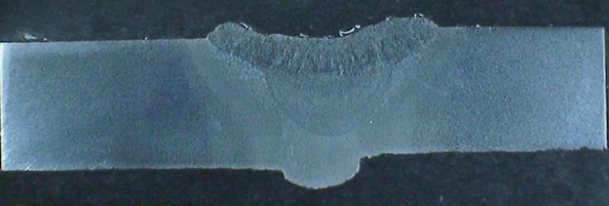
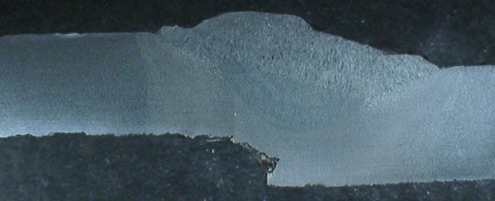
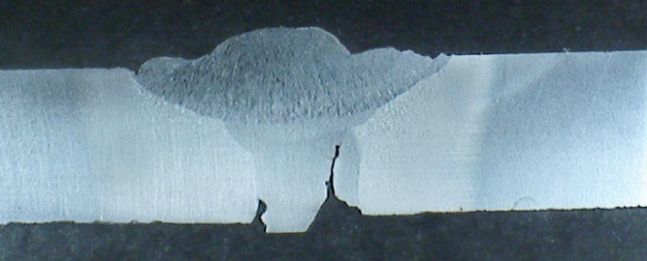
Visual inspection and NDE
36 Weld samples examined in this project – 26 contained defects of varying severity
  Majority minor/non-injurious
All welds had survived hydrotest
None of these welds had failed in-service
Excess Penetration, Concavity, minor misalignment
Type of Defect | Number of Occurrences
Crack | 1 (3%)
IP/LF | 7 (18%)
Slag | 4 (11%)
Por. | 6 (16%)
Burn through | 2 (5%)
Undercut | 10 (26%)
Concavity | 4 (11%)
Hi/Lo | Very common
Defect Free | 4 (11%)
Misalignment
Lack of Fusion, incomplete Penetration

Slide 6
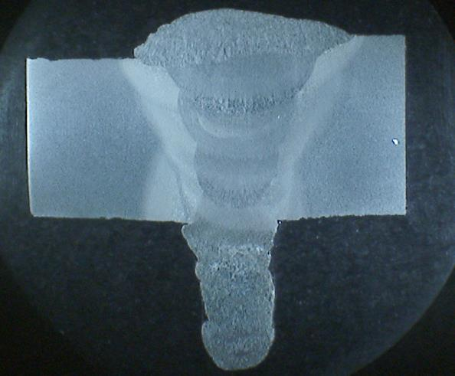
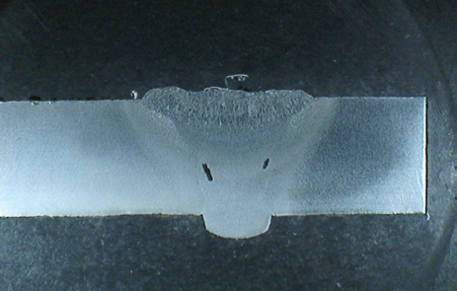
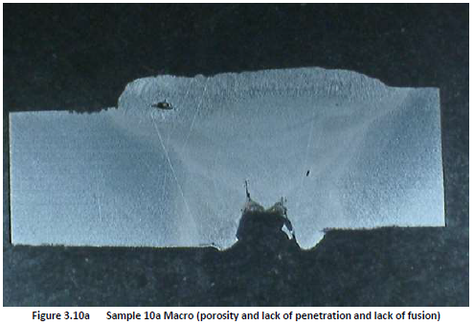
Weld Inspection
Excess Penetration, Oxide Inclusions/Porosity
Excess Penetration
Despite sharp stress-raisers no signs of fatigue cracking observed on static samples
  UKOPA samples taken primarily from liquid lines, so subject to higher cyclic loading
Microscopy found no significant differences between microstructures of vintage Girth Welds and modern equivalent
Porosity, Lack of Penetration, Lack of Fusion

Slide 7
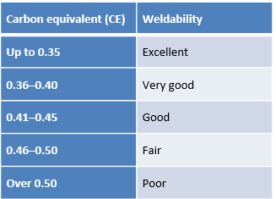
Mechanical Testing
Weld Property | Compared to | Why it matters
Chemistry | Established CE Ranges | Weldability
Tensile Strength | Weld overmatch, materials spec | Tensile strain capacity
Hardness (HV) | Limitations in modern codes of construction | Propensity for cracking, brittle failure
Impact Toughness | Pipe body, materials spec | Ductile behavior, weld spec
$${{CE}_{IIW}}_{ }=C+\frac{Mn+Si}{6}+\frac{Cr+Mo+V}{5}+\frac{Ni+Cu}{15}$$

Slide 8
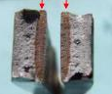
UTS and Hardness

Slide 9
Charpy Impact (V-Notch)
-10⁰C
+10⁰C

Slide 10
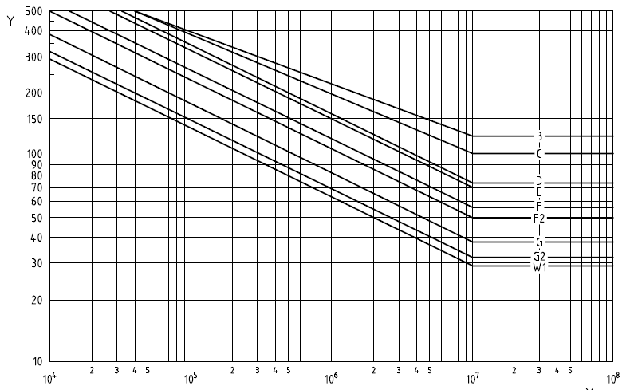
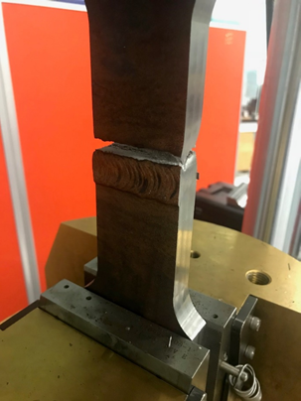
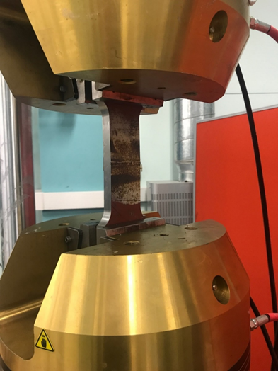
Fatigue Testing
Assessed against BS 7608 Fatigue Curves
  ‘E’ curve for welds of known good quality (Strathclyde)
  F2 curve for welds of un-known quality (Swansea)

Slide 11
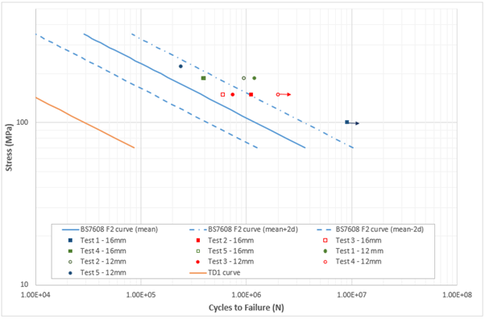
Welds without defects – Strathclyde (F2)
Notes:
The University of Strathclyde investigated the fatigue performance of two historical GW samples, selected to be representative of good quality vintage girth welds.
As such, the samples were not selected to include any defects.
Ten fatigue test samples were obtained from these two girth weld sections.
When plotted, the results of the fatigue tests lie above the mean-2SD ‘design curve’ of both the BS 7608 E curve and F2 curve
The results correlated particularly well with the E curve, with all results falling between the ±2SD lines.
These results suggest that the fatigue performance of good quality pre-1972 pipeline girth welds meets the requirements of the E curve.
When plotting against the F2 curve all of the results lie above the mean F2 curve line, suggesting that the use of the F2 design curve would be overly conservative.

Slide 12
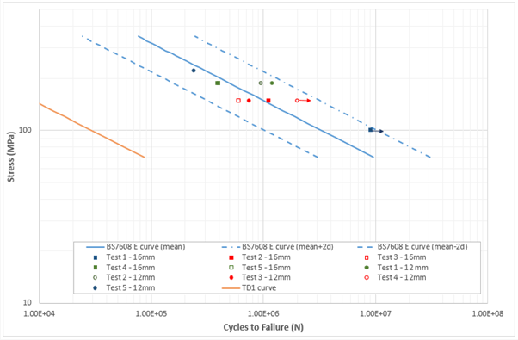
Welds without defects – Strathclyde (E)

Slide 13
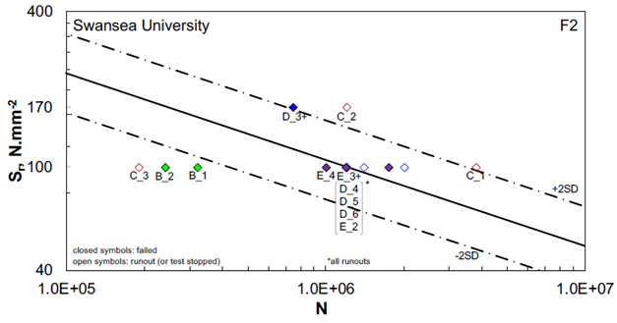
Welds containing defects – Swansea (F2)
Fractured (had longitudinal cracks, IP, mis-alignment and undermatch in specimen)
Test stopped due to rig issues
Notes:
Four weld sections were sourced from gas transportation pipelines
Sections were radiographed to identify defects, and small scale specimens were then machined to include identified defects within the specimen.
Defects included in the pipe weld samples were identified through inspection as being representative of the workmanship quality required by welding standards at the time of construction; with a bias towards surface-breaking defects such as lack of penetration and misalignment.
When plotted against the BS 7608 F2 curve all but two of the Swansea University samples lie above the design curve.
The two specimens which fractured below the design curve both included misalignment and lack of penetration defects. The relatively early failure of these samples was caused by the stress concentration due to misalignment and the large lack of penetration defects

Slide 14
Conclusions
All of the samples tested had acceptable mechanical properties, which indicated that the welds were relatively strong, tough and adequately ductile.
  No evidence of in-service material degradation was seen, and no signs of fatigue or crack initiation were observed, despite the presence of weld defects which could act as stress concentrators.
  Any poor results could be attributed to the presence of large defects in the small test pieces, so are not representative of the joint as a whole.
  Microstructures seen were similar to those expected in a weld manufactured to current standards
The results of the fatigue tests showed that the fatigue performance of specimens taken from pre-1972 pipe-weld samples would meet current fatigue S-N design criteria.
  Test results obtained from these studies are conservative, as the specimens tested were taken from pipe-weld samples from pipelines which had been in operation for more than 40 years.
The Swansea University study included fatigue samples containing defects, thereby confirming that the fatigue performance of welds containing defects typical of the welding standards applied to the fabrication of pre-1972 pipelines would typically be acceptable to current fatigue design criteria.
  This research found that the BS 7608 F2 design curve could be used to model the fatigue behaviour of vintage samples containing defects.

Slide 15
Conclusions
In the United Kingdom, not all pre-1972 girth welds were inspected during construction.
  Historical welds may contain defects which do not meet current construction standards
Static mechanical testing of these historical welds indicates mechanical properties are generally comparable with those welded to modern standards
  The absence of inspection, not the quality of the welding, per se, is the differentiating factor.
Samples from the UK and Canada behaved in a similar manner, suggesting that these observations are applicable in other countries where pipelines were constructed using similar codes and materials.
The BS 7608 F2 curve is demonstrated to be applicable to vintage girth welds that contain significant welding defects.
The data obtained does not support a hypothesis that pre-1972 welds are inherently of a poor quality, or have suffered a degradation in material properties over time. It is therefore concluded that historical welds constructed using similar materials to similar standards can be considered to be of good quality, unless there is inspection data to the contrary.

Slide 16

Questions/Comments?

