Slide 1

BPA UKOKA – 3rd Party Crossing TP Installation – Preliminary Discussions

Slide 2
Q
Introduction
Majority of 3rd party metallic pipeline crossings on BPA pipeline network do not have BPA CP monitoring facilities.
Its noted that:
BPA CP design standards (M206) requires third party monitoring
(many other operator standards have similar requirements)
Its general good practice to install CP monitoring facilities at crossings for interaction testing
BPA pipelines do suffer from stray current from third parties. These are generally identified during BPA 7 year rolling CIP survey program. This is not ideal as there could be long gaps between a stray current effect developing or increasing and BPA identifying it as a significant threat. Additionally if the effect wasn’t present during the CIPS it could take even longer to identify
Interaction testing between CP system operators generally needs improving
BPA have applied for funding (approx. £100k in 2023 and £100k in 2024) for test post replacement, repairs and third party monitoring facilities.

Slide 3
Initial Plan
BPA are looking to engaged with third party pipeline operators too:
Identify un-monitored metallic 3rd party crossings (BPA primary focus would be cathodically protected crossings)
Develop standard drawings for these crossings (see examples types on next slide)
(its suggested that both parties would have their own monitoring test post at the crossing)
Develop acceptable installation procedures for parties involved
Gather information about each un-monitored crossing and determine plan of actions for each location
Develop tenders and program for the work and agree payment structure (ideally looking to split the work equally / fairly between parties involved)
Install test posts (suggest single contractor working on behalf of both parties with agreed supervision plan)
Test and commission the test posts
Agree ongoing monitoring plan depending on results
Realistically due to size of the networks, coordination between many parties involved, budget, resources, general practicalities etc, BPA would be looking to segment the work (for example one region / pipeline section with one or two third parties) and complete the project in phases. See slide 6 for overview of BPA pipe network.

Slide 4
Example 3rd Party Crossings TP Types
Type | Suggested BPA Test Posts | Third Party Test Post (Optional) | Notes
Standard New TP | LCP TP C/W: 2 no. new BPA pipe connections (one bond (disconnected), one monitor) 2 no. new third party pipe connections (one bond (disconnected), one monitor) Permanent reference electrode DC coupon | Third party operator to determine, but suggested third party installs their own TP during the same installation | Where no existing test facilities exist
Link to existing TP | LCP TP C/W: Existing BPA pipe connection(s) Cable link to existing third party pipe connection(s) Permanent reference electrode DC coupon | Third party operator to determine, but suggested third party installs their own TP during the same installation | Where existing test facilities existing but requires modifications
Standard / Link TP + Mg anodes | Standard / Link TP + Magnesium anode(s) | Third party operator to determine | Suggest installation project includes some provisions for mitigation materials / additional monitoring. The TP installation project should aim to include interaction testing to determine if any action is required (this will save repeat excavations should interactions be a concern)
Standard / Link TP + Insulating sheet | Standard / Link TP + Insulating sheet | Third party operator to determine
Standard / Link TP + ER probe | Standard / Link TP + ER probe | Third party operator to determine

Slide 5
Discussion
At this stage BPA are looking to:
Secure budget to complete the work with BPA clients (this is likely to be agreed by the end of 2022)
Identify third parties who are interested / have resources to complete the work with BPA in 2023 / 2024
Discuss ideas with UKOPA members

Slide 6
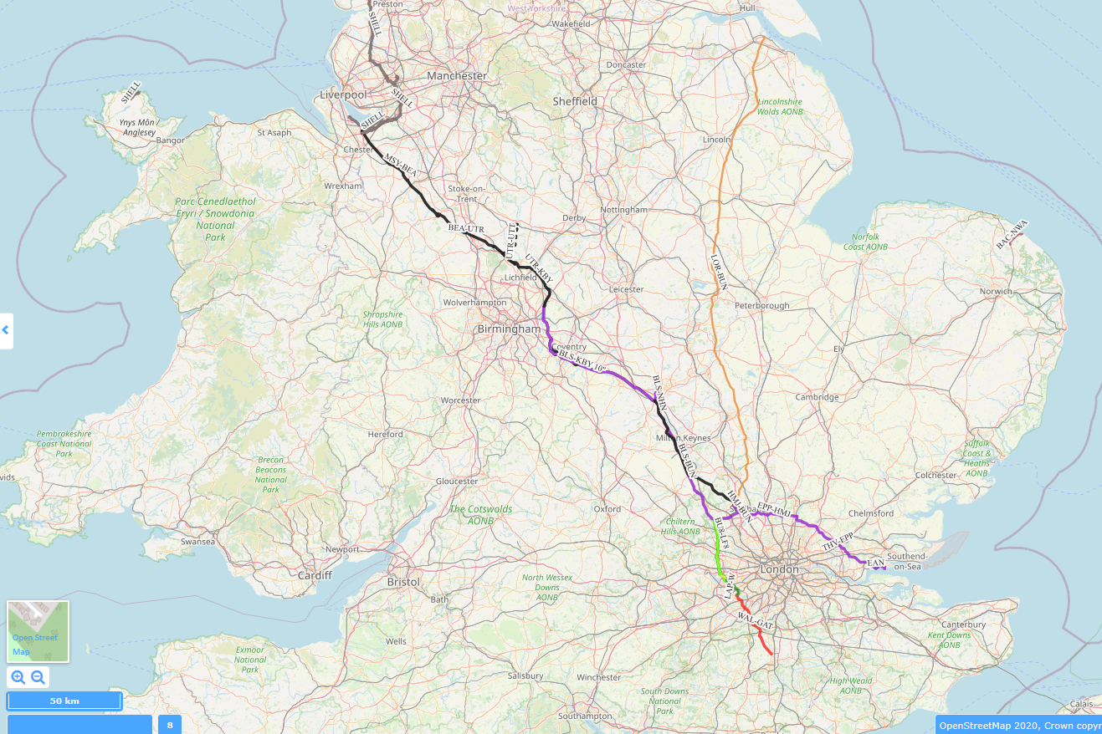
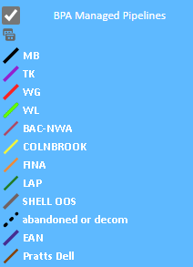
Appendix: BPA Pipeline Route Map
Note BPA initial focus / budget is for UKOP pipelines (Red box) and West London Pipelines (Blue Box)

