Slide 1

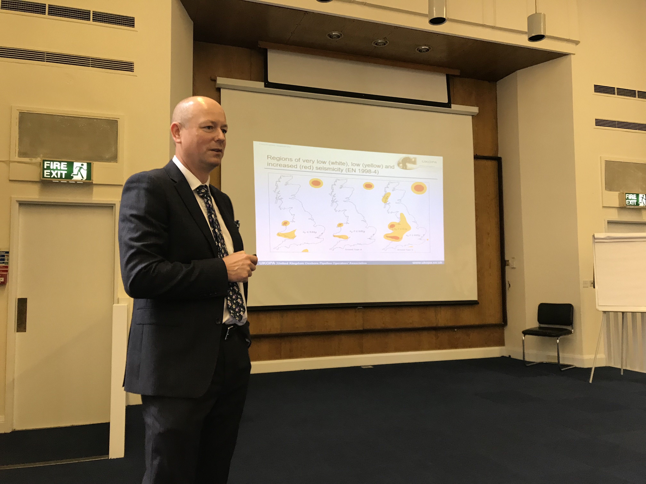
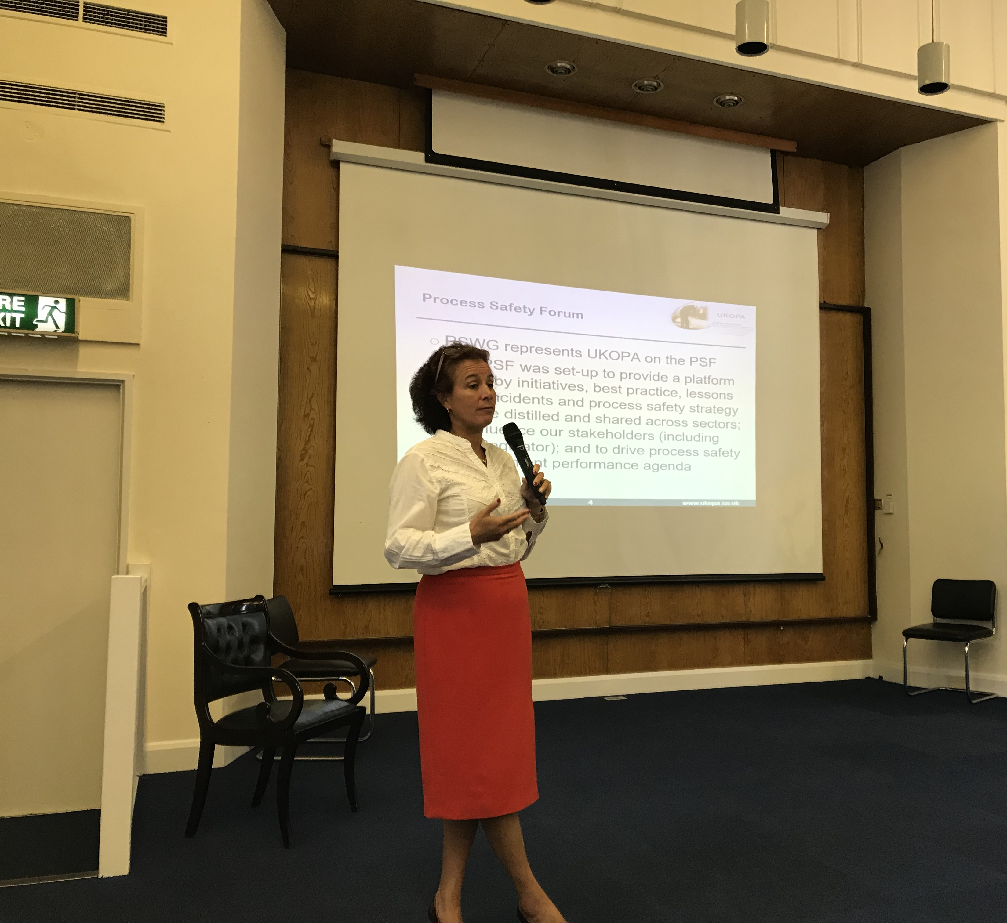
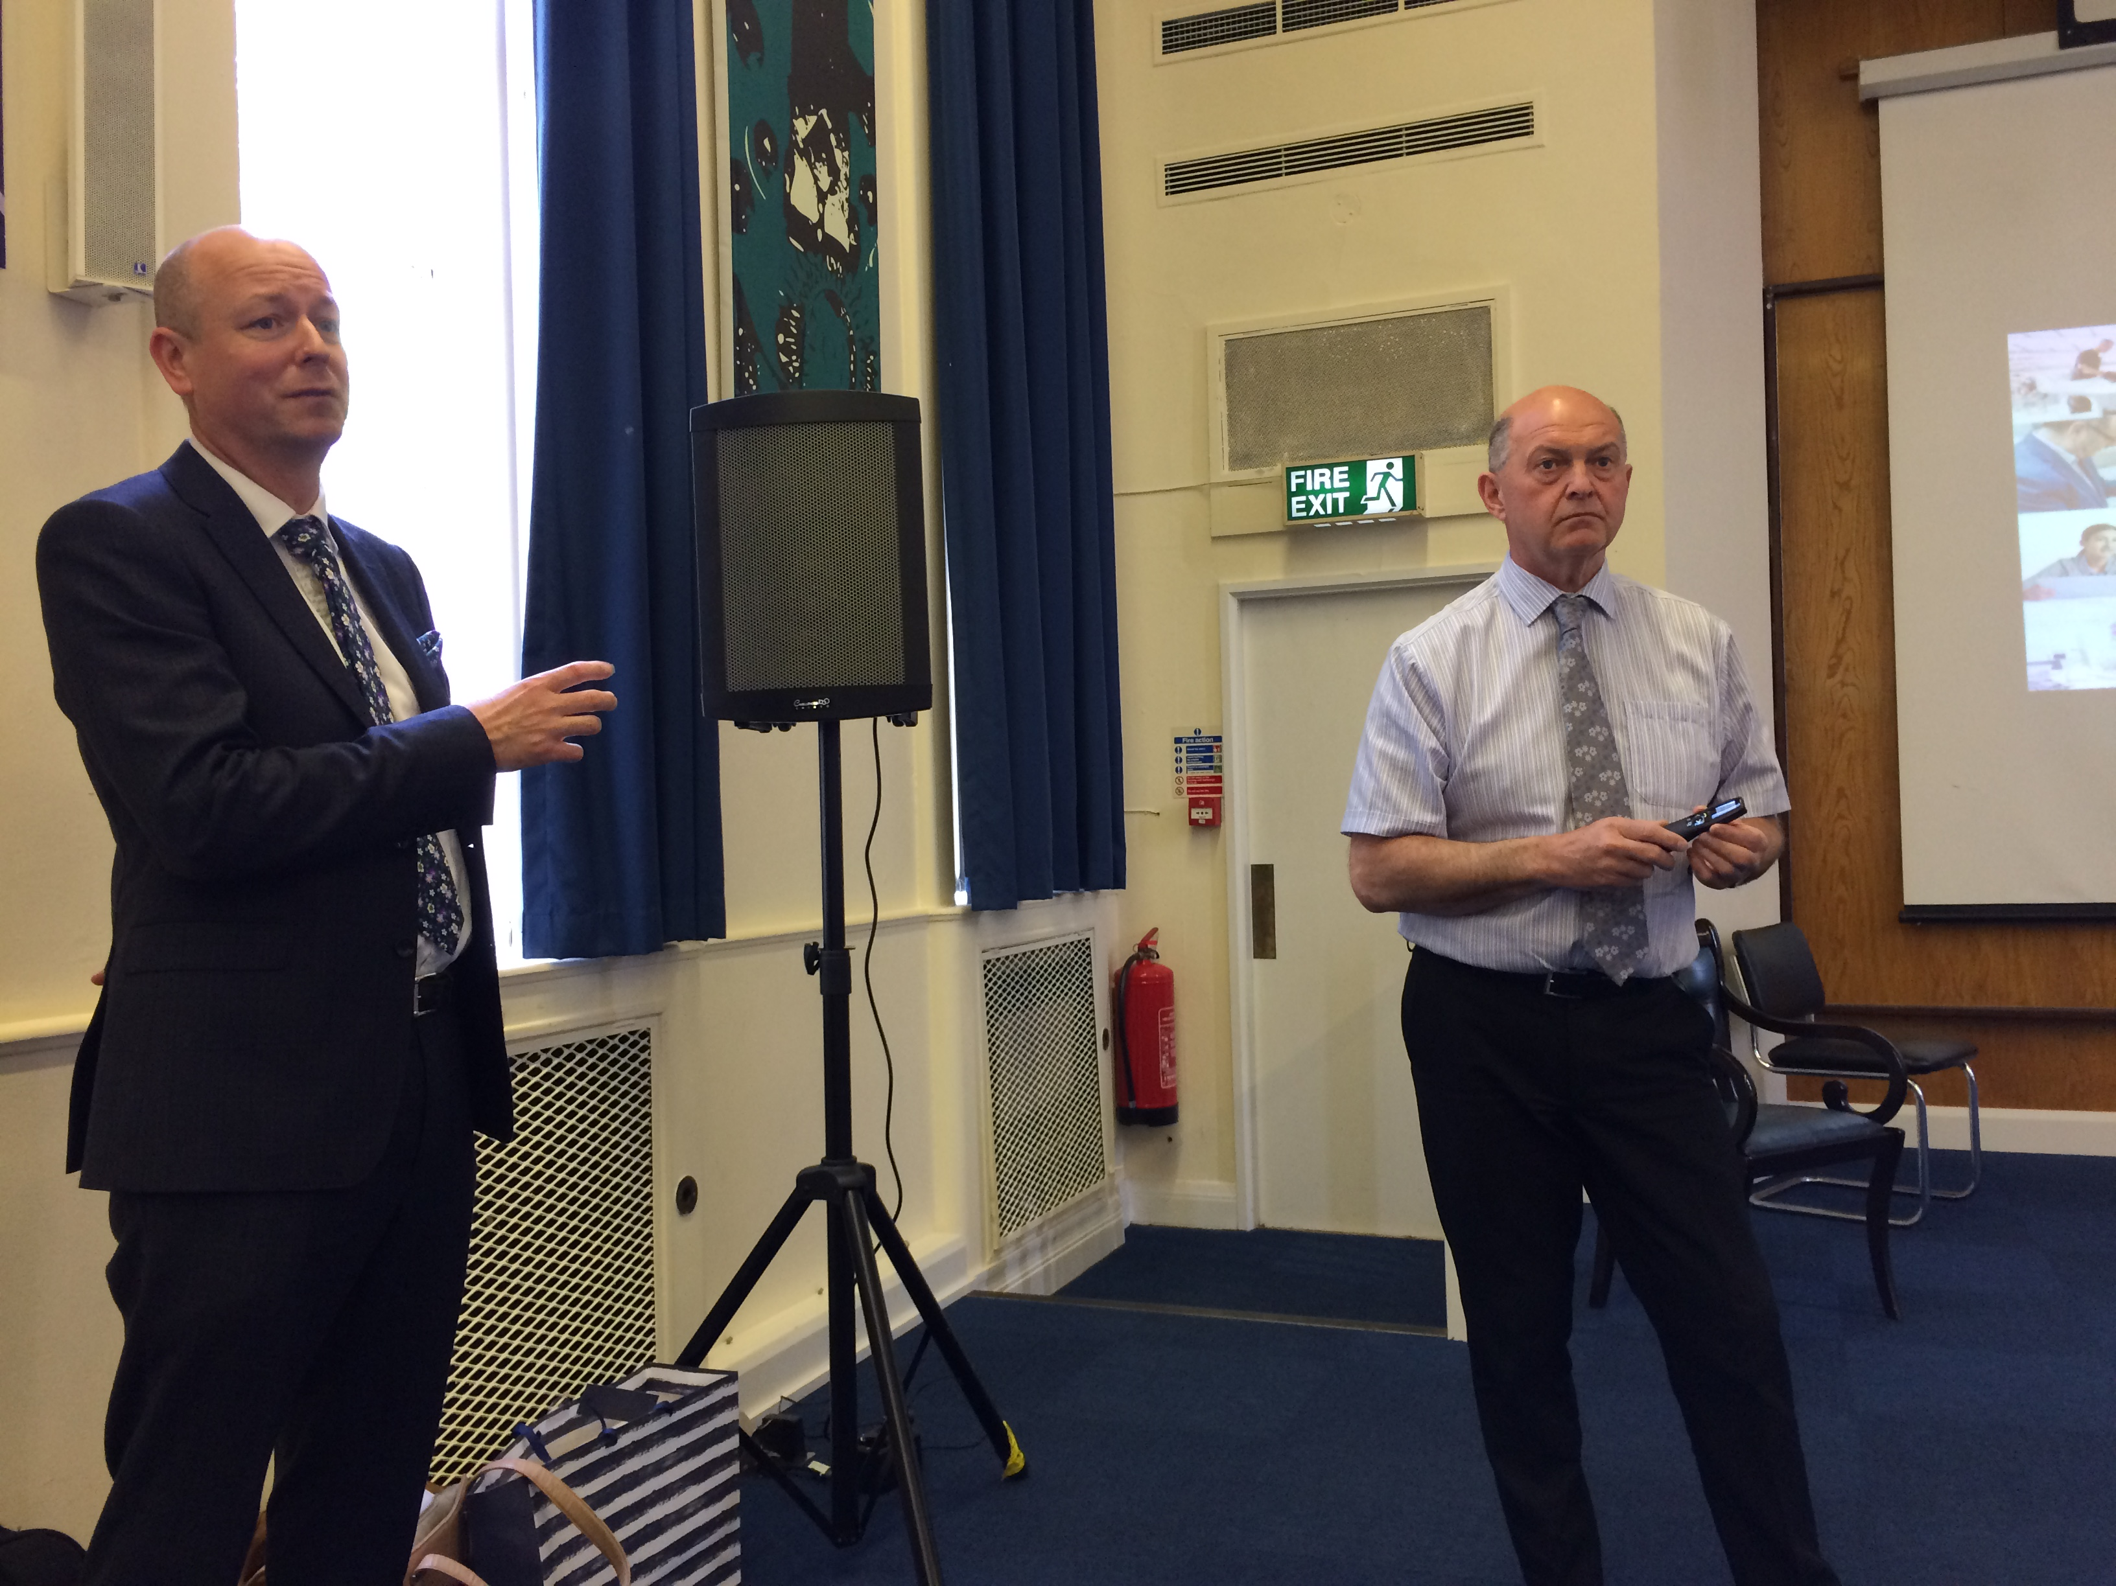

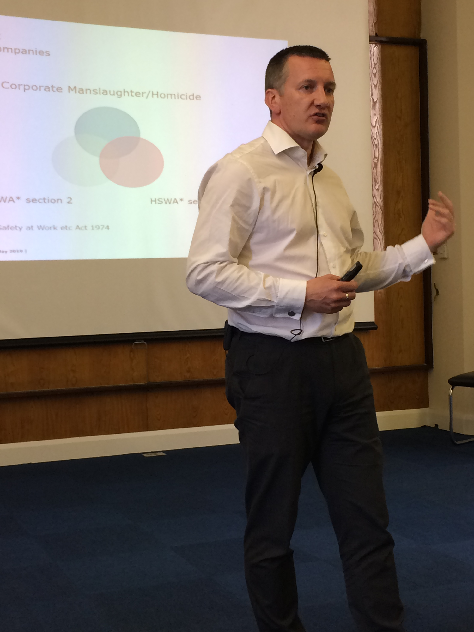

December 2019 Newsletter (Page 1 of 2)
Technical Seminar – 22nd May 2019
This year’s Technical Seminar was held at The Derby Conference Centre, with over 50 delegates from many of our member companies attending. The focus for the day was was the roll out of many of the UKOPA good practice guides and technical bulletins that had been approved by the Board. However, the presentation by Tim Hill on Corporate and Individual Heath and Safety Responsibilities, really engaged the audience.
UKOPA members can access details of each of the presentations in the members centre. If you work for a member company and do not have a login send a message to enquiries@ukopa.co.uk
Merry Christmas
The UKOPA Board would like to take the time to wish all our members a very Merry Christmas and a peaceful, prosperous and successful 2020.
We would also like to thank everyone who has supported our working groups this year. Without you, the work we do would not be possible.
To contact UKOPA please email: enquiries@ukopa.co.uk
Roll out of UKOPA Published GPGs
Included in the technical seminar was the roll out of a number of Good Practice Guides and Technical Bulletins.
Simon Joyce and Graham Goodfellow provided an outline of the Application of Cost Benefit Analysis to Demonstrate ALARP,
with supporting societal risk documents. Graeme Pailor had a busy morning outlining the Seismic Screen Assessment, Management of Pipelines Subject to Ground Movement and Verification of Features Identified by ILI guides – including hosting the round table discussion, while Geoff Glover provided an overview of the Land Use Planning guide for Local Authority Planners. Nikki Barker provided information on the Safety Alerts that had been issued in 2018-19 and requested members provide further information that would be beneficial for sharing across the industry.
Since 2014 UKOPA has published a number of Good Practice Guides (available to all from the main website) and Technical Bulletins (UKOPA membership access only).
01 – Management of Reduced Depth of Cover 14 – Solar Farm Installation in the Vicinity of HP Pipelines
03 – Pipeline Safety Monitoring 15 - Managing Pipeline Infringements
04 – Managing Pipeline Dents 16 – Pipeline Hazard Distances
05 – Managing Pipeline Sleeves 17 – Line Walking Surveys
06 – Impact Protections Slabs 19 – Seismic Screening Assessment of UK Onshore Pipelines
09 – Stress Corrosion Cracking 20 – Managing Pipelines Subject to Ground Movement
10 – MAHP Emergency Response Plan (Testing Guidance) 26 – Verification of Features Identified by ILI
11 – MAHP Emergency Response Plan (Template) 27 – AC Corrosion guidelines
12 – MAHP (Exercise Pro-forma) 29 – LA Planner information regarding Onshore Pipelines
13 – Wind Turbine Installations in the Vicinity of HP Pipelines
UKOPA members can find all published Technical Bulletins and other information in the Members Centre of the UKOPA website. If you do not have access please contact the secretariat.
Corporate and Individual Health and Safety Responsibilities –
Tim Hill, Partner at Eversheds Sutherland
The aim of Tim’s presentation was to outline the key health and safety duties for both organisations and individuals, explain the recent sentencing guidelines and how they are being implemented, outline what individuals need to know ‘in the real world’ and touch on safety culture and leadership.
It was interesting to note that for the case of Corporate Manslaughter / Homicide the balance moves from ‘innocent until proven guilty’ to ‘guilty until proved innocent’. The presentation also made attendees aware of the cost associated with organisational culpability. Tim spoke about Regulatory interactions, corporate memory, responding to enforcement notices and leadership – particularly noting the HSE publication ’Leading Health and Safety at Work’, assessing safety performance using leading and lagging indicators and promoting positive health and safe culture in a practical manner.
Tim’s presentation is available to members on the UKOPA members centre
Next UKOPA full members meeting is scheduled to take place on 26th and 27th February 2020 in Reading

Slide 2
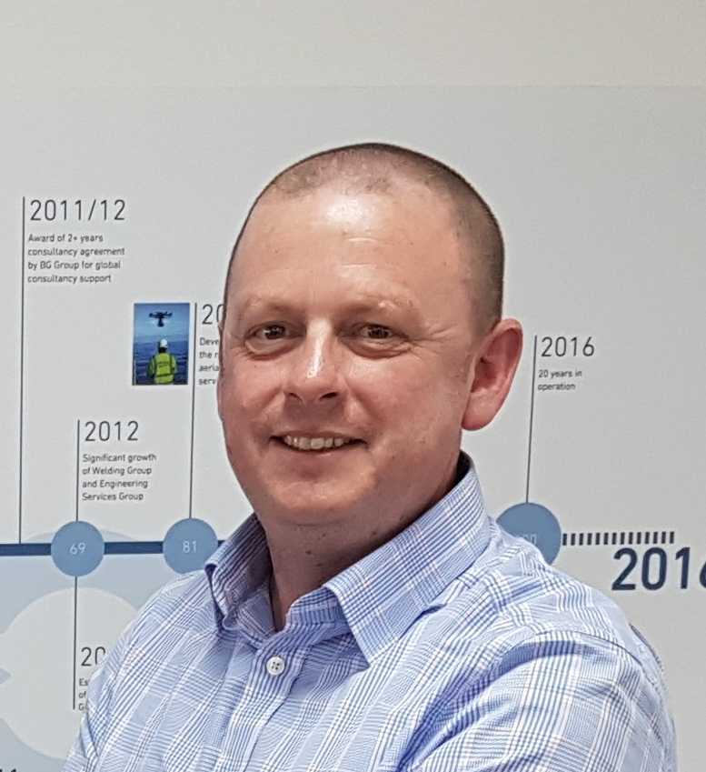
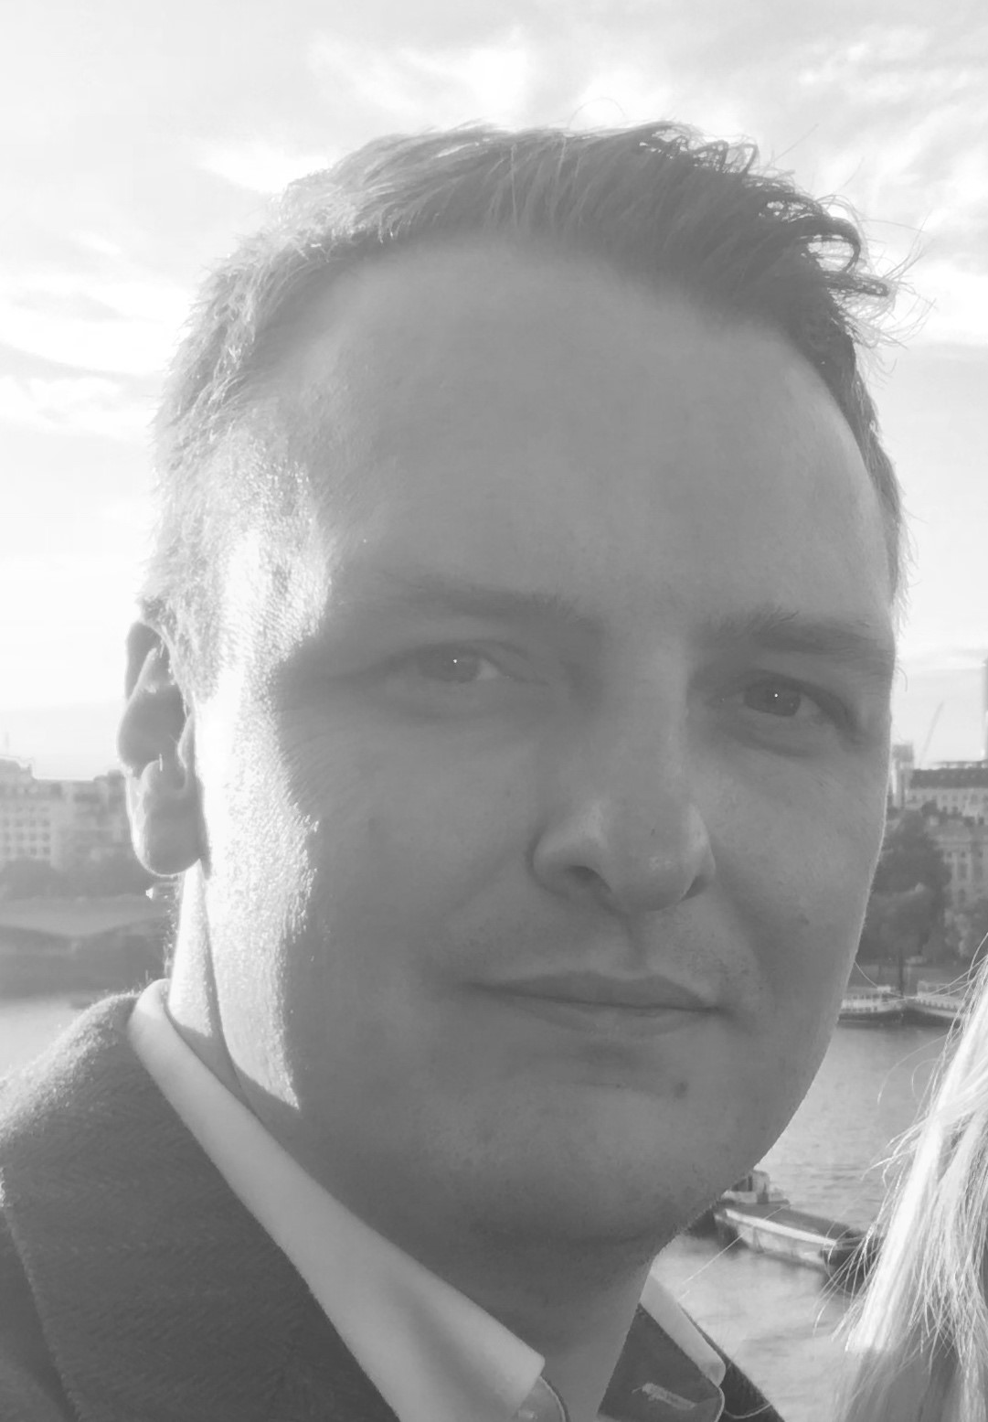
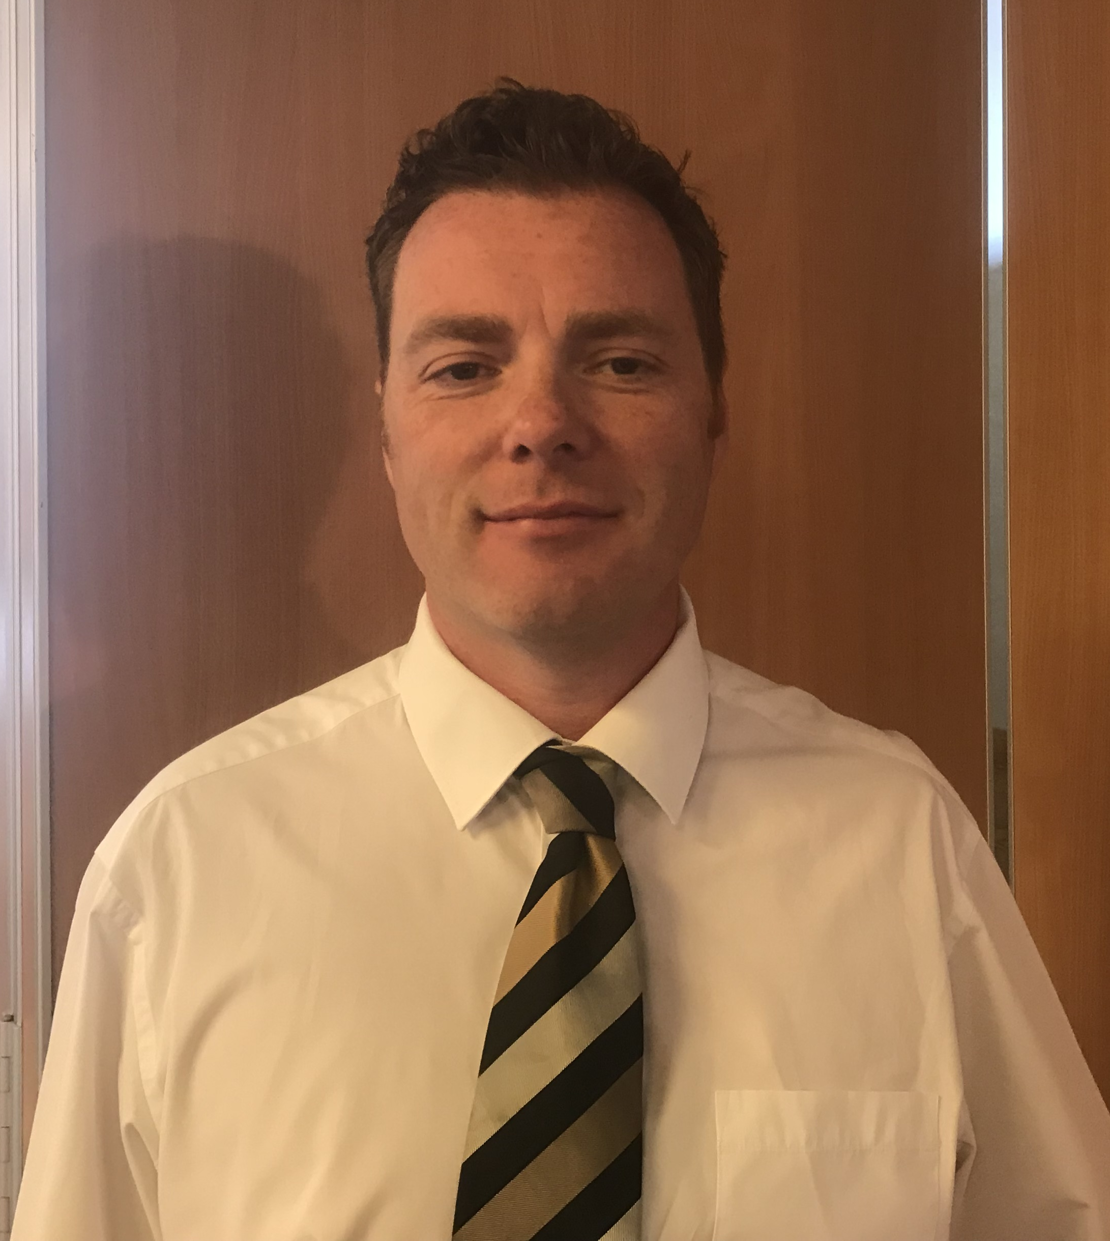
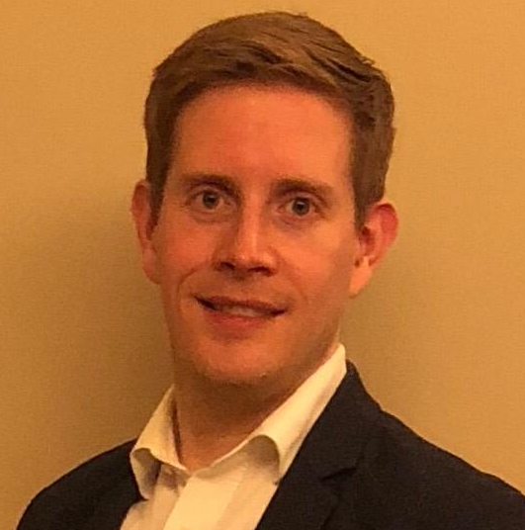
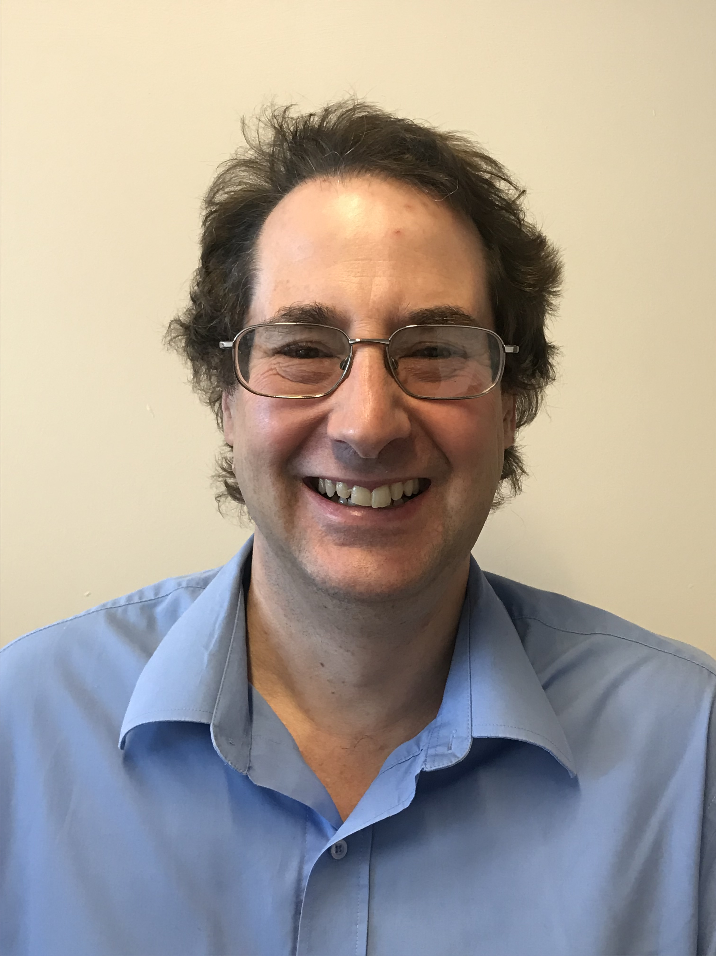
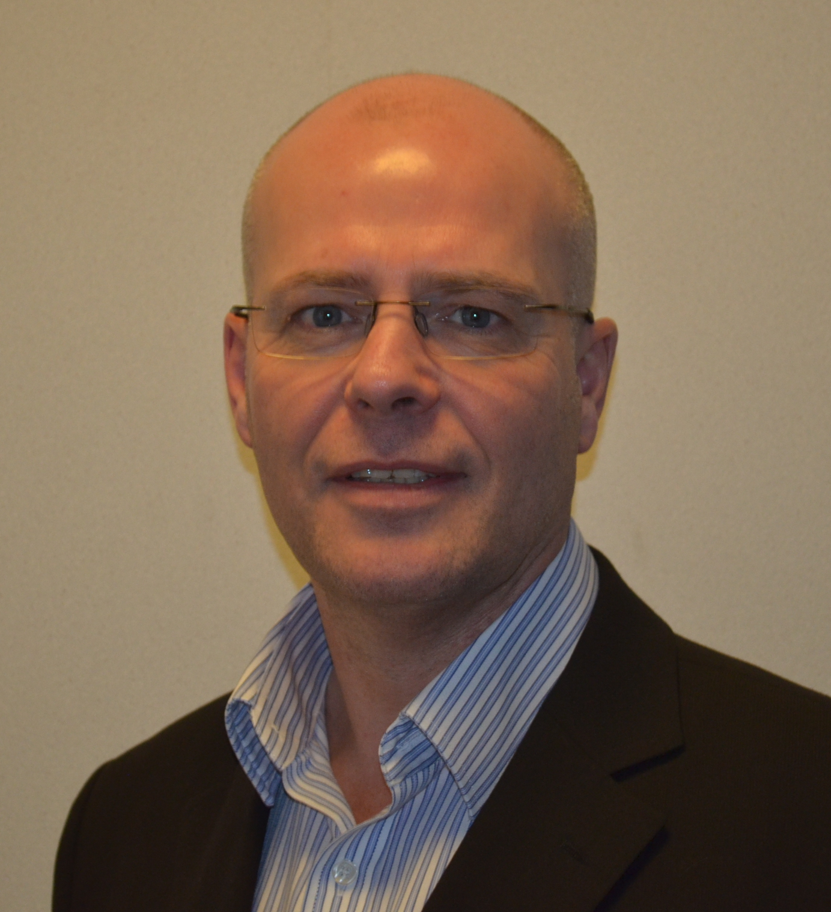
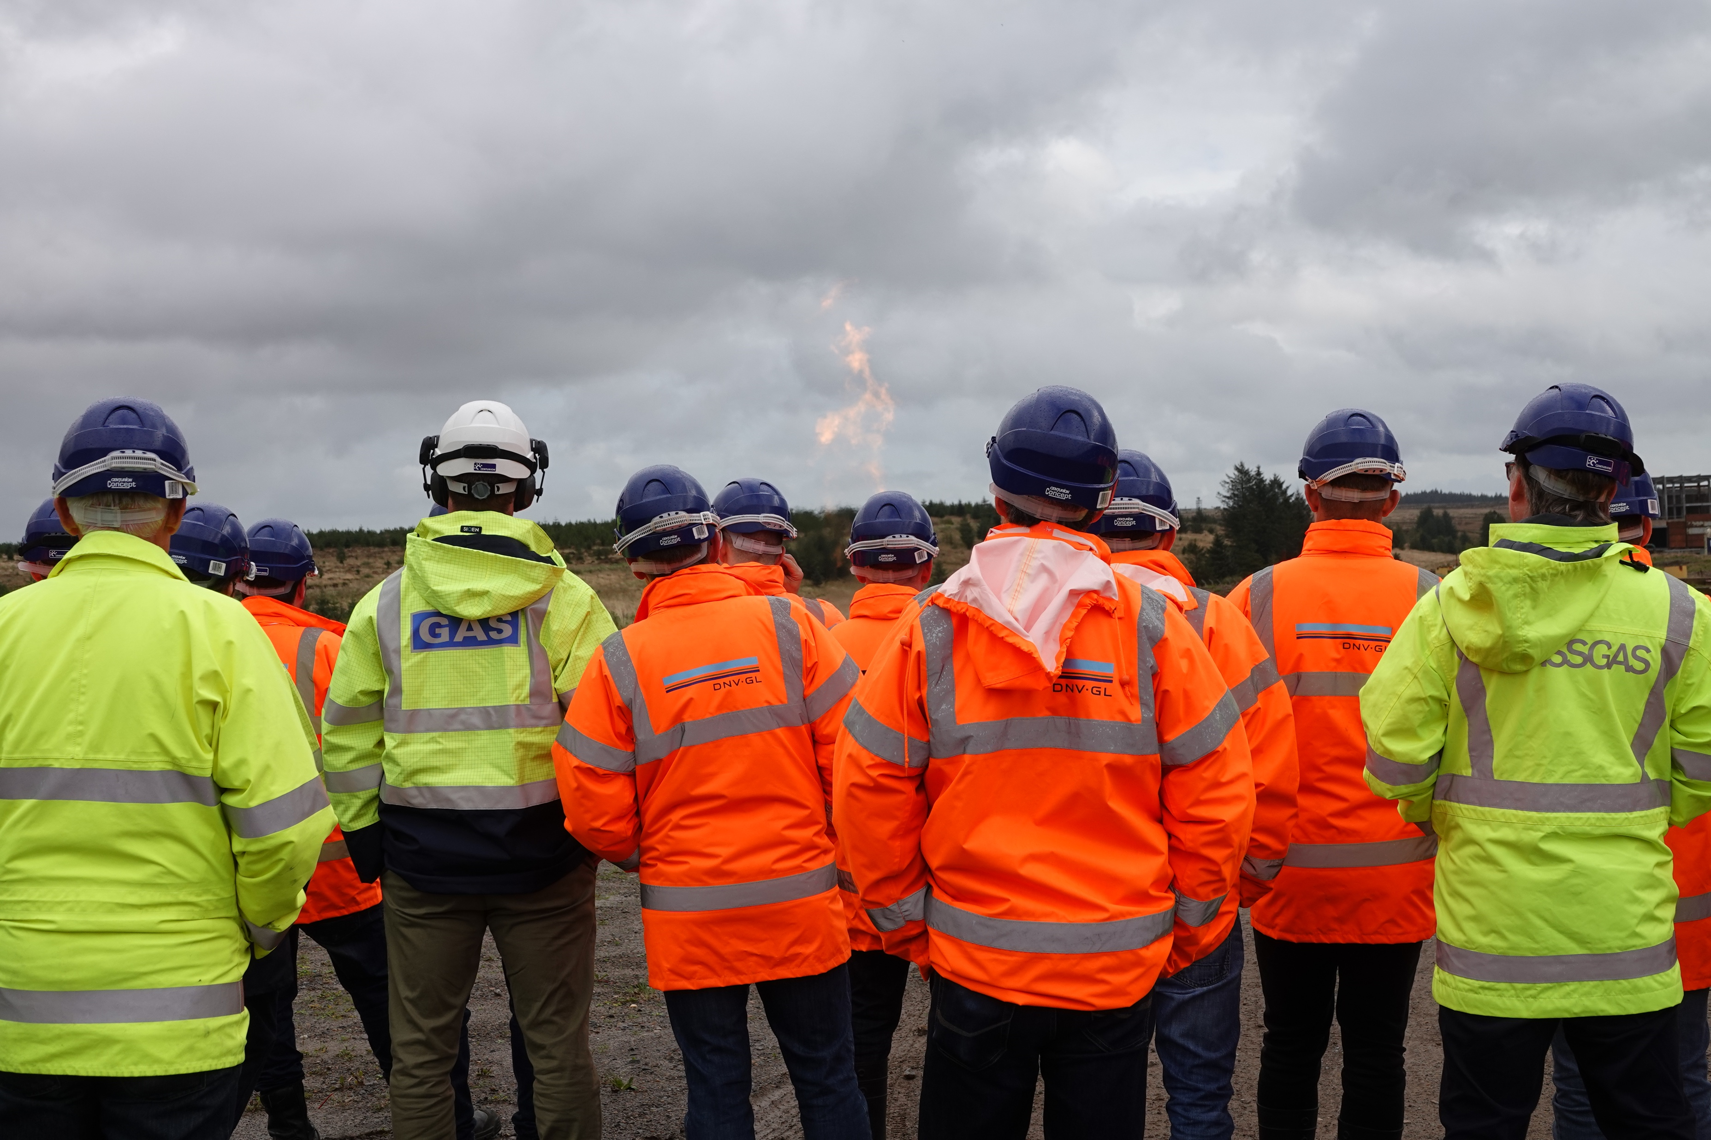
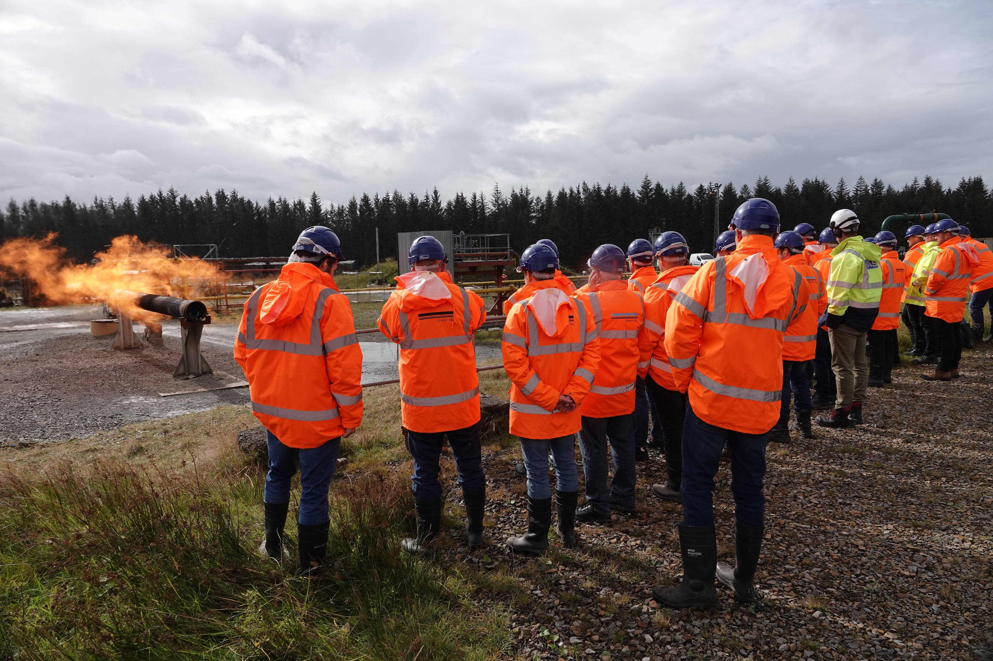
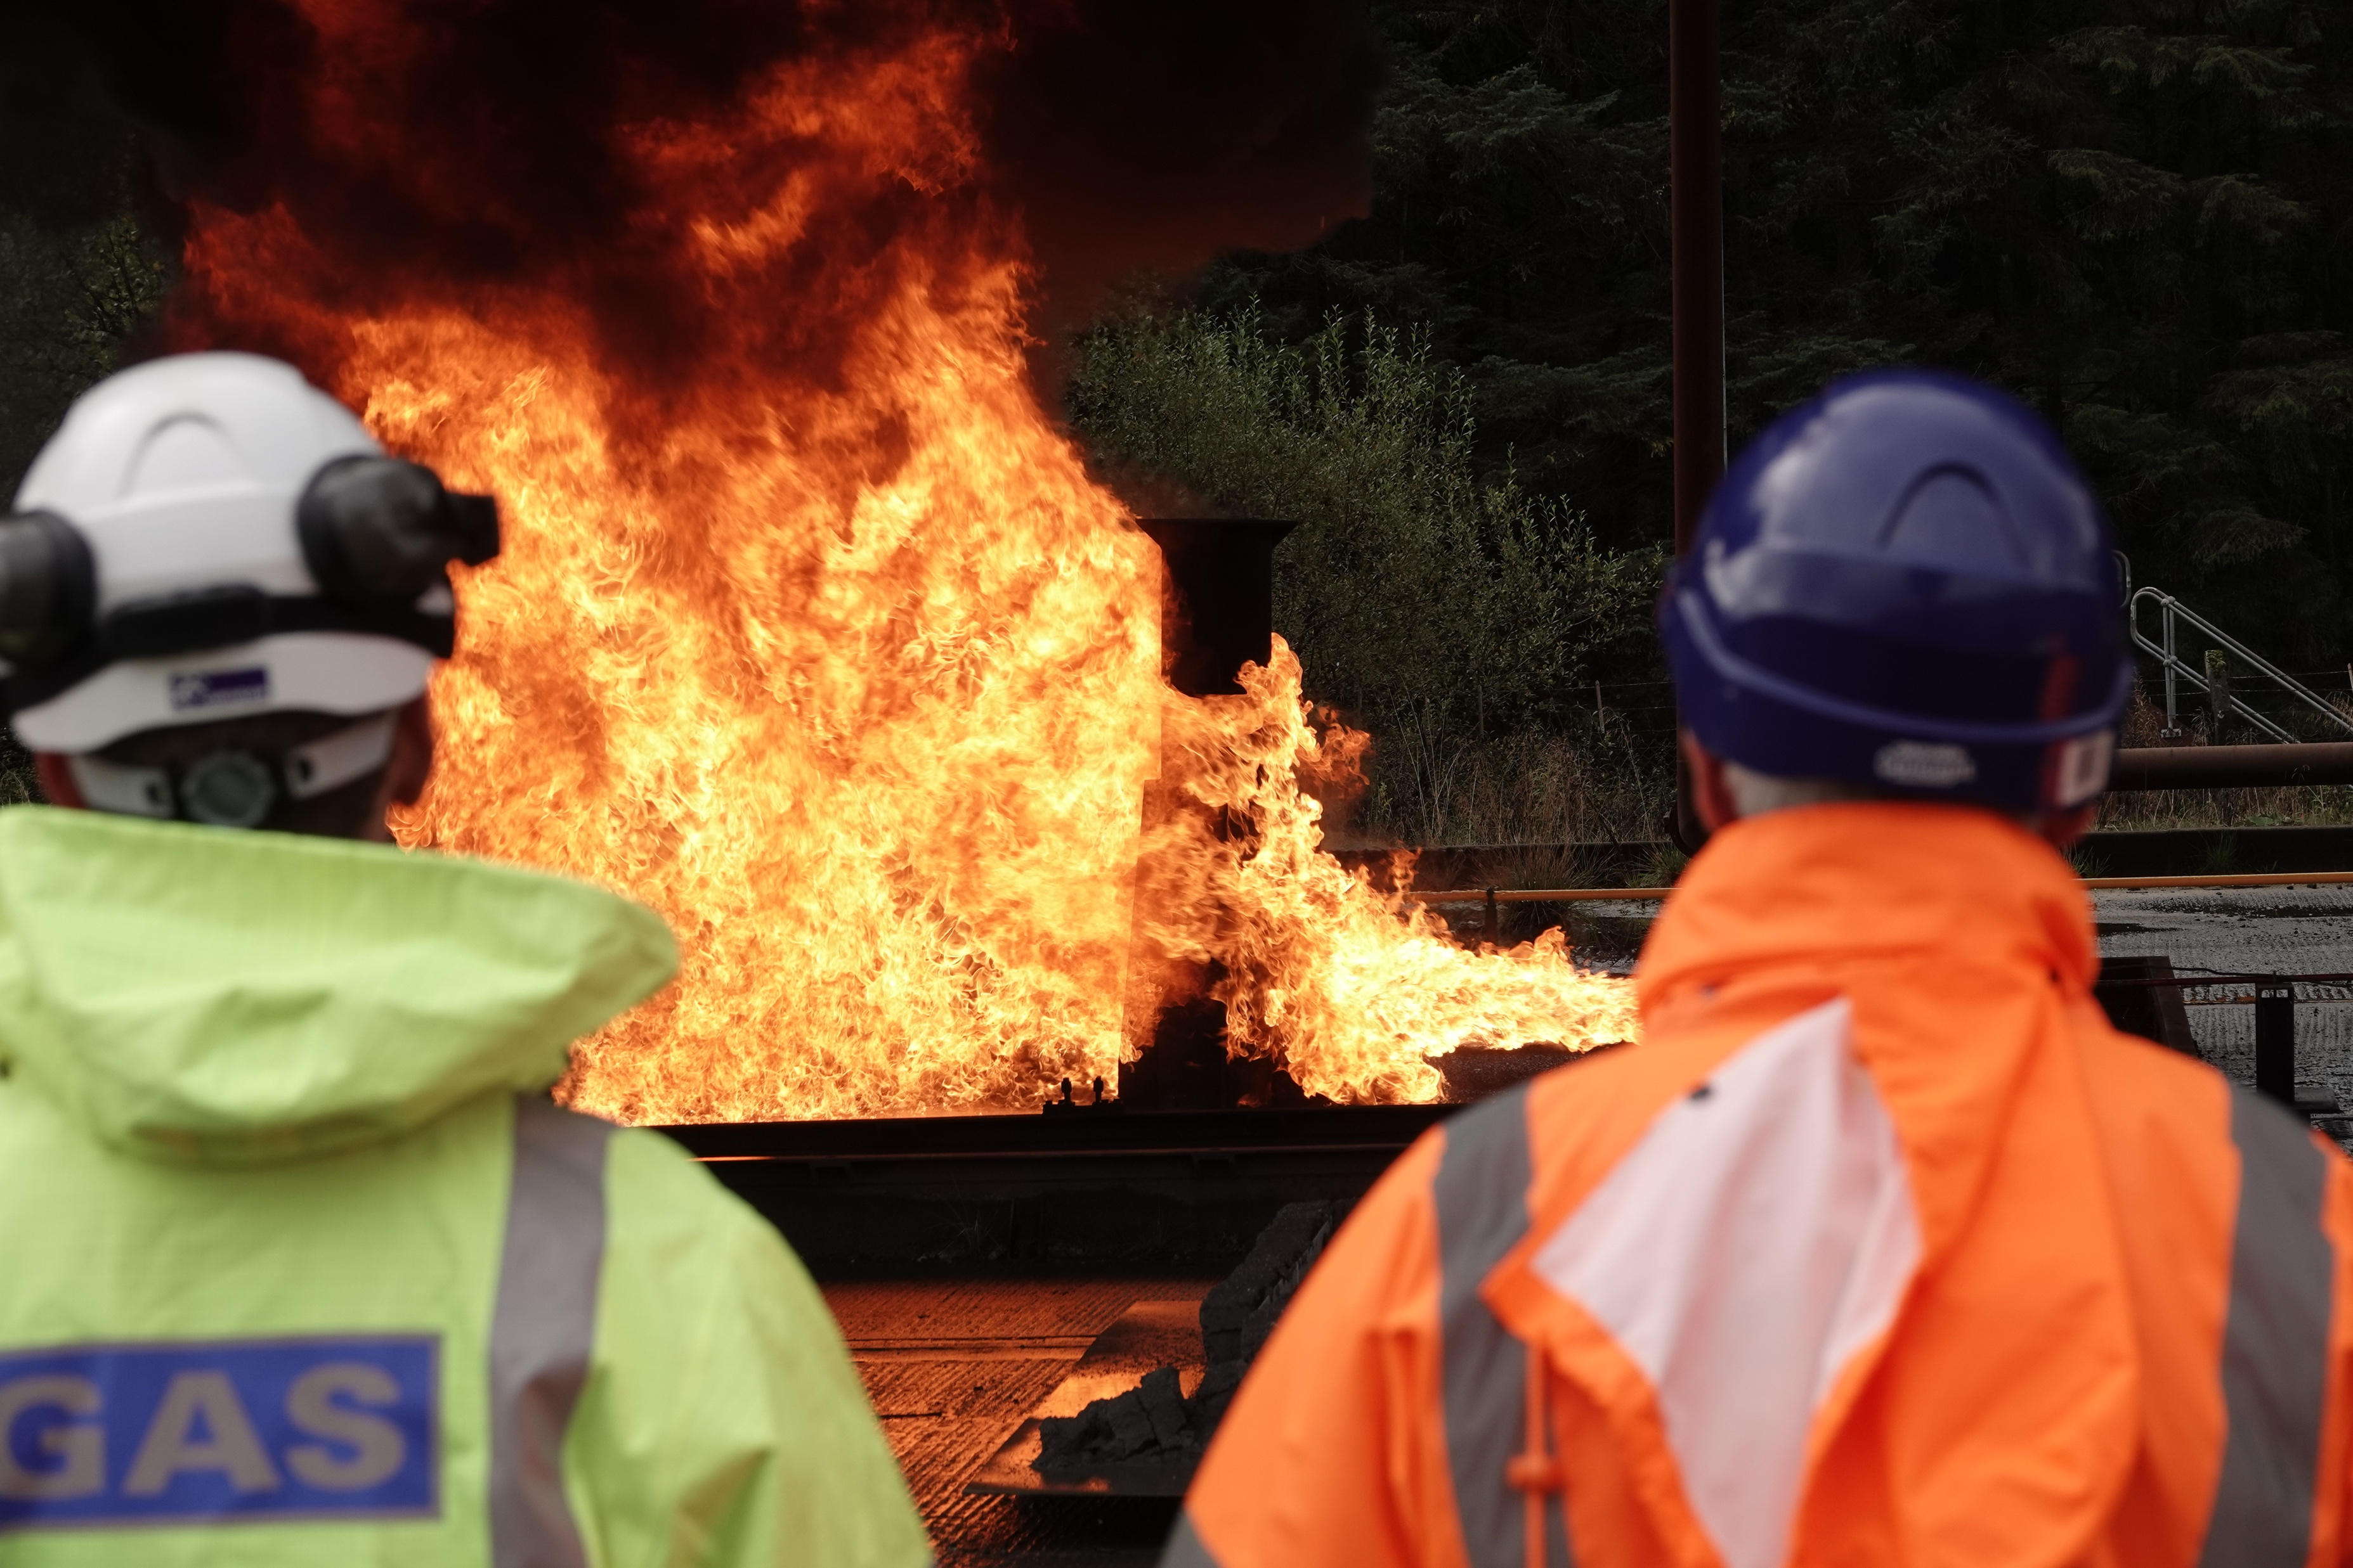
June 2018 Newsletter (Page 2 of 2)
Meet the UKOPA Working Group Chairs
Emergency Planning Working Group Chair, Andy Middleton, is Network Integrity & Compliance Lead for NGN. He has been a member of the working group for 3 years taking over as chair at the end of 2018. Andy, was instrumental developing the UKOPA Hazard Awareness Course which ran for the first time in 2019.
Fault and Risk Assessment Working Group Chair is Simon Joyce. Simon is Engineering Policy Manager – Transmission and Plant. Simon became Chair in 2017, he also sits on the PIWG. Simon’s focus is to ensure that UKOPA collects data for the annual report and that is relevant for industry use.
Infringement Working Group Chair, Phil Taylor, is Lands Manager for BPA. He has been a member of the IWG for almost 10 years and took over as Chair in 2017. Phil has reengaged UKOPA’s interactions with the NFU to further raise awareness within the farming community of HP pipelines.
Pipeline Integrity Working Group Chair is Tim Rudd. Tim is Manager Logistics Engineering for Valero Logistics Ltd. He has been a member of PIWG for a number of years and became Chair in 2019. During the past few years Tim took a lead on testing for the UKOPA Weld Quality Project and will be presenting results internationally next year.
Process Safety Working Group, Chair, John Ferrari, is Infrastructure Asset Manager at Essar Oil (UK) Ltd. He has been Chair of the group for the past 2 years. John has focused on pipeline process safety, the first GPG is due in 2020, and sharing learnings both from inside and outside the pipeline sector.
Governance Group Chairman is Barry Dalus. Barry has over 40 years experience in the gas industry. Prior to retiring from NGN, was a UKOPA Board Member and Chair of the Emergency Planning Working Group. Barry ensures that all of UKOPA’s published documents are developed correctly and follow the governance process.
UKOPA Hazard Awareness and Consequence Course
For 2019, UKOPA ran its first Hazard Awareness Course at the DNVGL Spadeadam site in Cumbria. The aim of the course was to provide attendees with a practical appreciation of the consequences of an uncontrolled release from hydrocarbon pipelines under various credible scenarios. They experienced the effects of these ignited releases from devastation, to aftershocks, to heat, vibration and sound.
Members Meeting Updates
Members Meetings take place twice per year in February and October. This year, these meetings took place in Warrington and Newcastle respectively.
February’s meeting focused on the UKOPA strategy, taking time to review what had happened during the last 2 years and having round table discussions regarding where UKOPA should look to focus its resources during the coming 2 years. The meeting was joined by the land use planning team from HSE (previously HSL based in Buxton) who have developed the LUP app for use by local authority planners and developers. UKOPA members have provided pipeline data that is included in the application and discussions were held with regards to how to ensure accurate data and updates moving forward.
October’s meeting had a theme of ‘what can the pipeline industry learn from other sectors’. Time was spent in round time discussions focusing on: how to respond to emergency incidents that occur due to external factors (such as a dam-burst); human factors and its impact on pipeline operators and how learnings from other sectors can be shared and translated into the pipeline sector.
All members are invited to attend these meetings as part of their annual membership fee.
If you have proposals for what might be the theme of future members meetings, then please contact UKOPA, enquiries@ukopa.co.uk
Pipeline Emergency Response Officer (PERO) Courses
Course dates for 2020 have been confirmed and members have received both flyers and booking forms.
The 2-day course costs £1123 and is exclusively for UKOPA member staff and contractors.
If you want more details please contact Nikki Barker, enquiries@ukopa.co.uk
Safety Alerts – Don’t forget to share your safety learning: these are published in the members centre.
All information can be found at - www.ukopa.co.uk
Any question or queries email
enquiries@ukopa.co.uk

