Slide 2
AC Corrosion - an Update by David Eyre

Slide 3
AC Corrosion Criteria
DD CEN TS 15280 - 2006
BS EN 15280 – 2013 / BS ISO 18086-2015
Current Density
< 30 A/m² no or low likelihood.
> 30 <100 A/m² medium likelihood.
100 A/m² very high likelihood
Current Ratio
Iac/Idc<5 AC corrosion likelihood is low
Iac/Idc between 5 and 10 AC corrosion likelihood can exist further investigation necessary
Iac/Idc>10 AC corrosion likelihood is high
AC Voltage
Pipeline AC voltage should not exceed at any time:
  10V over the entire pipeline
  4 V where the soil resistivity is less than 25 Ohm m (2,500 Ohm.cm)
AC voltage <15V rms average
and
AC current density < 30A/m² on a 1cm² coupon
or
Average DC current density <1A/m² if AC current density is > 30 A/m²
or
Maintaining ratio of AC/DC current density <5 and preferably <3 over representative 24hr period

Slide 4
Key differences
Differences between DD/CEN/TS 15280 and BS EN 15280/BS ISO 18086
Voltage criteria for different soil resistivity removed, maximum AC value of 15V rms stated.
Regions of uncertainty removed.
Recognition that more than one criterion might be required and clearer guidance on how to apply them.
Soil Resistivity
BS EN 15280 also states that:
Below 25 Ω.m : very high risk
Between 25 and 100 Ω.m : high risk,
Between 100 and 300 Ω.m : medium risk
Above 300 Ω.m low risk
Very important:
Most incidences of AC corrosion in the UK have been in low resistivity wet soils

Slide 5
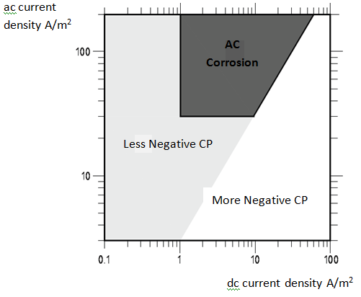
BS EN 15280 / BS ISO 18086 criteria
Graphical Presentation of Criteria
AC corrosion is the result of a complex interaction between the ac and the cathodic protection:
The anodic half cycle creates a passive film which is converted into a non passive film by cathodic reduction during the cathodic half cycle . Corrosion therefore proceeds instead of slowing down
It follows that AC corrosion can be controlled at high or low CP current densities.
From BS EN 15280-2013

Slide 6
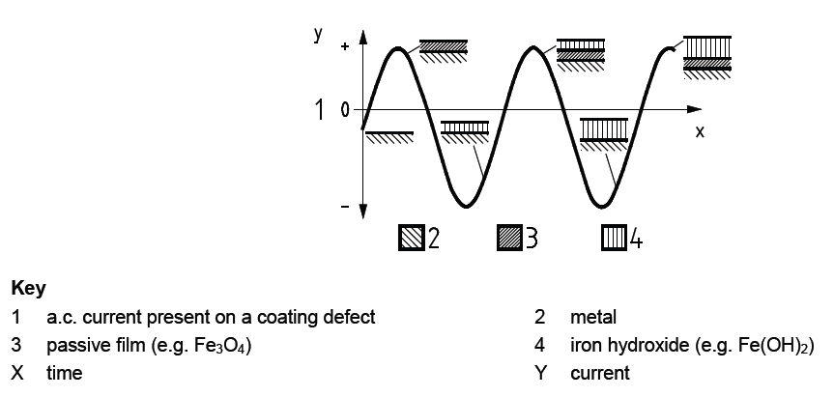
AC Corrosion Mechanism
Graphical Representation of the Process
BS EN 15280

Slide 7
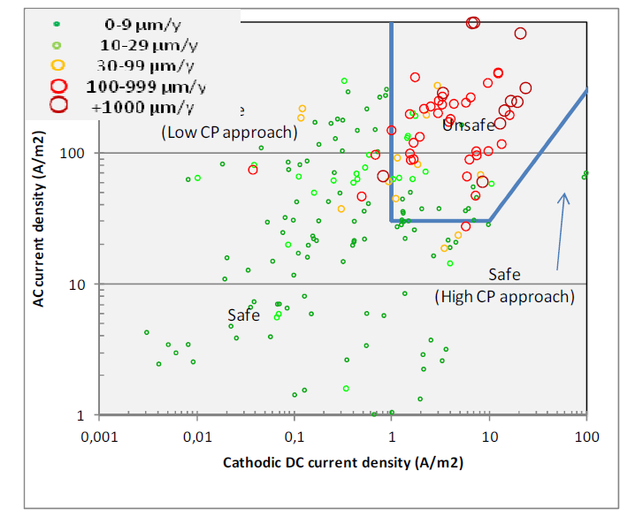
Published Data
Measured Corrosion Rates Compared to Criteria
Generally good agreement
Some high corrosion rates in the “safe areas”
Nielson LV, AC influenced Corrosion in Pipelines: Cost Effective Assessments

Slide 8
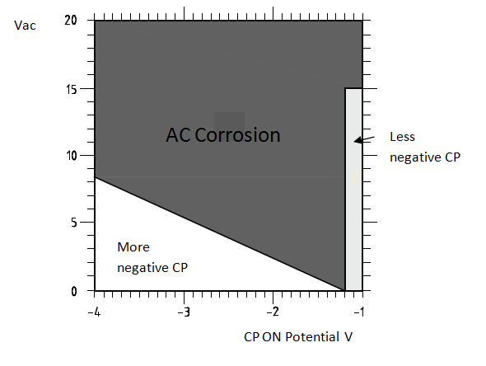
BS EN 15280 /BS ISO 18086 Informative
Alternative Criteria Based on Voltage
Current density is related to potential so it follows that voltage criteria can be used
Informative only
Note :
1) CP Potential is ON potential and the standard recommends remote potentials are used.
2) AC corrosion can occur at very low AC voltages in low resistivity soil
From BS EN 15280-2013

Slide 9
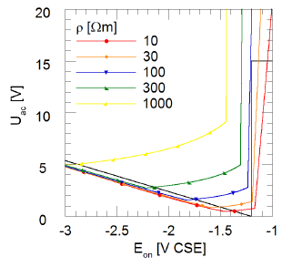
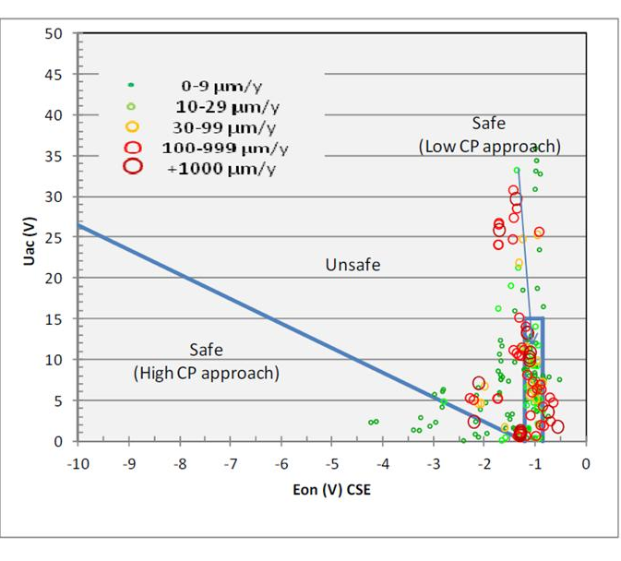
Published Data
Based on laboratory and field tests
The extent of the “safe” zones varies with soil resistivity
Corrosion occurs at low ac volts and less negative CP potentials possibly due to rectification of the AC caused by the corrosion product film ^{[1]}.
1 Bűchler M, Determining the ac risk of pipelines based on coupon measurements
2 Nielson LV, AC influenced Corrosion in Pipelines: Cost Effective Assessments

Slide 10
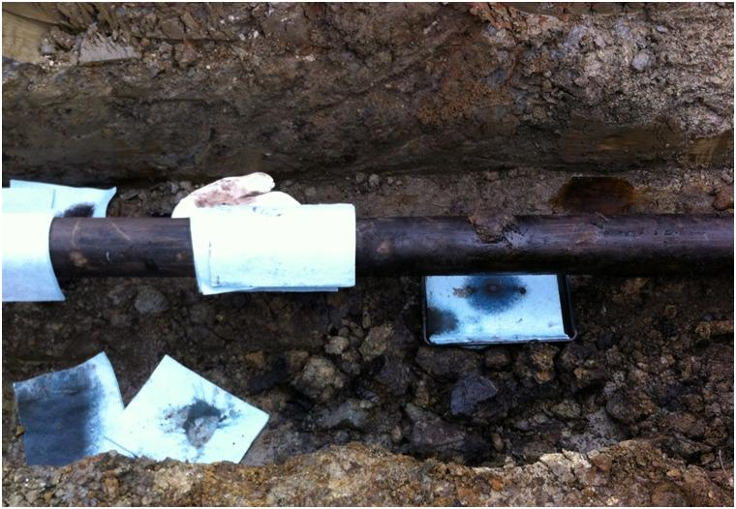
Case Study 1: Aviation Fuel Pipeline
Leak Found at CP Drain Point
Pipeline details:
Diameter 8 inch
Material API 5L Grade B
Wall thickness 7.7mm
MOP 49.5 bar
Coating - Reinforced enamel
Construction year 1977
Product Aviation fuel
Soil resistivity 10 ohm m

Slide 11
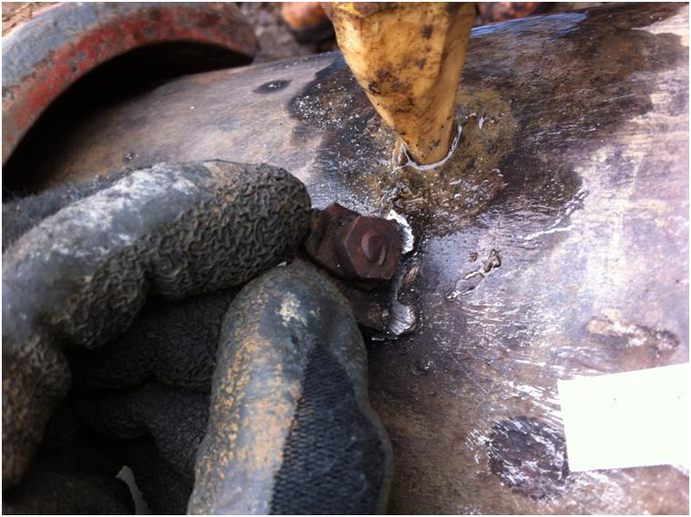
Case Study 1: Aviation Fuel Pipeline
Leak was next to an old drain point connection stud

Slide 12
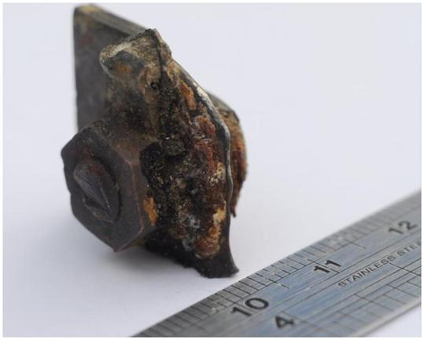
Case Study 1: Aviation Fuel Pipeline
Old Drain Point Connection Stud
Corrosion of mild steel stud evident.
Also corrosion of brass bolt and nut.
Three possible causes considered:
  Reverse polarity
  Inadequate CP
  AC corrosion
Reverse polarity was eliminated using ILI data. 2006 run showed 49% wall thickness loss at this location. Therefore reverse polarity would have to have preceded and followed this date - unlikely

Slide 13
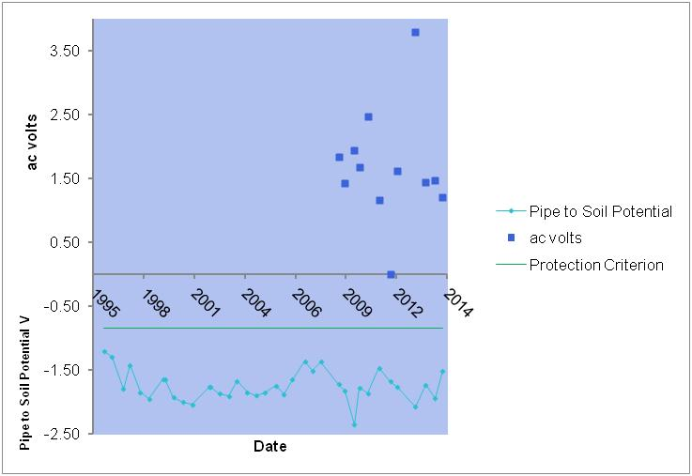
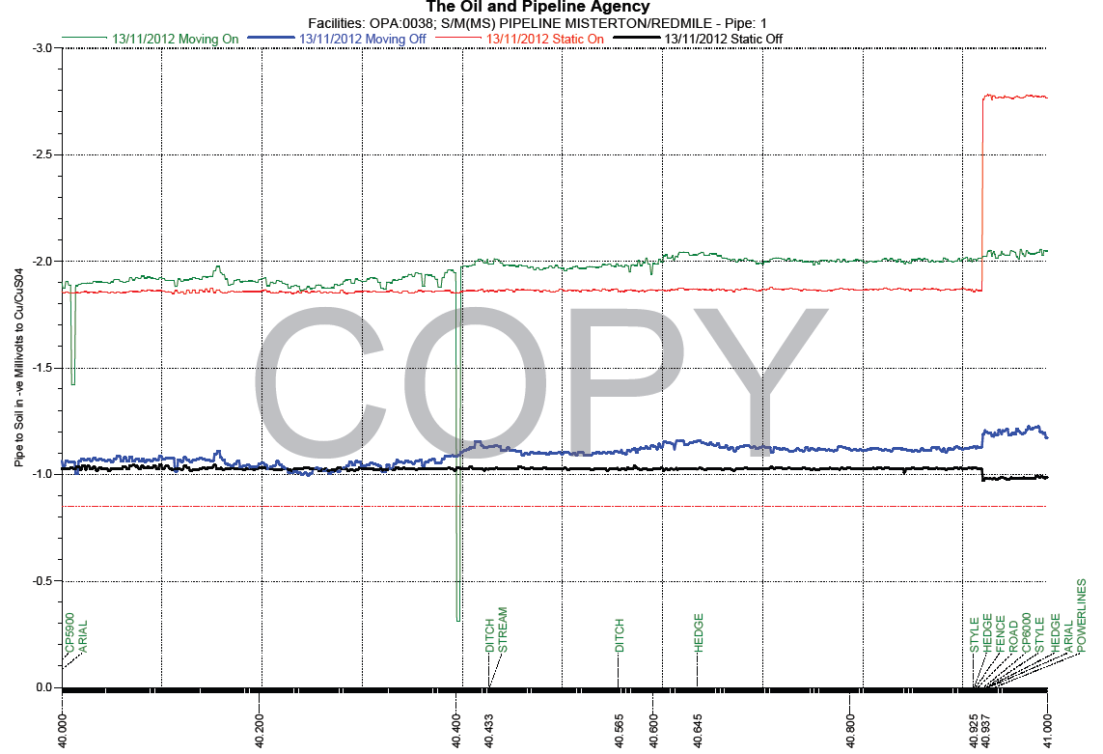
Case Study 1
Monitoring Data
CP data from 1995
V_{ac} from 2009
CP potentials averaged -1.75V ON.
V_{ac} averaged 1.7V
CIP data from 2012 showed good CP potentials.
No evidence of under protection and if there was the brass nut should not have corroded

Slide 14
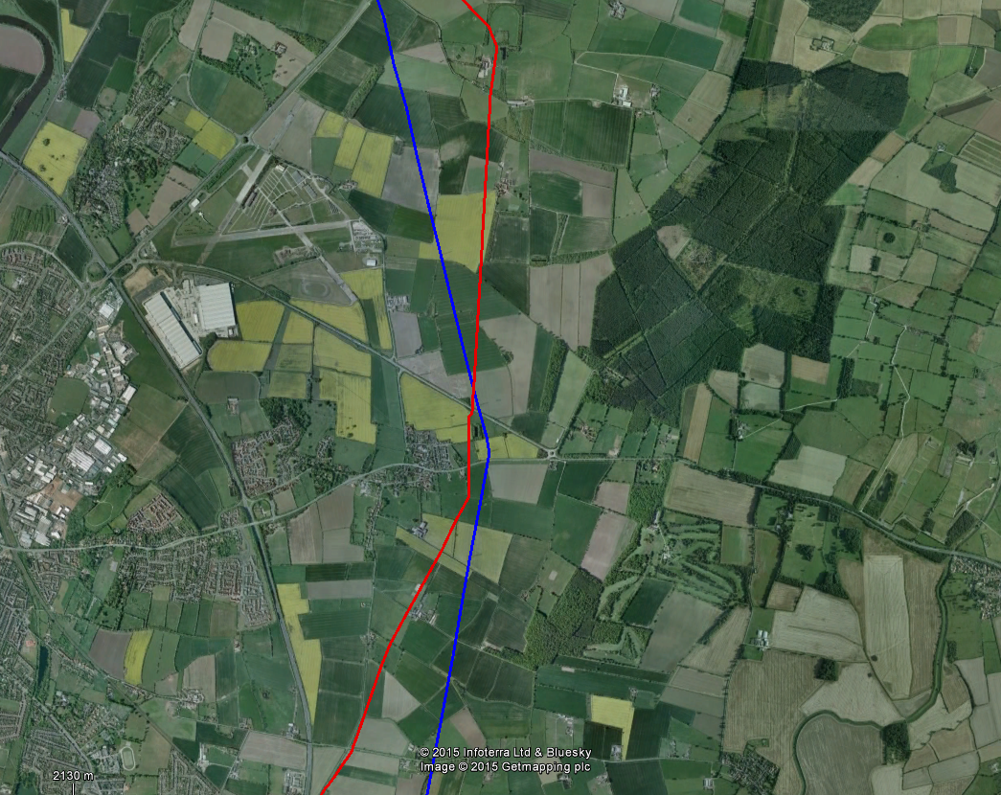
Case Study 1: Aviation Fuel Pipeline
Power Line / Pipeline Configuration
Leak site
400kV Power Line

Slide 15
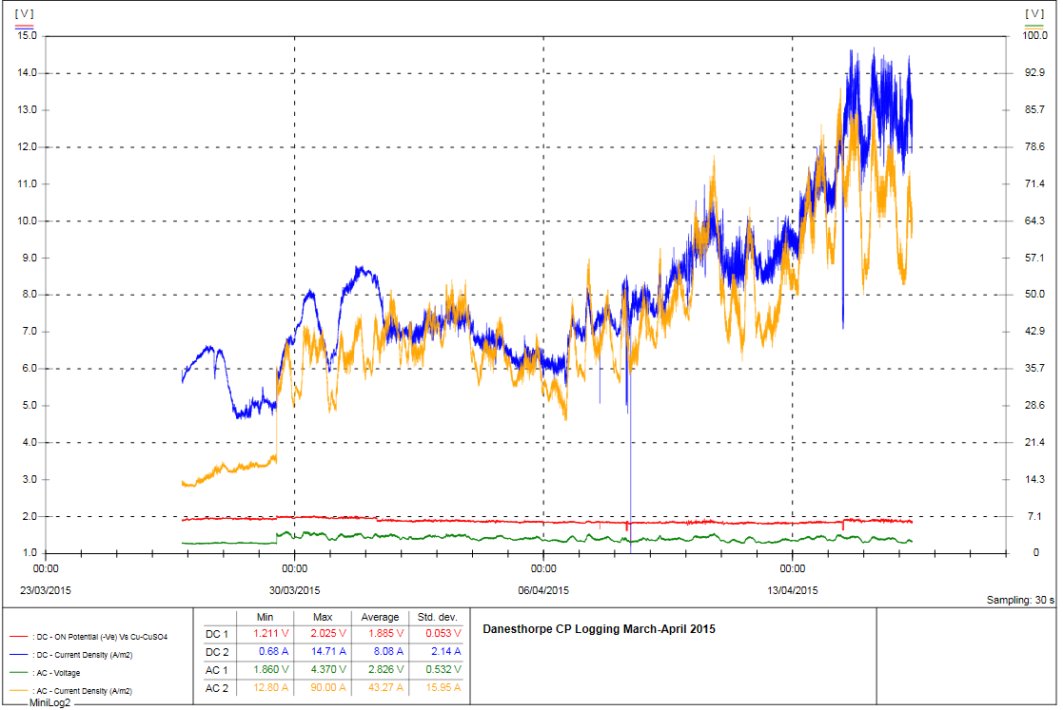
Case Study 1: Aviation Fuel Pipeline
Logging data confirmed high AC current density
A

Slide 16
Case Study 1: Aviation Fuel Pipeline
Comparison of Monitoring Data with BS EN 15280 - 2013
All criteria were exceeded therefore concluded that leak was due to AC corrosion

Slide 17
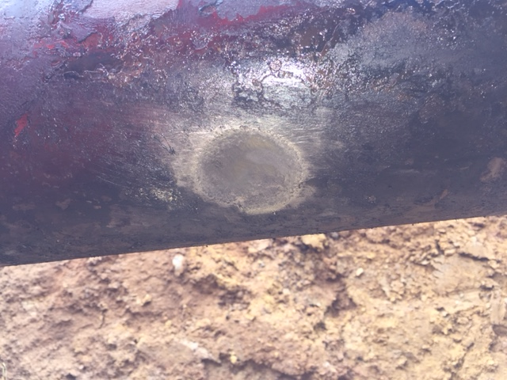
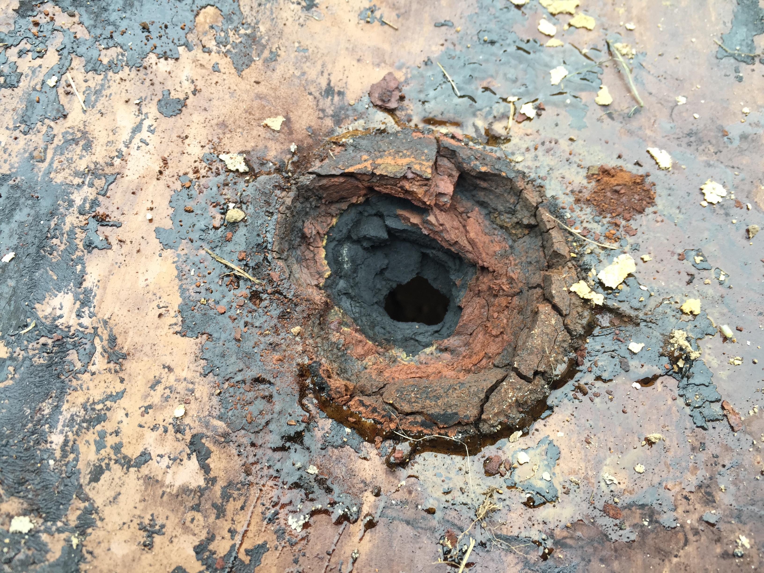
Case Study 2 – Refined Product Pipeline
Pipeline Details
Coated with bitumen tape wrap
Soil resistivity 1 ohm.m
Pipeline part of CP Joint Scheme that already had some ac mitigation
65% wall thickness loss
Near diversion where ac mitigation was omitted
Back of the coating

Slide 18
Case Study 2 – Refined Product Pipeline
Monitoring Data
Good CP potential. AC volts started to be monitored in 2009, 1-6V_{ac}

Slide 19
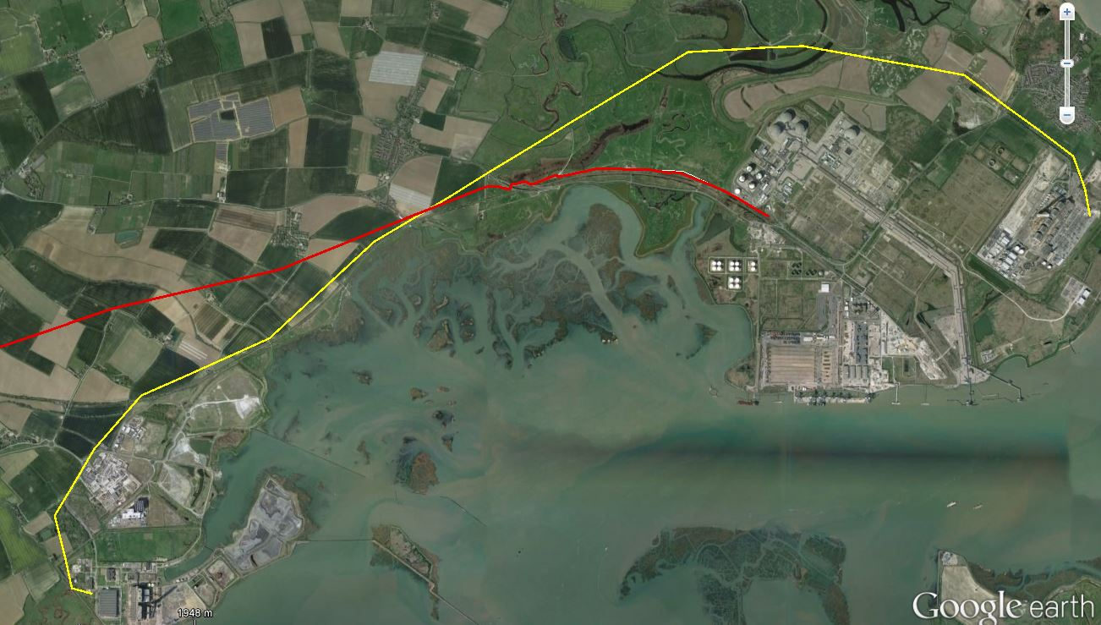
Case Study 2 – Refined Product Pipeline
Pipeline Power Line Configuration
400kV Power line
Pipeline
AC Corrosion Defect

Slide 20
Case Study 2 – Refined Product Pipeline
Monitoring Data May to August 2015
 | E_{dc} ON | E_{dc} OFF | J_{dc}A/m² | J_{ac}A/m² | Uac | Corrosion rate
Max | -1.009 | -0.963 | -0.044 | 383 | 10.8 | 21μm/yr
Min | -1.277 | -1.167 | -6.973 | 4.9 | 1.3
Average | -1.127 | -1.055 | -1.814 | 133 | 6.2
First ER probe corroded in 4 months Dec – Mar.
DC potential reduced to -1.1 ON in May → corrosion rate reduced to 21 μm/yr.
Data complicated by drying out of probe - deeper burial required.
Zinc ribbon mitigation installed start of September discharging 60A ac.
AC current density now typically 20-40A/m^{2.}
Area affected by tidal level which impacts dc and ac. AC current densities peak at 70A/m^{2.}

Slide 21
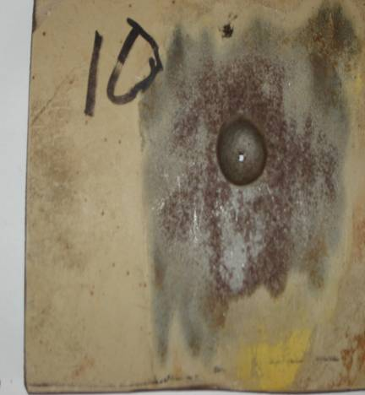
Case Study 3: Gas Pipeline
AC Corrosion c2002 – Salt marsh/reed beds
Gas Pipeline
CP Potentials -1.3V
Soil resistivity 8 Ohm m
AC Volts (Uac) ~ 3 to 4V rms
AC Current density (Jac) ~200 to 500A/m²
Pat Lydon

Slide 22
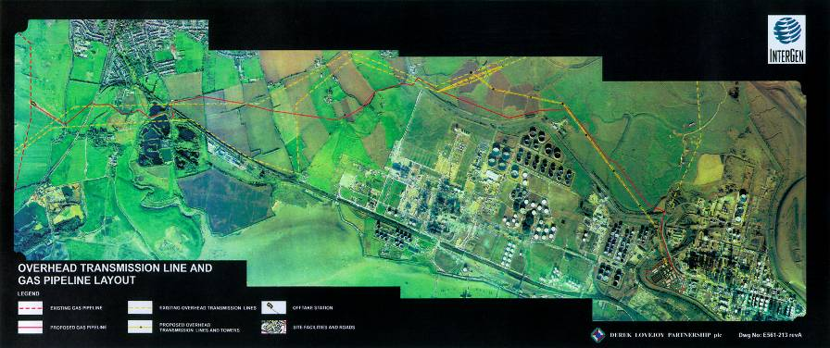
Case Study 3: Gas Pipeline
Pipeline / Power Lines Configuration
AC Corrosion

Slide 23
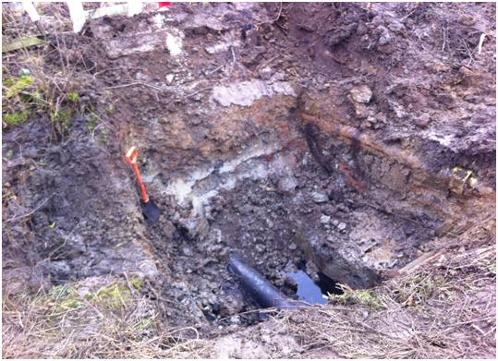
Monitoring Issues
Limitations - Coupons and probes only show what is happening to the coupon or probe. The risk to the pipeline can be inferred from these data if the data is reliable
Surface area of coupons and ER probes may change with time if corrosion occurs and or scales form. Painted coupons almost certainly will. Plastic or epoxy encased are better.
Position of coupon/probe in relation to pipe is critical if soil strata varies – they can dry out.
If more than one coupon at a location then it has double the area – disconnect the other when taking a reading
IR free or remote potentials need to be considered. See informative section of BS EN 15280 – 2013.
Drier
Wet

Slide 24
Concluding Thoughts
AC corrosion can and does occur on poorly coated pipelines e.g. coated with aged enamel or tape wrap coatings.
AC voltages by themselves, do not give a good indication of the risk of AC corrosion. Low resistivity + Power Lines = High Risk.
Understanding the risk should start with an assessment of the pipeline power line alignment followed by more detailed monitoring.
Understanding the limitations of the monitoring technique is crucial.
Using more than one monitoring method improves the reliability of the regime. Using more than one criteria is a sensible precaution.
AC corrosion can be controlled by adjusting the output of the CP system - active control. It may be the only option if the earthing option is restricted by space.
AC current densities can only be reduced using ribbon earthing – passive control.
ER probes provide added confidence that the mitigation regime is effective.

Slide 25
David Eyre d.eyre@penspen.com
+44 (0)208 334 2700
Thank you

