Slide 1

Working safely near high pressure pipelines
Protecting yourself and UK high pressure pipelines

Slide 2
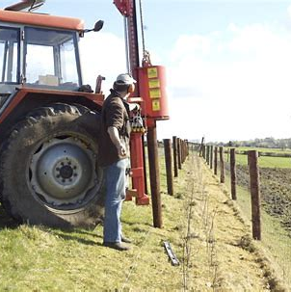
Introduction
i
This short course will demonstrate the importance of working safely near high pressure (HP) pipelines.
Why?
To make sure you stay safe when working near HP pipelines
To protect HP pipelines from damage
To make sure fuel and gas supplies are not interrupted
To protect the environment
To make sure you know what to do if a pipeline is damaged

Slide 3
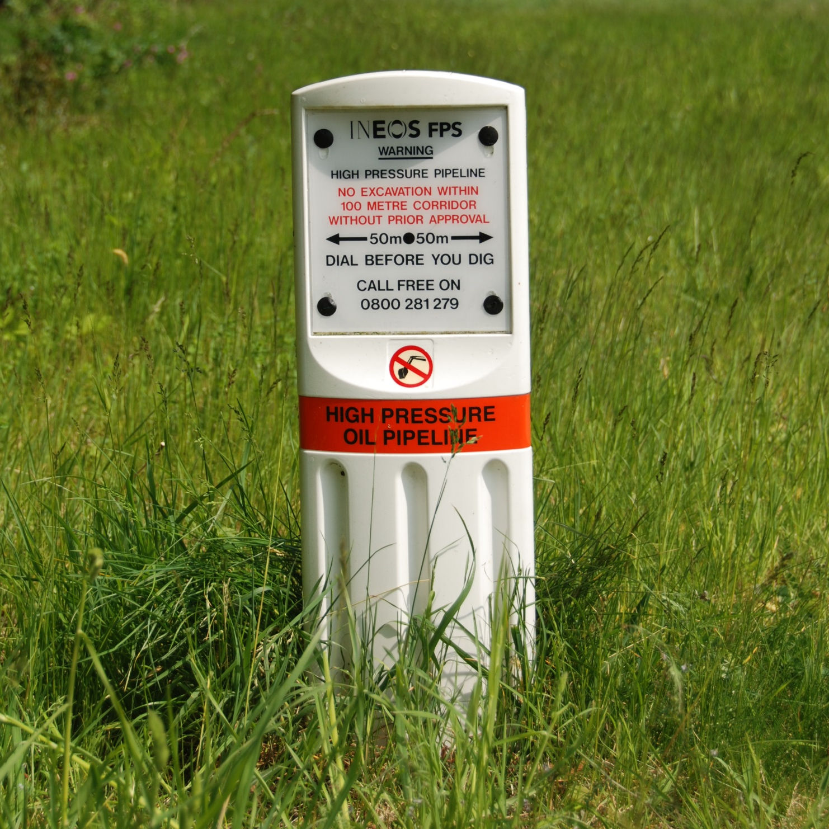
Learning outcomes
Following this presentation, you should have enough knowledge to understand:
How you can find out if there is a HP pipeline in the area where you want to carry out work
Who is responsible for keeping pipelines safe
Types of work you can/cannot carry out near a HP pipeline
How you can work safely near a HP pipeline
What you must do in an emergency situation or if a pipeline is damaged

Slide 4
UKOPA Overview
UKOPA
is an industry
group comprised of
30 UK onshore
HP pipeline
operators
It provides a recognised and authoritative view on strategic issues relating to safety management, operations and integrity management of hydrocarbon (gas, crude oil and petrochemical) pipelines
The length of
pipelines operated by our members is nearly 30,000km
(nearly 5 times the distance between London and New York)
It produces Good Practice Guides and Technical Bulletins and carries out research to support the industry

Slide 5































UKOPA Organisation
Chairman
Secretariat
Board of Directors
Members
International Associates
Technical Consultants

Slide 6
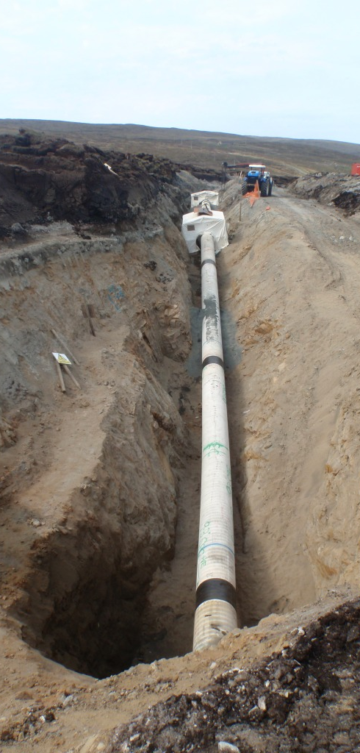
High pressure pipelines
HP pipelines are the most efficient and safest way to transport large quantities of hydrocarbon products over large distances.
They transport hydrocarbon products including gas, crude oil and petrochemicals
HP pipelines are predominately made of steel
HP pipelines are wrapped in a protective coating (which can easily be damaged)
They are nominally laid at 1.1 mtrs deep (although this might vary)
They can be anything from approximately 6” to 42” in diameter
They operate at up to 120 bar - approximately 50 times the pressure of a car tyre
They run cross country (through farmland, under roads and rivers)
Most of us are unaware that they are there

Slide 7
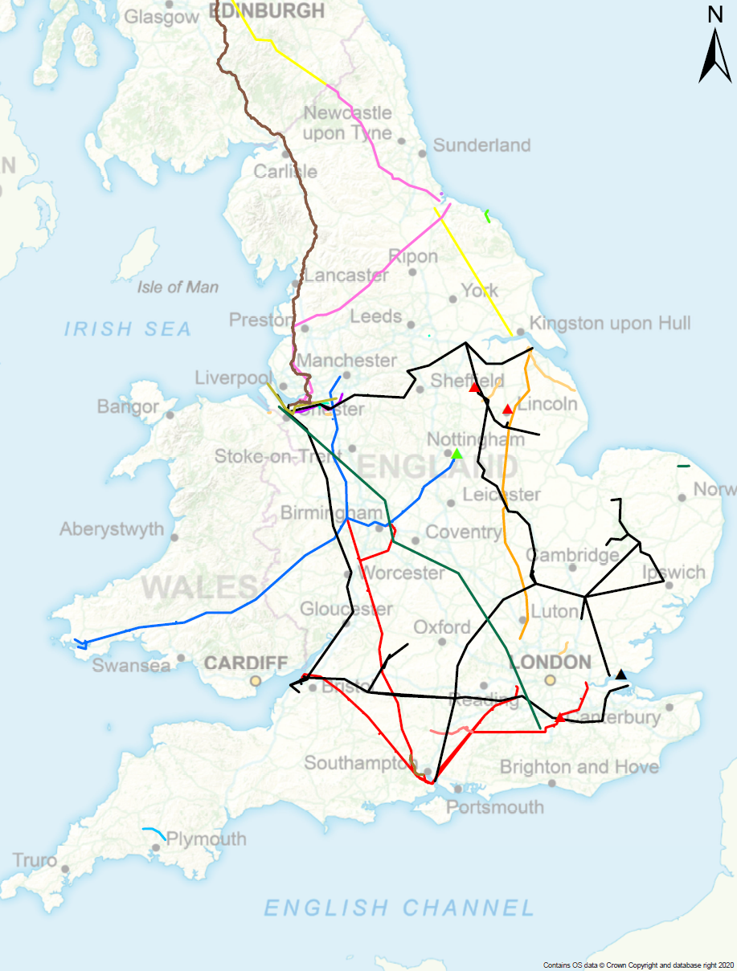


Sample pipeline routes
Length of pipelines operated:
Nearly 30,000km (nearly 5 times the distance between London and New York)

Slide 8
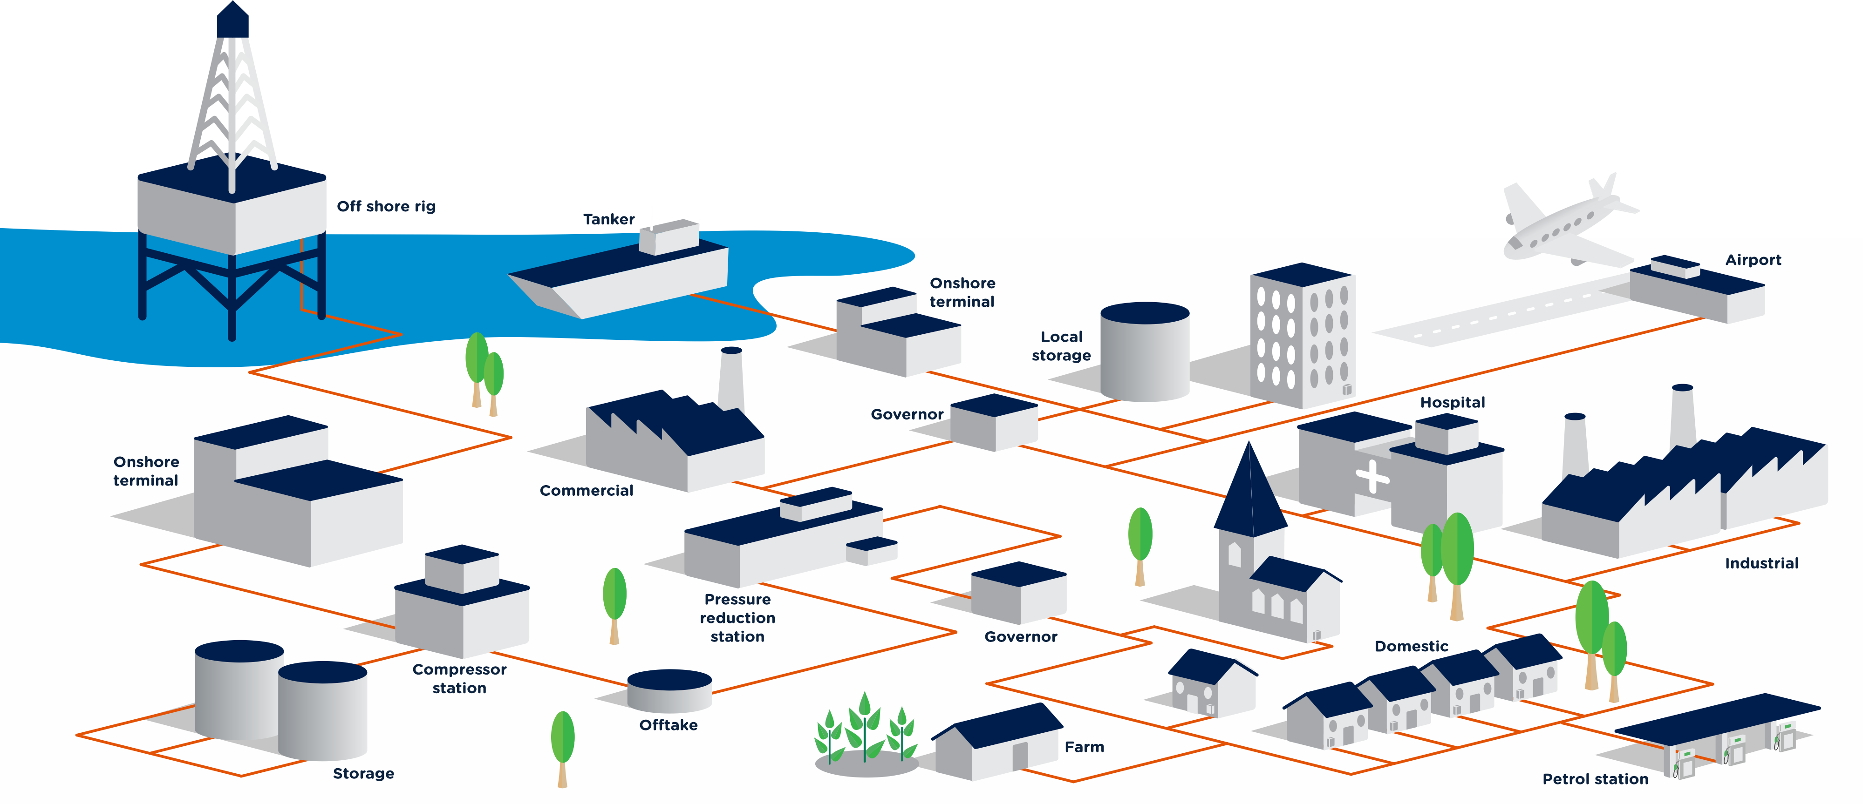
UK’s HP pipeline network –
The fuel and energy to keep the UK running

Slide 9
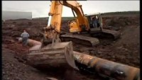
https://www.youtube.com/watch?v=itacNeMqEXU
Notes:
https://www.youtube.com/watch?v=itacNeMqEXU

Slide 10
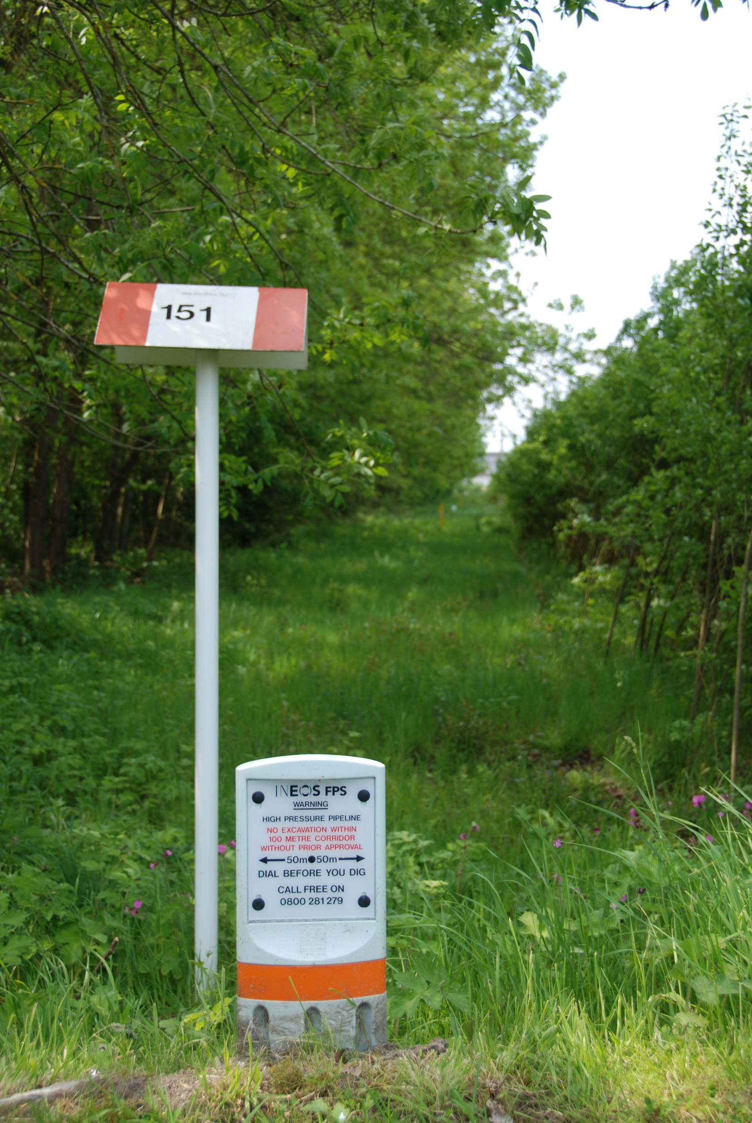
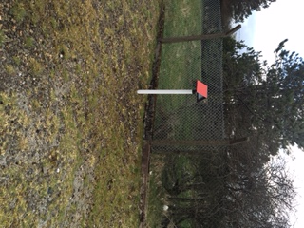
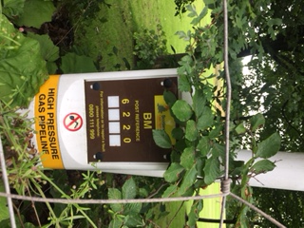
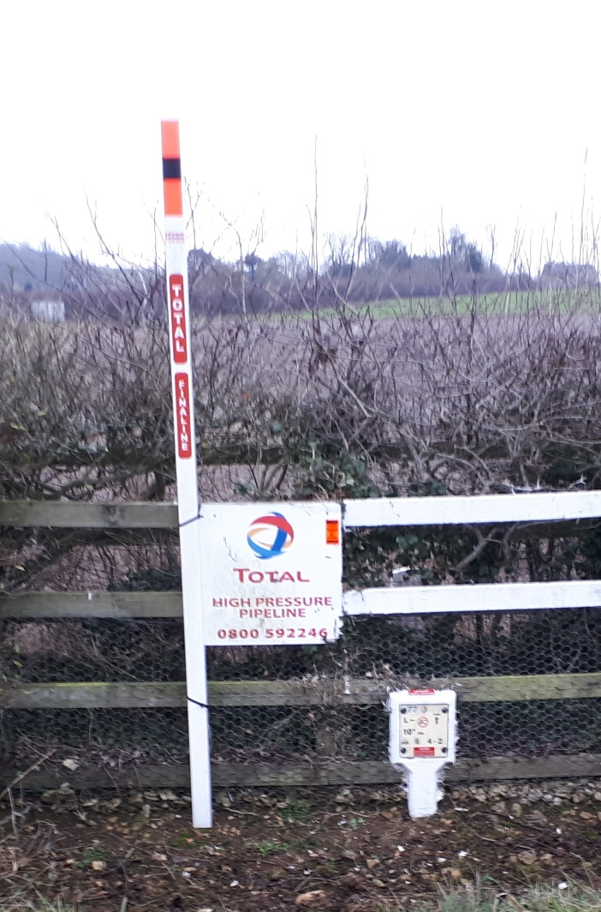
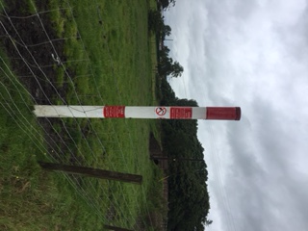
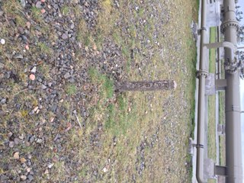
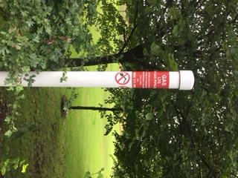

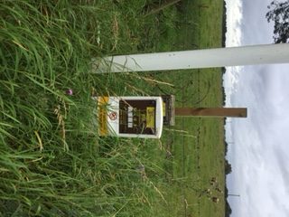
How to spot a pipeline marker
Typical HP pipeline markers

Slide 11
Keeping the pipelines safe: the operator responsibilities
Regulation 16 of the Pipeline Safety Regulations 1996 states
‘for the purposes of ensuring that
no damage is caused to a pipeline,
the operator shall take such steps to inform persons of its existence and whereabouts as are reasonable.’
Pipelines Safety Regulations include:
      Network condition monitoring and maintenance
      Network pipeline plant protection and landowner liaison

Slide 12
Keeping the pipelines safe: other peoples’ responsibilities
The Pipeline Safety Regulations 1996 has a complementary regulation relating to all people regarding pipeline safety
Regulation 15 of the Pipeline Safety Regulations 1996 states ‘No person shall cause such damage to a pipeline as may give rise to a danger to persons.’
!
It is everyone’s responsibility to ensure that HP pipelines are not damaged

Slide 13
Keeping the pipelines safe: the landowner responsibilities
There will be an agreement between landowner and pipeline operator detailing responsibilities
Landowner responsibilities:
Allow the pipeline operator access to its pipeline/s at all times
Contact pipeline operator as early as possible when you are planning works
Don’t damage the pipeline and take all reasonable precautions to prevent damage
Don’t reduce the soil above the pipeline and don’t affect the support around the pipeline
Don’t build any structure on or erect any permanent apparatus on or near the pipeline
The landowner always has ultimate responsibility but anyone working on their land should check they have made the necessary enquiries before starting any work
!

Slide 14

Keeping the pipelines safe: the law
The Health & Safety Executive (HSE) is responsible for enforcing health and safety law with regard to high pressure pipelines.
HSE could do any / all of the following
Work with pipeline operators to ensure they comply with the law
Comment on planning applications
Lead investigations into damage to pipelines
Prosecute offenders
It’s against the law to damage pipelines!
!

Slide 15

https://www.youtube.com/watch?v=VMhI1qG_qso

Slide 16
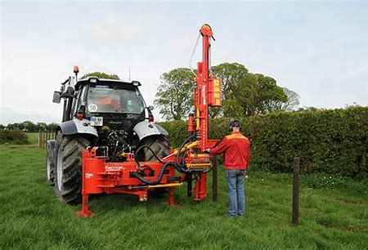

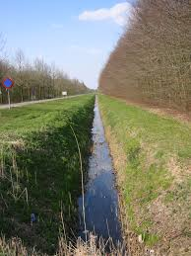
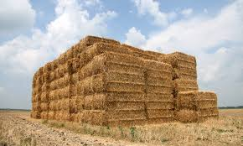
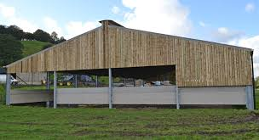

Types of work you can/cannot carry out near HP pipelines
Would you contact the pipeline operator first?

Slide 17
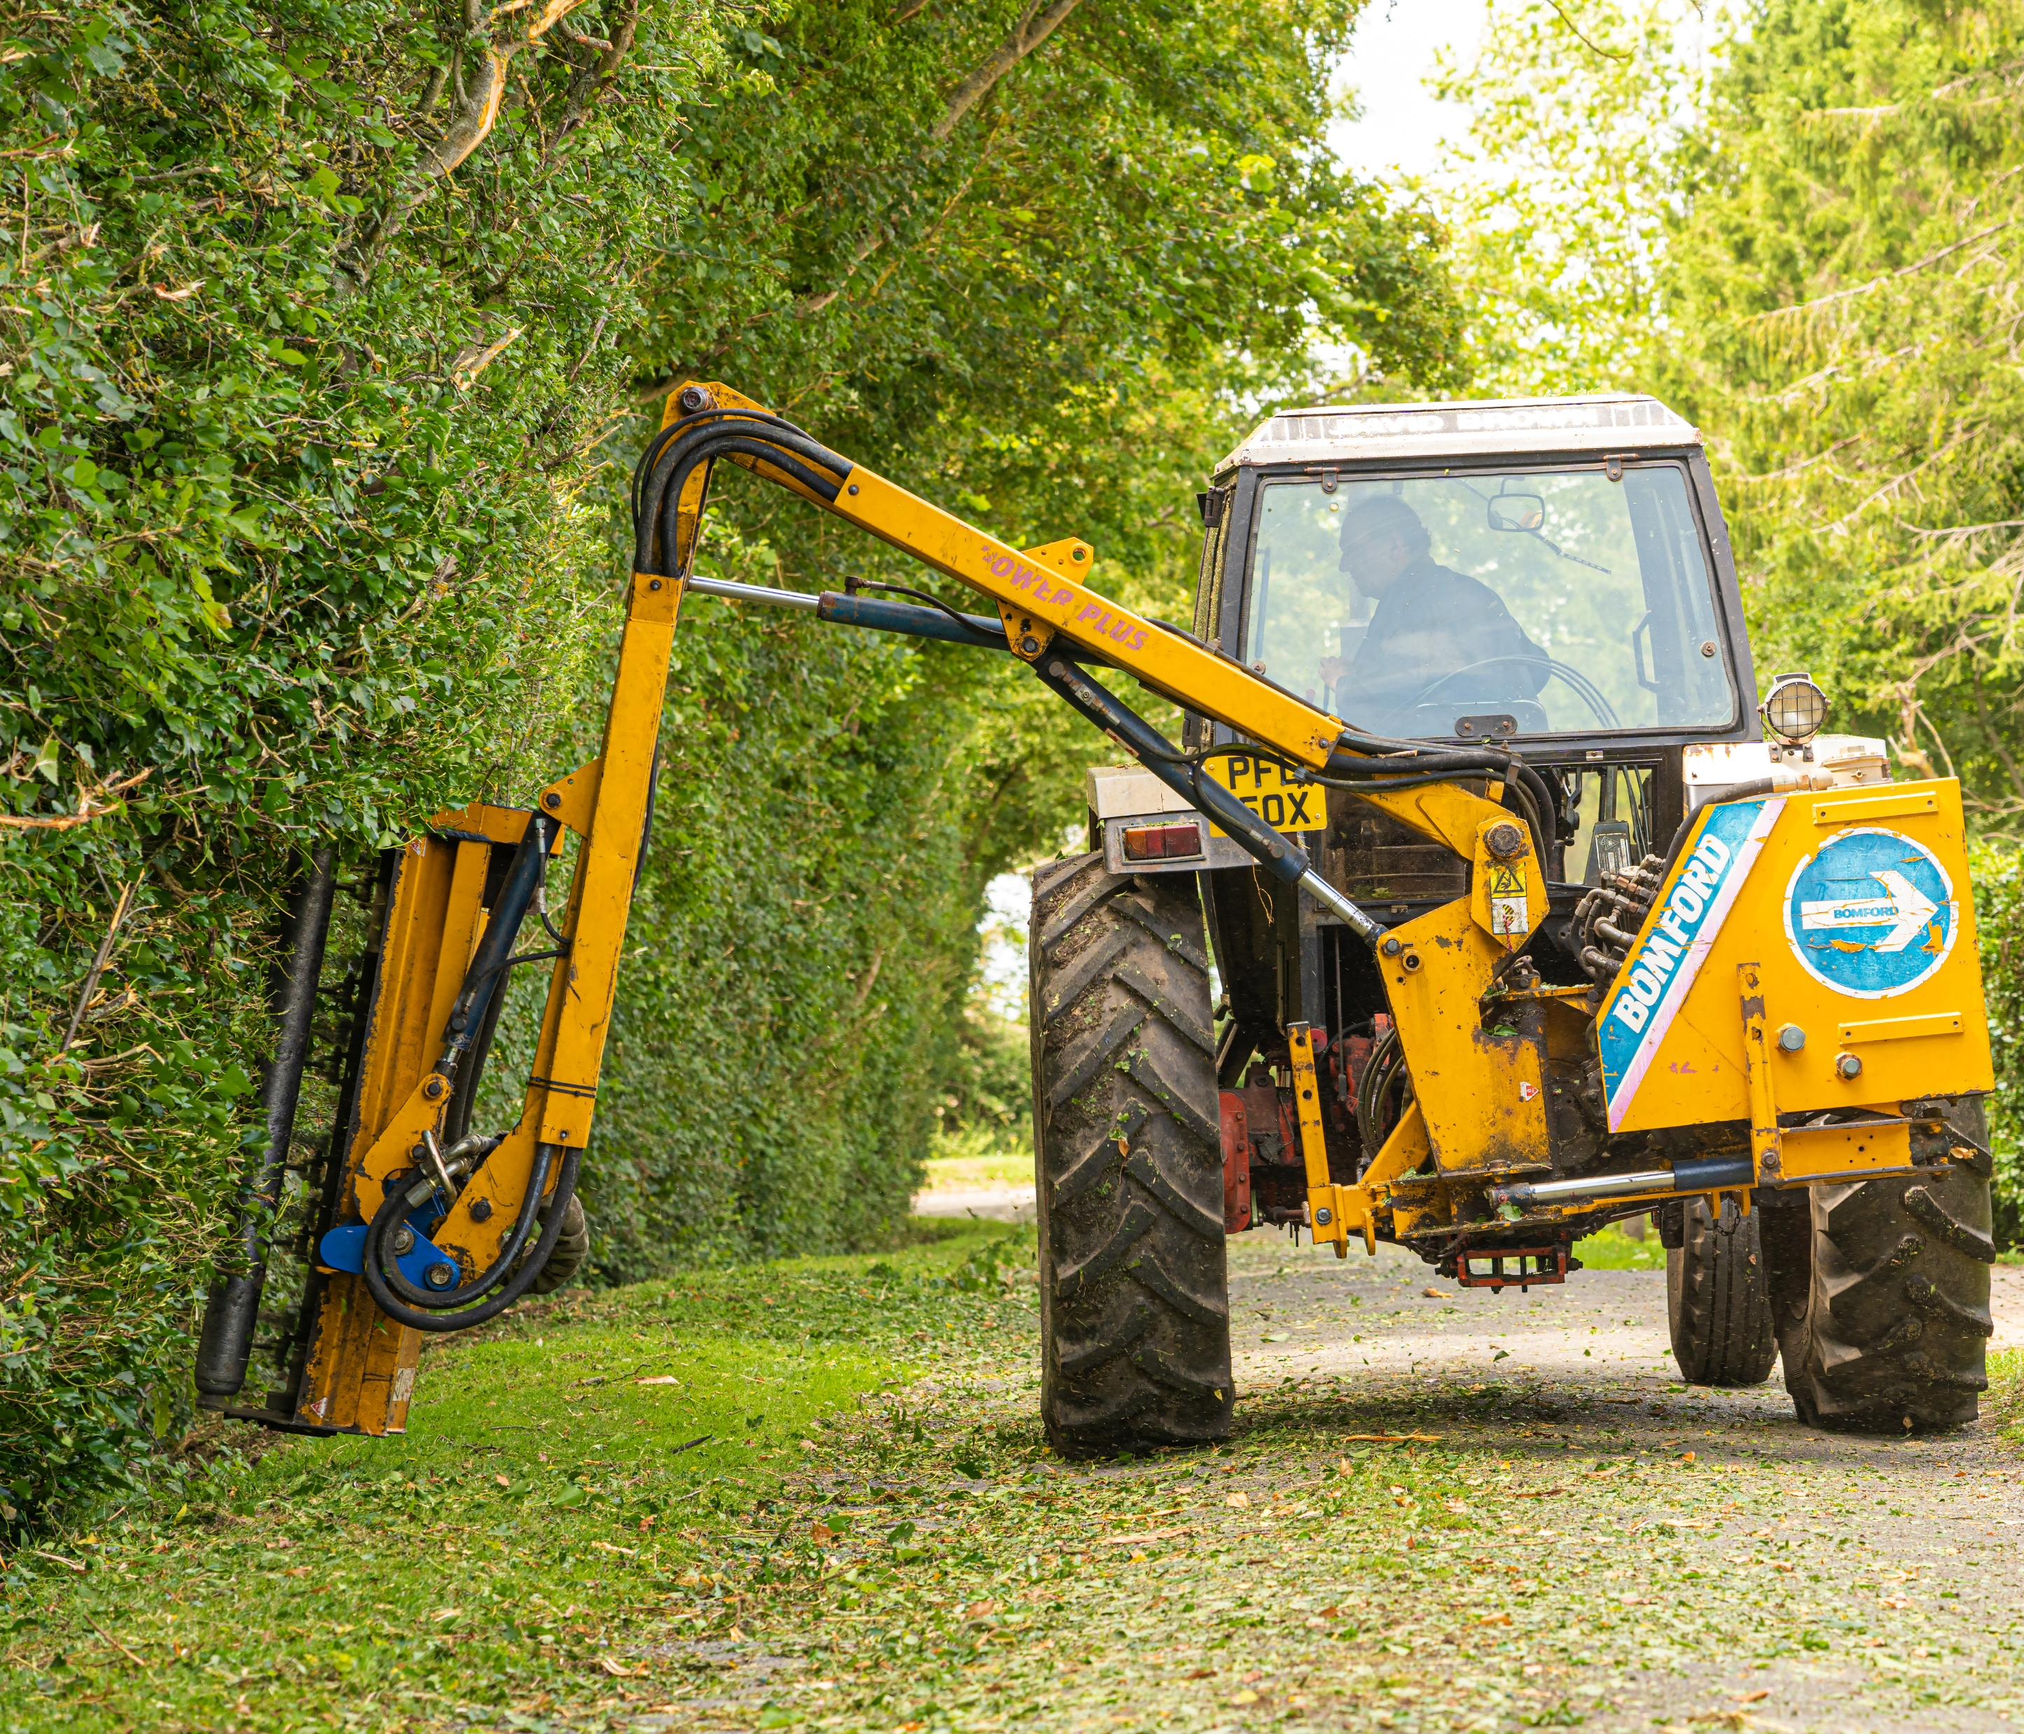
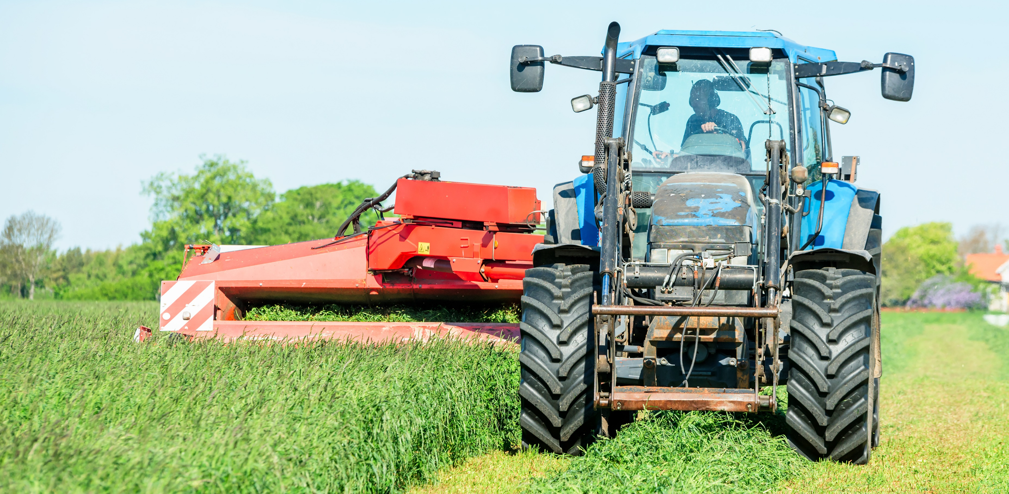

What can you do

Slide 18
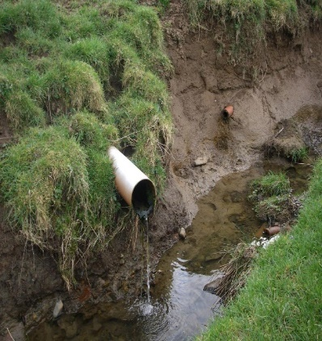
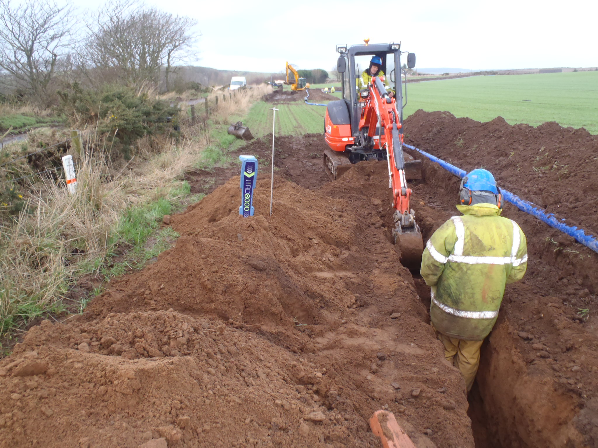
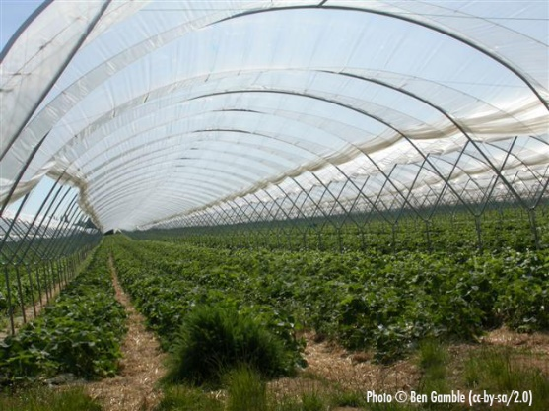

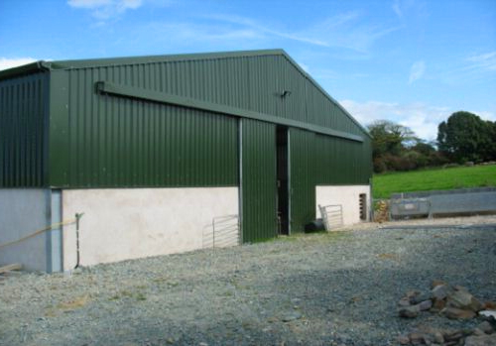

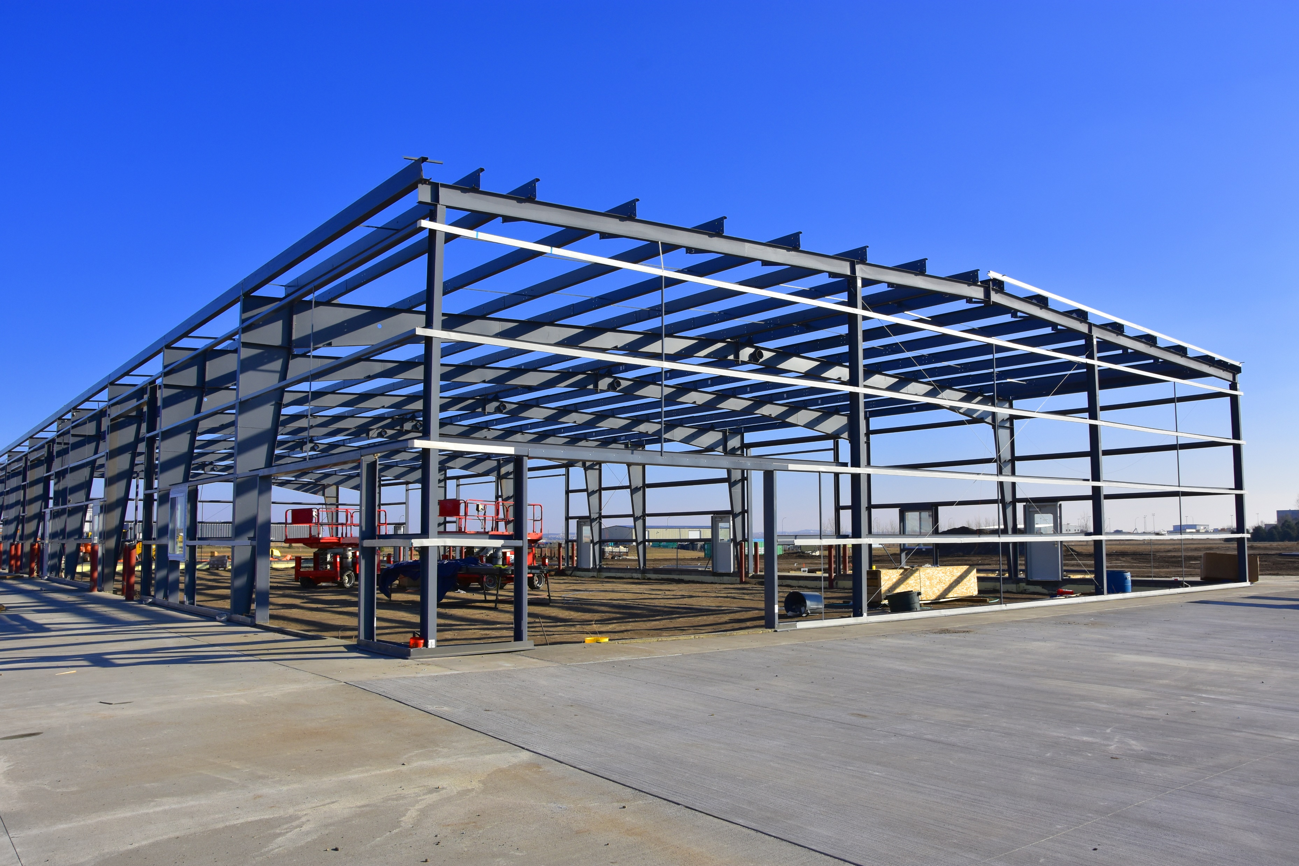

What can’t you do (contact operator first)

Slide 19
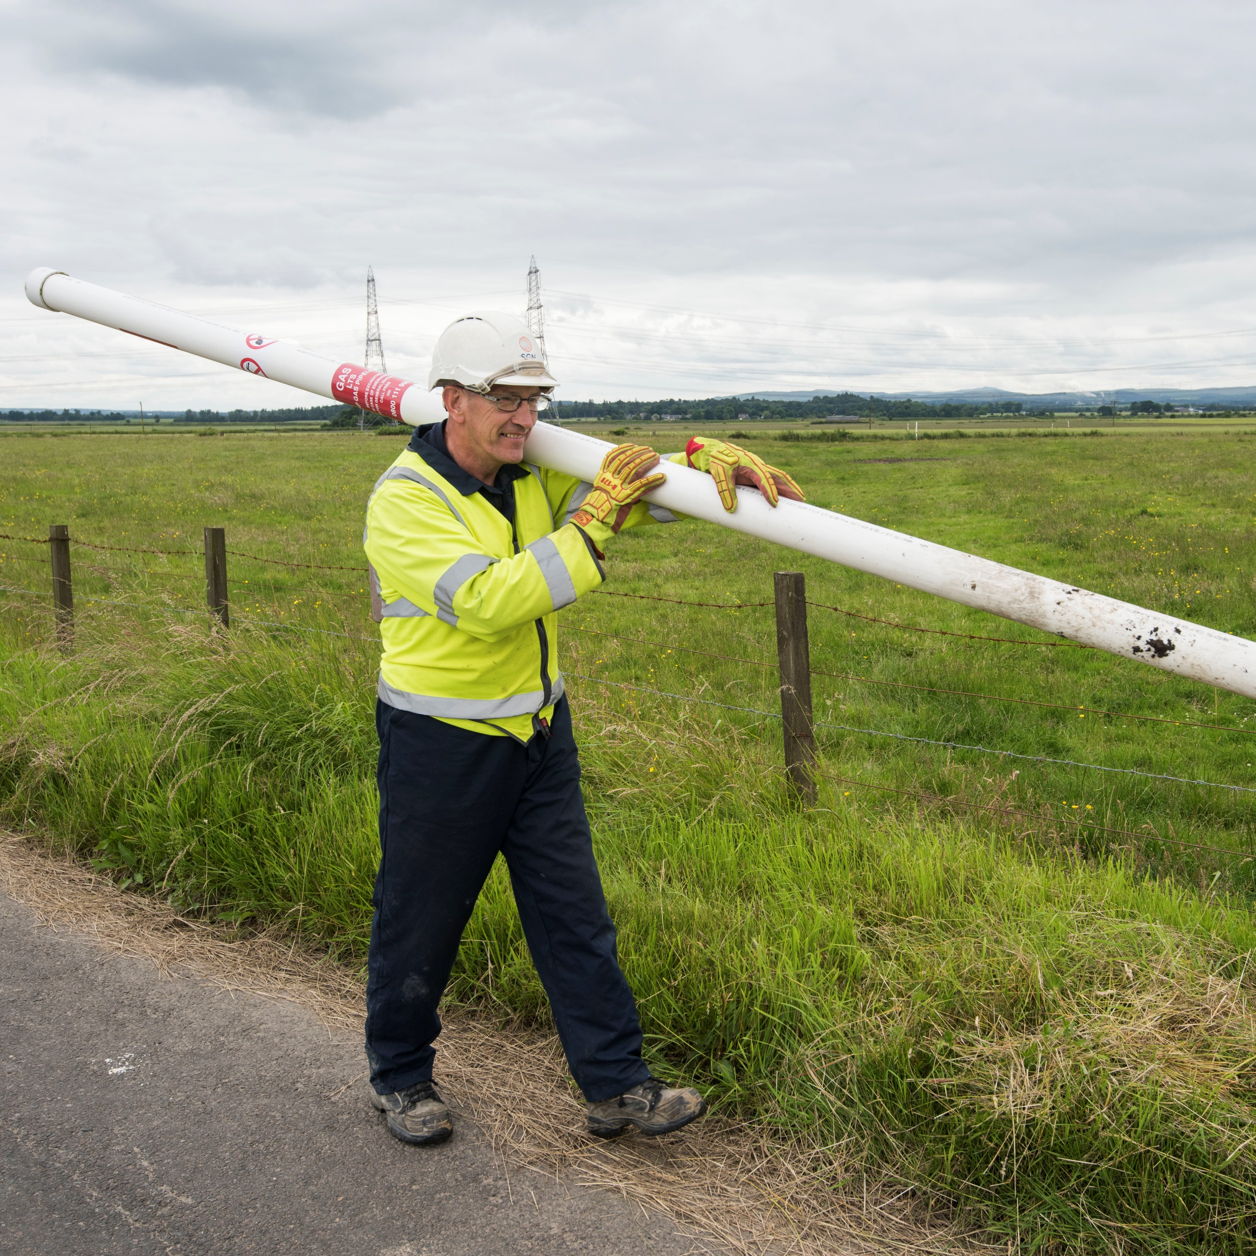
Contacting a pipeline operator
Pipeline operators engage with landowners on a regular basis, including:
    an annual letter
    prior to any line walking taking place
    Before any other works are conducted
Pipeline operators contact details will be on maker
posts that are found on field boundaries, where
pipelines change directions and road crossings
Contact details are also included on any
communications received from pipeline operators
On the pipeline operator website
Please contact the pipeline operator prior to
undertaking work, operators services are
(normally) free of charge

Slide 20
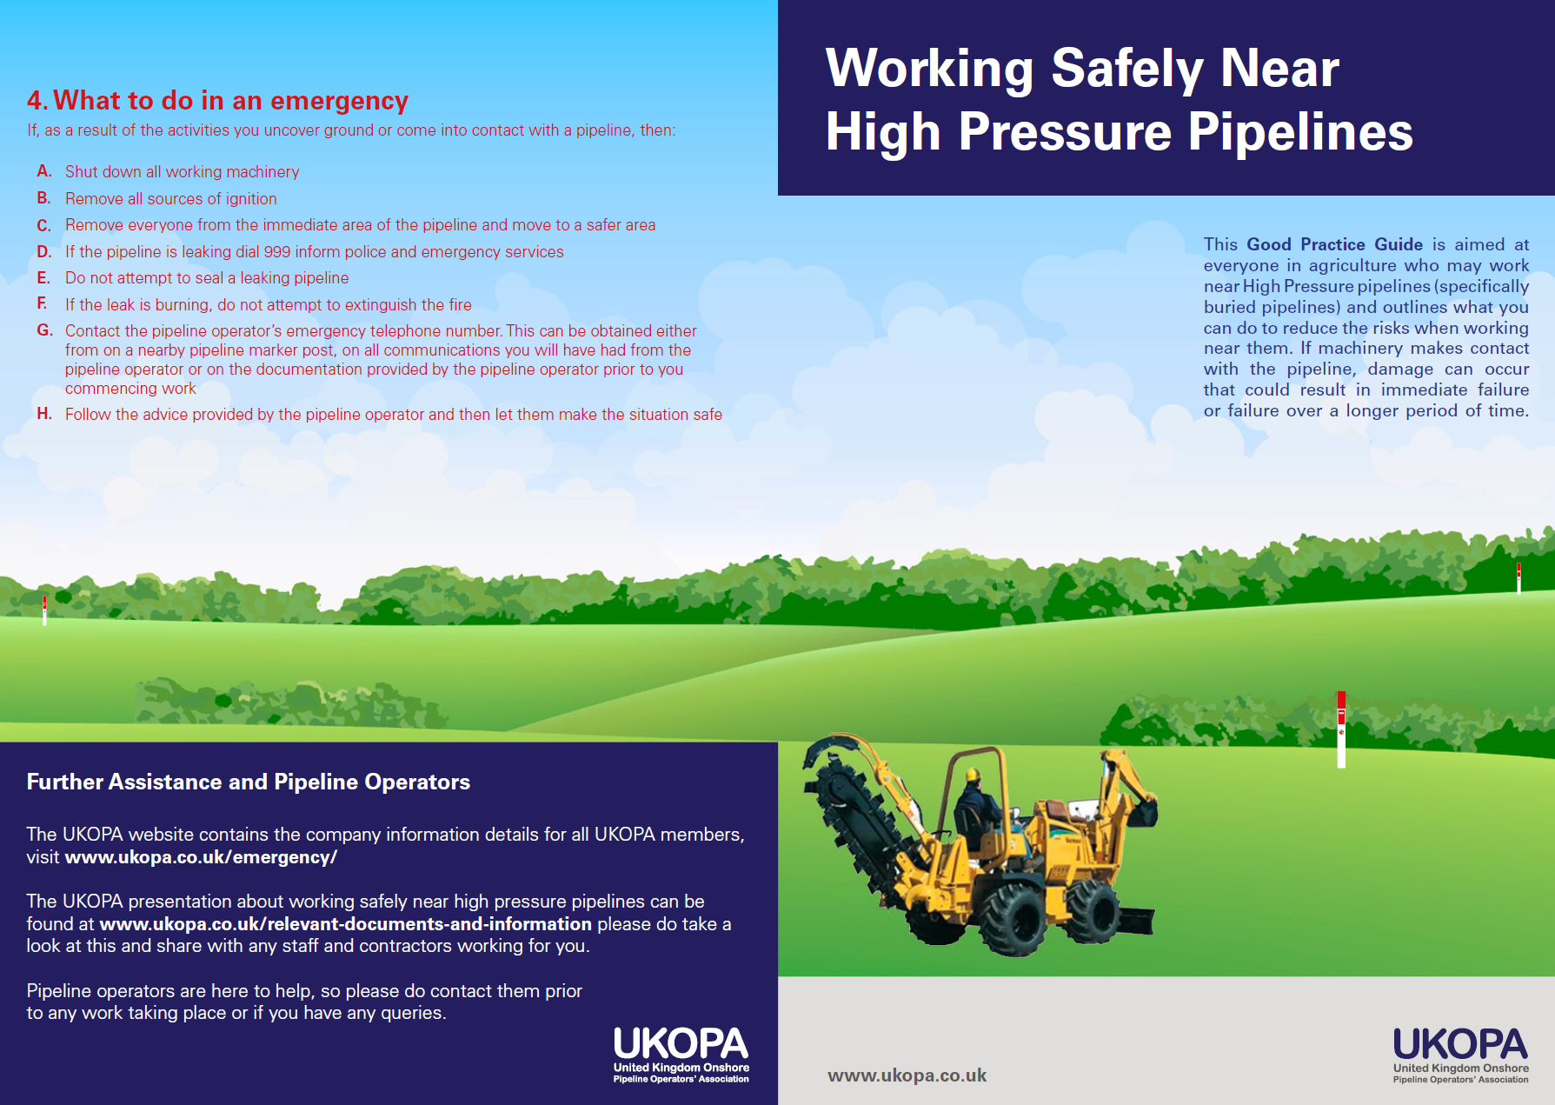
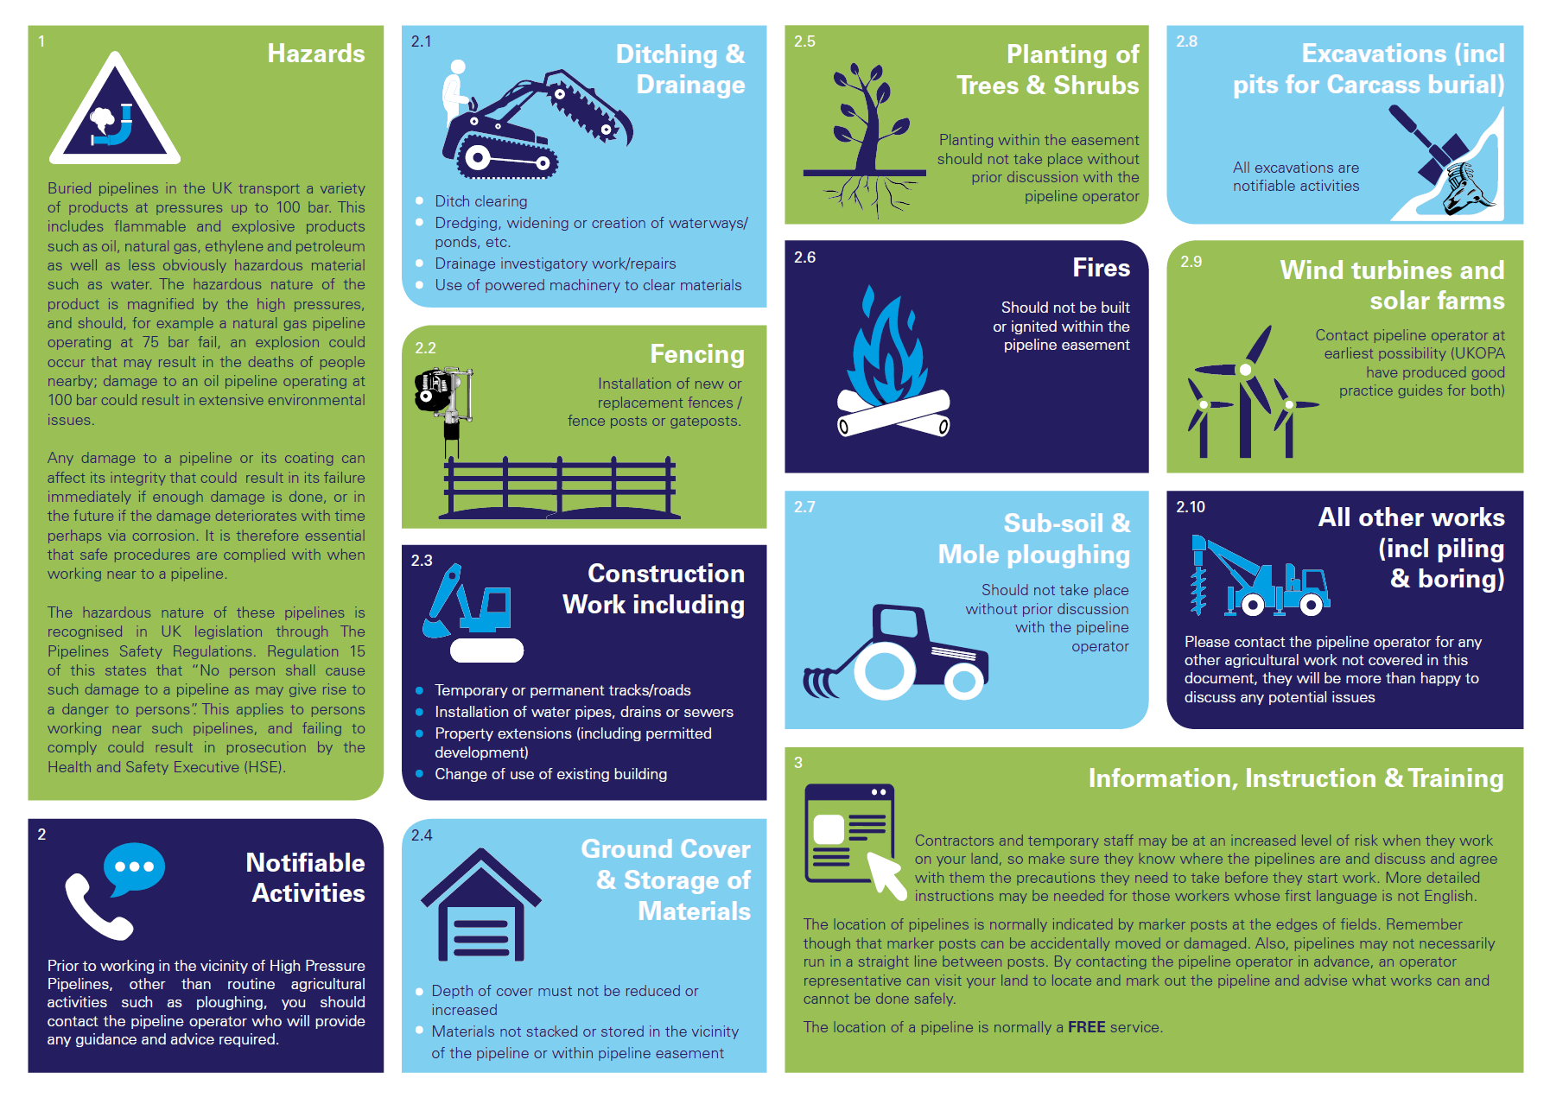
Working safely near HP pipelines
https://www.ukopa.co.uk/wp-content/uploads/2021/03/Agricultural-Working-Safely-2019.pdf

Slide 21
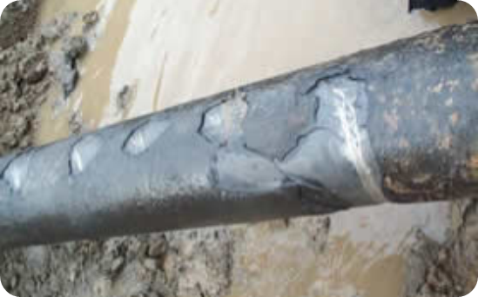
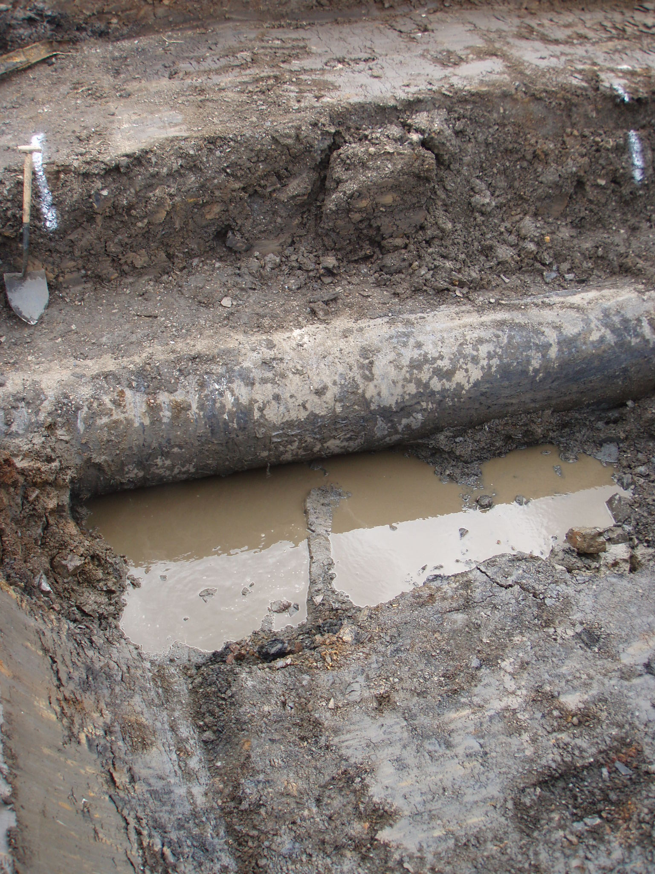
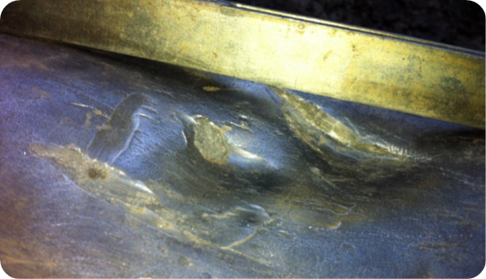
What you must do if a pipeline is unearthed or damaged – contact the pipeline operator
Types of damage:
breaks
scrapes
piercing
dents
damage to the
pipeline coating

Slide 22
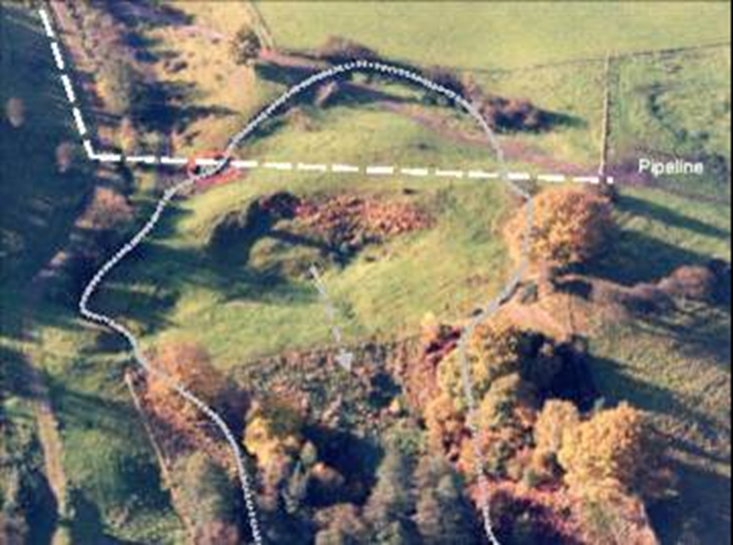
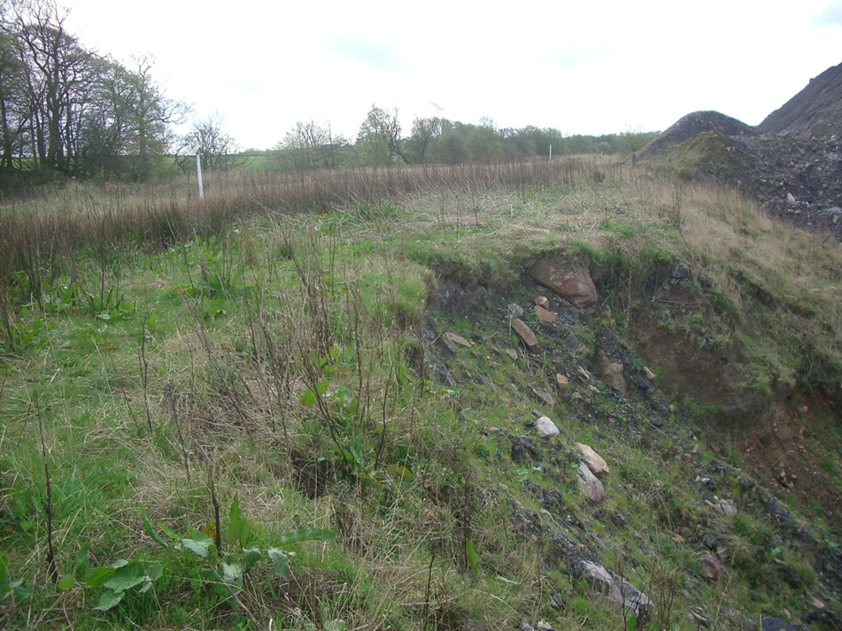
Examples of other potential issues – please inform the pipeline operator

Slide 23
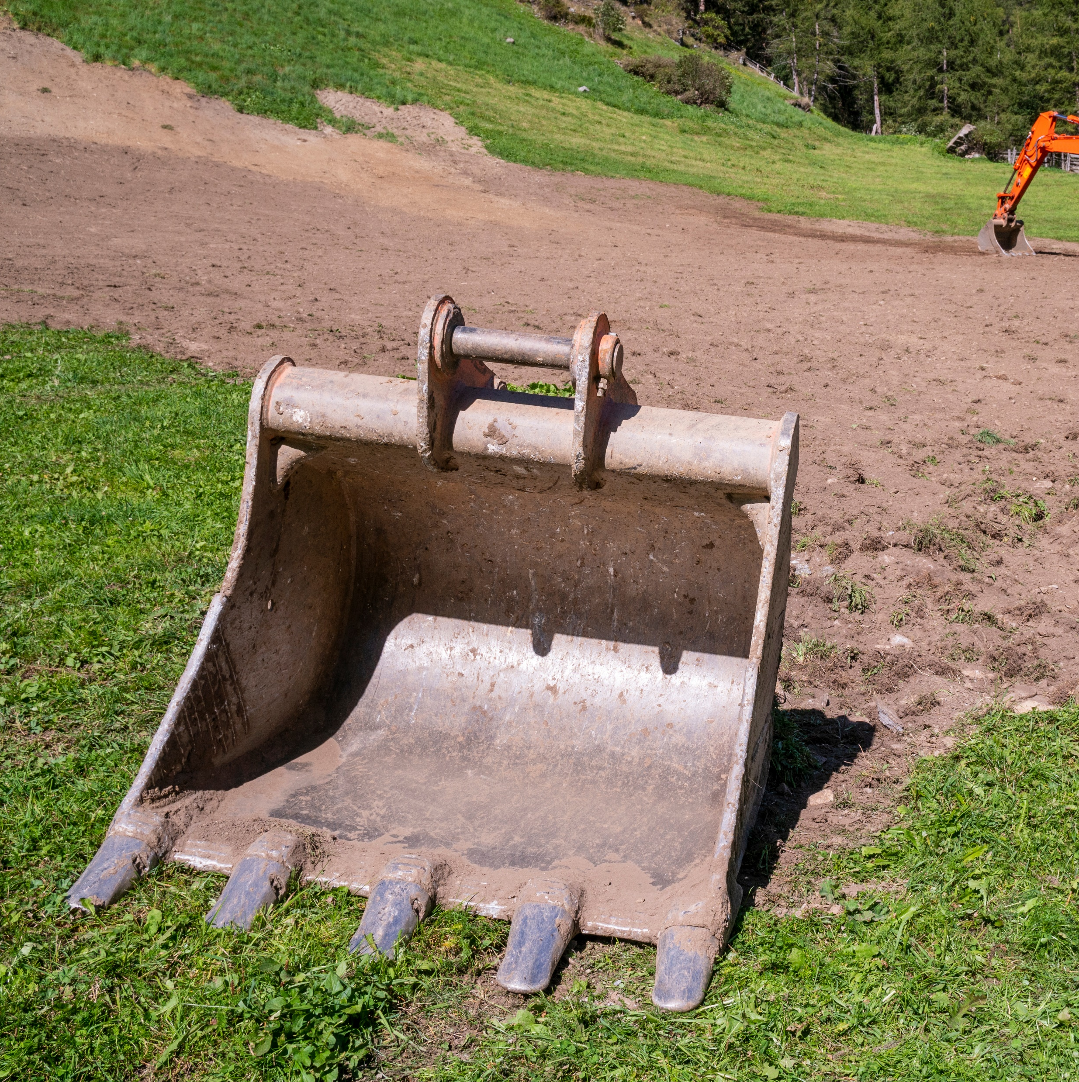
What should you do?
What you must do if a pipeline is damaged:
Shut down all working machinery
Remove all sources of ignition
Remove everyone from the immediate area of the pipeline
If the pipeline is leaking dial 999 inform police and
emergency services
Do not attempt the seal a leaking pipeline
Contact the pipeline operators emergency number (on all documentation you will have received from the pipeline operator prior to work commencing)
Follow advice provided by the pipeline operator and let them make the situation safe

Slide 24
https://www.youtube.com/watch?v=ZkEXfa2AMY0

Slide 25
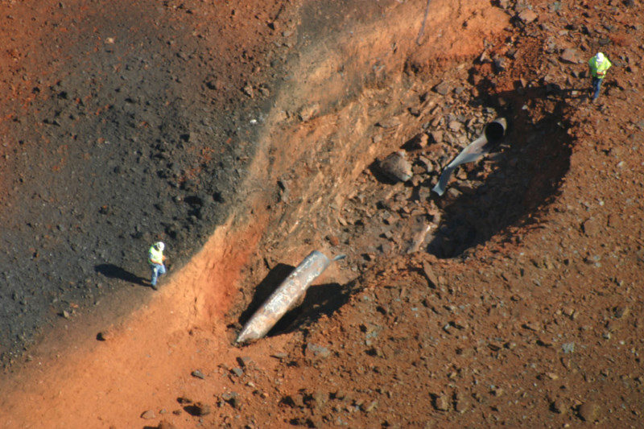
USA pipeline rupture Sept 2008

Slide 26
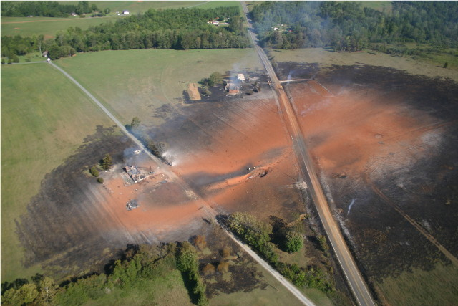
USA pipeline rupture Sept 2008

Slide 27
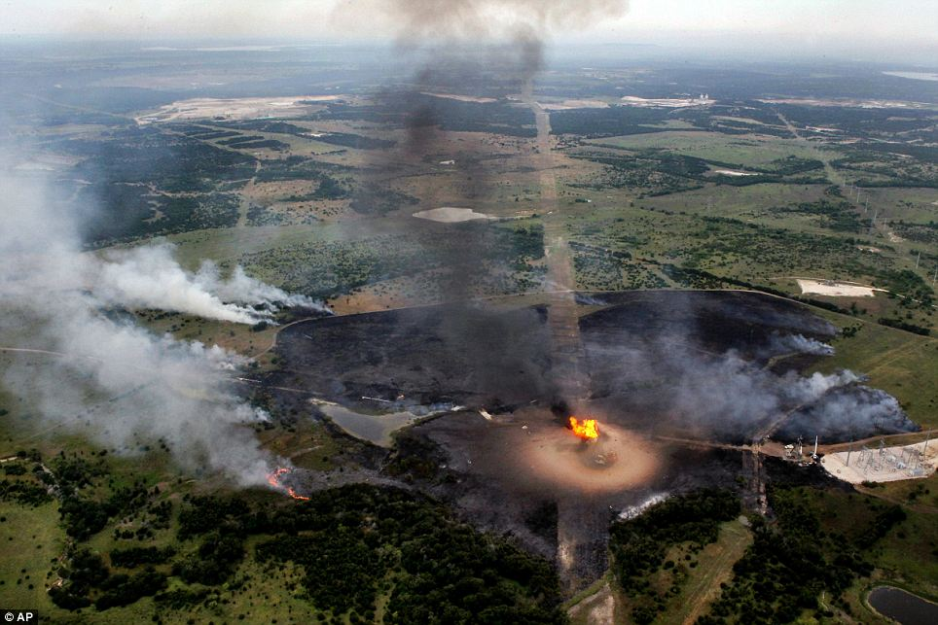
Texas third party damage 2010

Slide 28
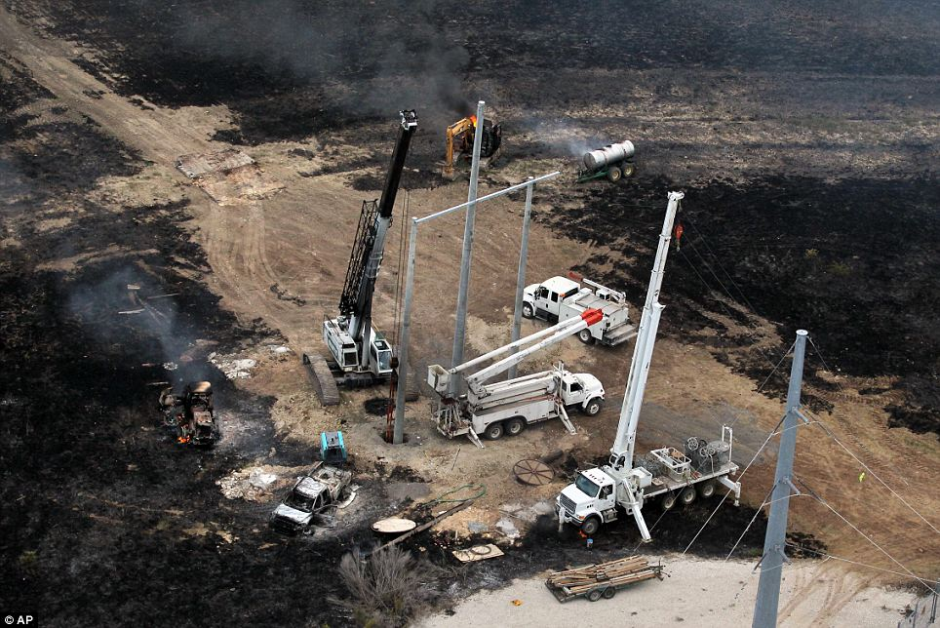
Texas third party damage 2010

Slide 29

https://www.youtube.com/watch?v=RSCz-35M9hA&t=5s

Slide 30
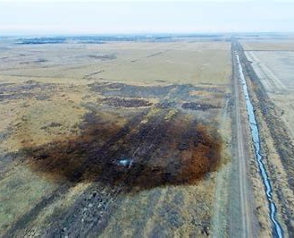
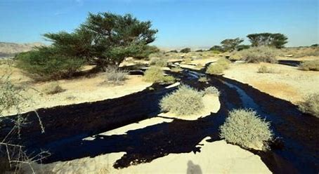
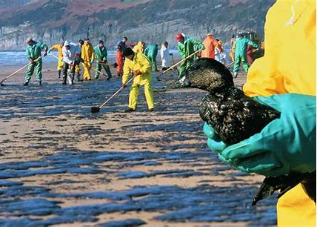
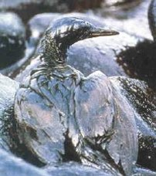
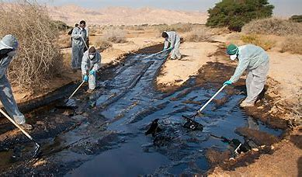
Environmental issues

Slide 31
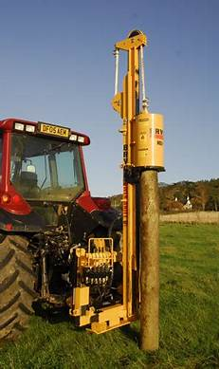
Protecting yourself:
Damage to pipelines can have serious consequences
Check with the pipeline operator before you start any work
To avoid:
Death or injury to yourself or others
Disruption to UK Fuel supplies (gas, crude oil, etc) – claims for compensation
Claims for costs to repair the pipeline damaged
HSE investigations – prosecution and fines for the contractor and the landowner
Environmental issues and the costs associated (which can be >£1M)

Slide 32

How to find out if there is a HP pipeline in the area where you want to carry out work
Check on line before you
start any work
Pipeline operators website
linesearchbeforeudig.co.uk/
These
are free
services

Slide 33
Statistics
UKOPA records the number of infringements that occur near HP pipeline on an annual basis
The
average number of infringements that occur each year is
780
Over half of all infringements occur in farmland / private land
These are mainly attributed to fencing, ditching, drainage and excavation work
Pipeline operators want you to contact them prior to any work taking place near HP pipelines

Slide 34
Remember
If you do
damage a pipe and/or
cause a leak/explosion
Immediately telephone
the Emergency Services on
999

