Slide 1
PIWG – Feedback From Strategy Workshop
PIWG 15 008
Graeme Pailor
PIWG Chairman

Slide 2
What did we do?
Decision support tools
Classification of Pipeline Damage
Inherent threats / pipeline damage
Maintenance frequency
Pipeline revalidation
New repair methods
New threats / failure modes
Cost effective maintenance
Asset life extension
Management of change / mods / repairs
Notes:
The audience were divided into 5 groups and asked to discuss a series of topics based on a number of specific questions
Group 1 - Website / Communication / LinkedIn and UKOPA New Pipeline Engineers Group.
Group 2 – Competency Framework / Standards / Training Support
Group 3 - Engineering Governance / Input into Standards Good Practice / R&D Collaborations / Specialist support
Group 4 - Non-Pigable pipelines / End of Life pipelines / ILI - state of the art / Repairs
Group 5 - Local Authority Planners Proactive Liaison (including defence when planning process fails)

Slide 3
What were some of the most popular topics?
Establish end of life methodolgy (including coatings)
Good practice for unpiggable pipelines
Repair
Relate maintenance frequency to probability of failure
Guide for I-L-I and non-piggable solutions
  Etc. etc.
Notes:
What is apparent from the feedback –
Terminology – different people mean different things for the same word
Life cycle aspects
At a high level, asset management strategy – ISO55000

Slide 4
Context – PIWG Terms of Reference
Act of behalf of UKOPA Members as the expert body on pipeline integrity and defect assessment issues.
Support, on behalf of member companies, the development and acceptance of appropriate good practice for pipeline integrity management and defect assessment.
Provide the specialist / expert point of contact for UKOPA internal and external communications on pipeline integrity / defect assessment issues.
Provide a formal UKOPA interface with HSE for discussions on pipeline integrity related issues.
Provide a point of focus within UKOPA for commissioning and progressing technical work related to pipeline integrity and defect assessment with external expert bodies and technical specialist organisations including Universities.
Notes:
Note – nothing in here about repairs!!
If we can frame the ToR in the context of a common strategy which everyone has access to then we can start to talk a common language

Slide 5
A useful platform
BS8101-4 lists areas of an Asset Management Strategy:
  Contribute to the design
  Define the system
  Subdivide into segments
  Define the threats
  Identify the failure modes
  Gather likelihood data
  Carry out a risk assessment
  Introduce mitigation
  Carry out process and condition monitoring
  Carry out inspection
  Manage information
Notes:
We need to use what is available and build on it.
The highlighted areas are things that the PIWG is focussed on.
A high level briefing document outlining where the group will focus in the context of this (or any other) asset management strategy will help us to:
Remain focusses on the key areas of interest
Define areas for further work on a proactive basis
Categorise all of the feedback from the strategy sessions

Slide 6
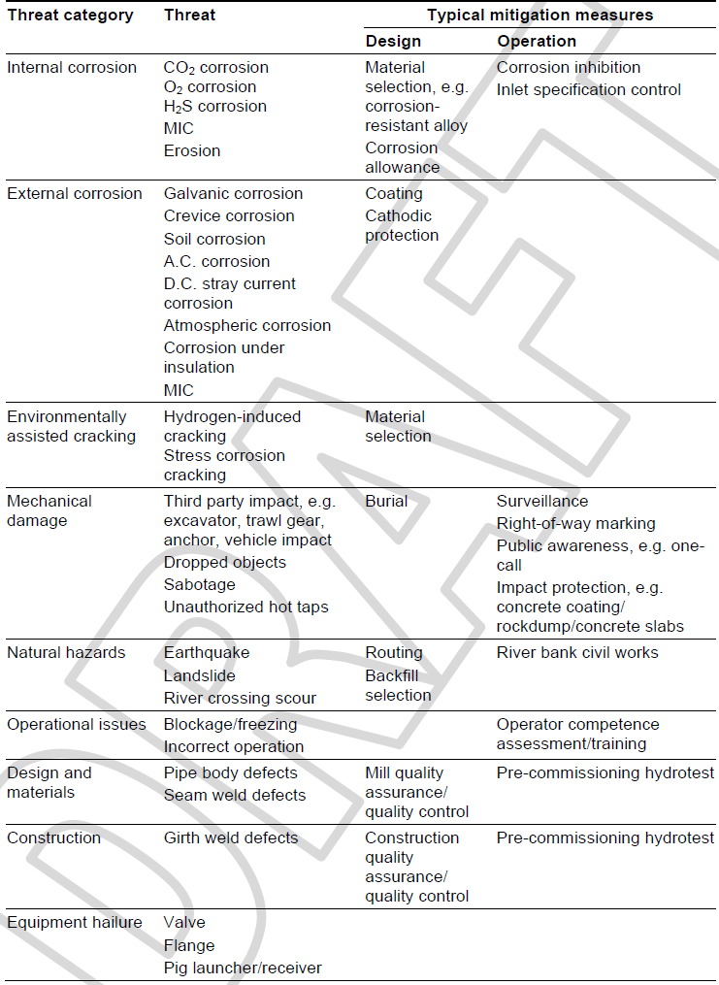

The top-down approach
Identify and Mitigate Threats to Integrity
BS8010-4 gives a list of threats to pipelines and suitable mitigations in design and operation.
The PIMS is associated with on-going operational aspects of mitigation
An example of an extension to the threats list…….
Threat Category | Threat
Mechanical Damage | Unintended, direct (i.e. damage
 | Unintended, direct (i.e. in easement)
 | Unintended, misidentification
 | Intended, theft
 | Intended, sabotage

Slide 7
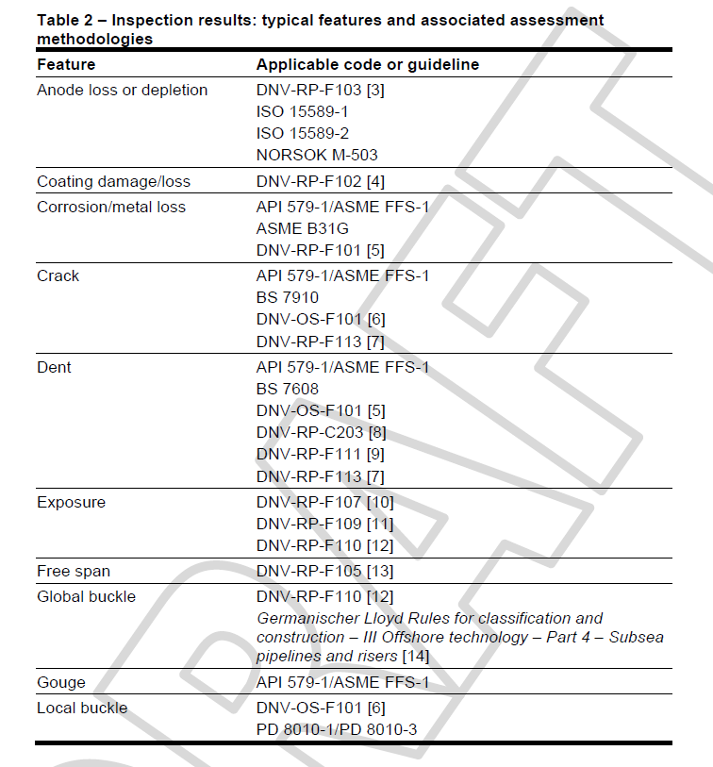
The top-down approach
BS8010-4 also contains a list of defect assessment methods.
Some of the PIWG work expands on this, e.g. dents on welds, dents with fatigue etc.
It is notable that PDAM featured in the feedback on a number of occasions.
Notes:
Keeping these documents up-to-date as live documents will have a number of positives:
For threats, it will be a live document which can be augmented as new threats come to light (e.g. solar farms, DC cable crossings etc. etc.). The list can be used to define priorities going forward both new and proactive.
For Defect assessment, it can be used to highlight gaps and give general advice as new techniques are assessed.
This will cover most of the relevant aspects of asset management strategy at a high level. More detailed documents will sit underneath these.

Slide 8
Detailed Work
R&D work will inform Good Practice Documents:
  Dents
  Sleeves
  Siesmic
  Depth of Cover
‘State of the Art’ reviews can be used to pull together current industry practice
  ILI
  Above ground techniques
  Repair Methods

Slide 9
Discussion?
Notes:
We need to come to some conclusion so that we can show some forward planning back to the members.
Note, the ‘most popular’ topics of Non-piggable, End of Life and repairs need to be included in any plans.
There are detailed work programmes in PRIC and EPRG which may inform what we are doing – how do we access these?
How do we leverage other resource – e.g. a State of the Art review of above ground techniques may be a reasonable dissertation topic for a Masters Student?

