Slide 1
UKOPA Dent Management Strategy
Validation of Dent Fatigue Life Estimation Method
PIWG 15 009

Slide 2
Validation of Dent Fatigue Life Estimation Method - Penspen Report
UKOPA Dent Management Strategy allows use of finite element analysis (FEA) for dent fatigue assessment
FEA allows accurate assessment of the dent shape, the stress field and the stress concentration factor
A study to validate the fatigue life of dents determined using FEA and published SN curves against full scale test data has been carried out by Penspen for UKOPA
The results of the work are documented in Penspen Report 13131-RPT-002, circulated for comment

Slide 3
Full Scale Test Results
  Full scale test data obtained from PRCI sponsored work published at the International Pipeline Conference in 2008, 2010 and 2012:
    2008 12 full scale tests modern X52 & X70 pipelines, 6 restrained plain dents, 6 unrestrained
    2010 – 18 full scale fatigue tests(including 12 from the 2008 paper), 6 restrained, 12 unrestrained, + 16 full scale fatigue tests on dents on welds, 6 restrained, 10 unrestrained, 14 of these dents were located on or within 2” of a girth weld
    2012 – 17 full scale tests, plain dents, X52 material removed from service, 8 restrained, 9 unrestrained
    Errors in description of experimental work were identified and corrected through contact with IPC authors
    Material data for X52 pipe removed from service not available,m modern pip properties assumed

Slide 4
Modelling Methodology
  Indenting, with internal pressure if present in full scale test
    Removal of indenter (assessment of spring-back)
    Initial high pressure cycle (re-rounding)
    Subsequent pressure cycling between 10% - 80% SMYS to achieve material shakedown and stable dent shape
    Single application of internal pressure to model with elastic material to determine fatigue cycle in each dent (as would be applied in analysis of ILI data)
    An iterative approach for estimating the depressurised dent shape is described

Slide 5
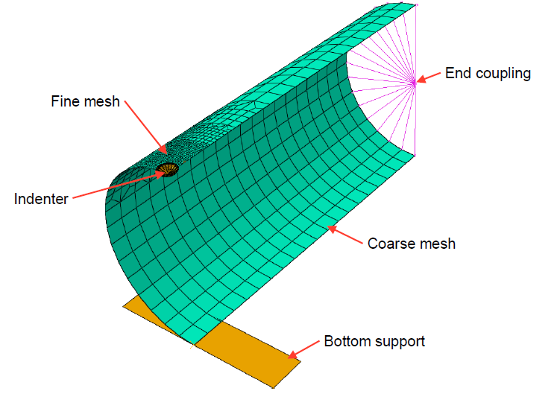
FEA Model

Slide 6
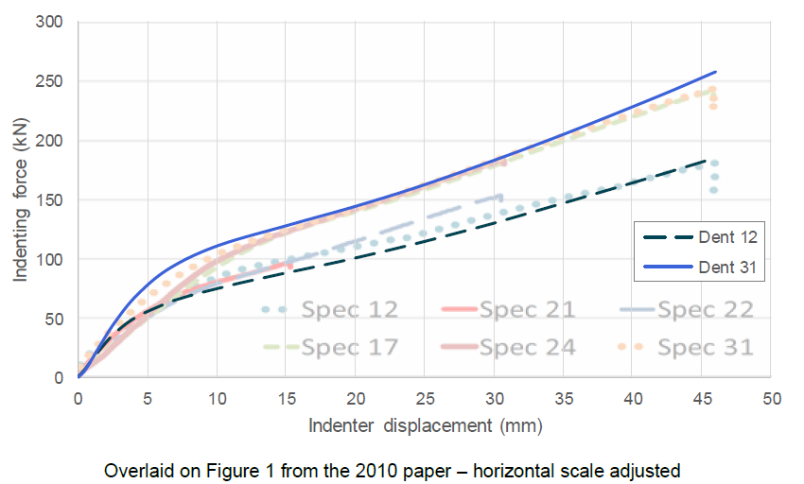
Results – Indenting Force

Slide 7
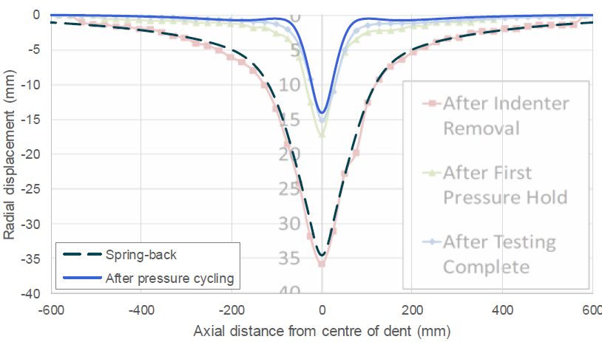
Results – Dent Shape after Spring-back

Slide 8
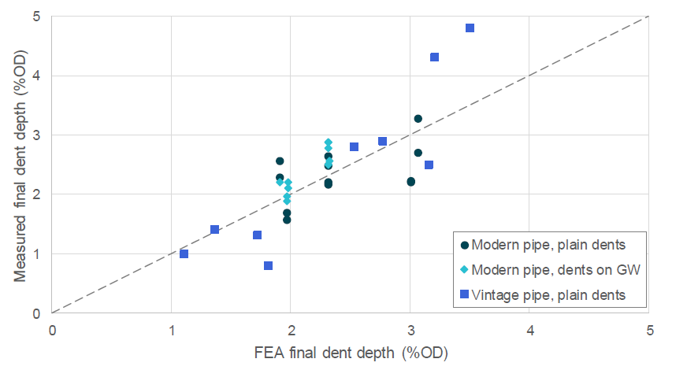
Results – Dent Depth

Slide 9
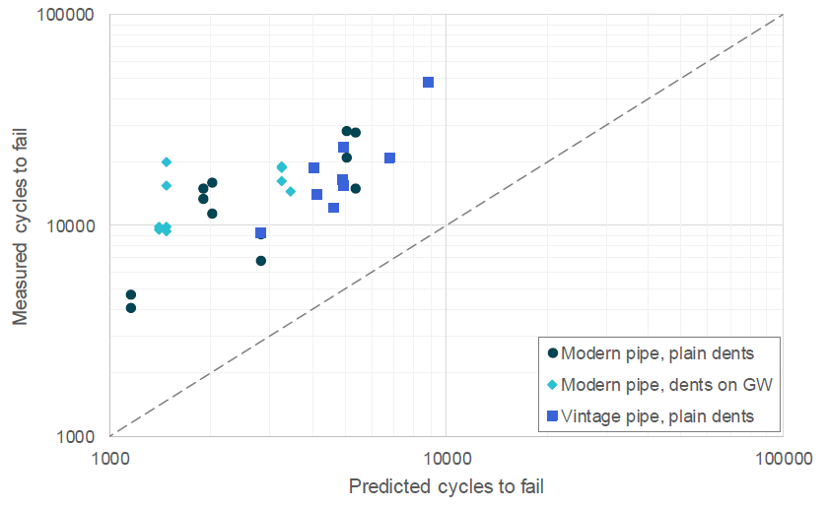
Results – Fatigue Life Predictions

Slide 10
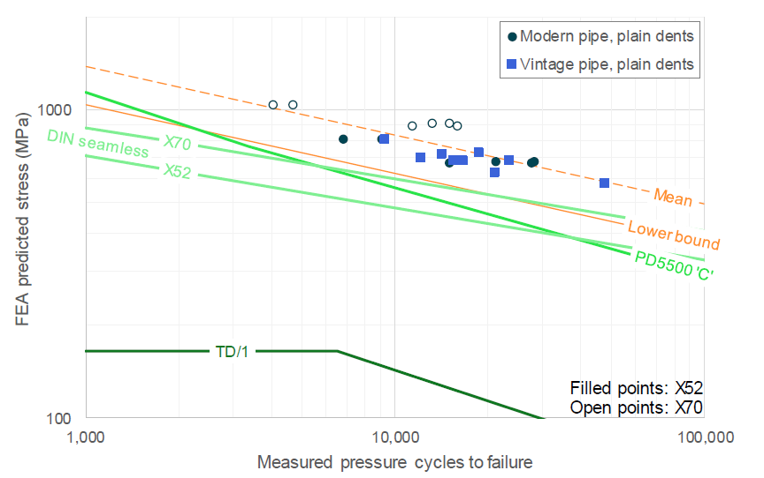
Comparison with SN Curves – Plain Dents

Slide 11
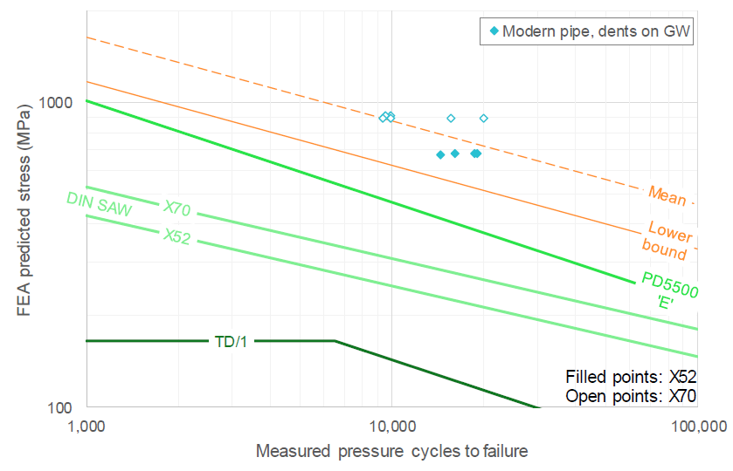
Comparison with SN Curves – Dents on Welds

Slide 12
Findings:
  FEA results show good agreement with full scale test results for material behaviour and dent shape
    Predicted fatigue life is conservative for all dents
    PD 5500 SN ‘C’ curve should be used for plain dents, ‘D’ or ‘E’ for dents on welds
    The work validates the application of FEA in the estimation of dent fatigue life

