Slide 1
UKOPA Dent Management Strategy TooL
PIWG 15 010
25/03/2015

Slide 2
Dent Management Strategy
Flow chart basis for
Spreadsheet tool
Tool to assess dents following ILI
Based on DMS from document UKOPA/14/016
Set of rule allow priority ranking for repair based on cond.
assigned

Slide 3

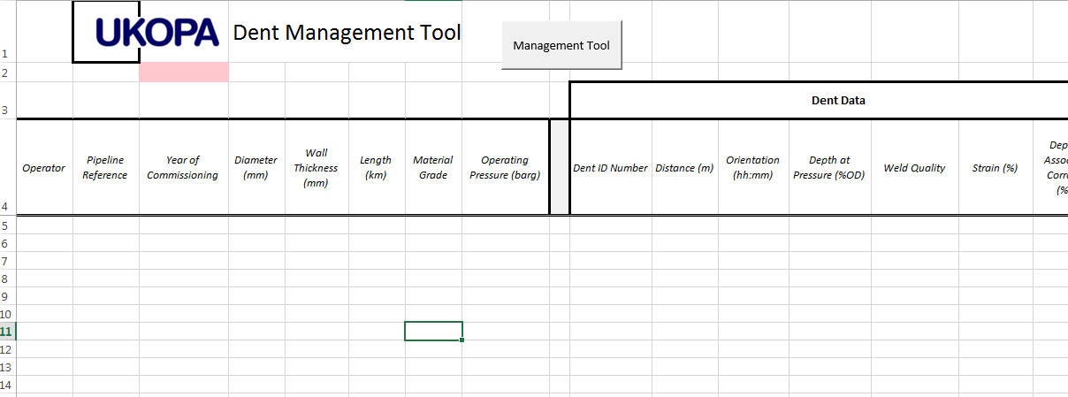
Spreadsheet tool
The program run using command
button on spreadsheet
How the tool is constructed and operated
Blank Spreadsheet looks like this
Spreadsheet shows column
Headers for data which will be filled

Slide 4
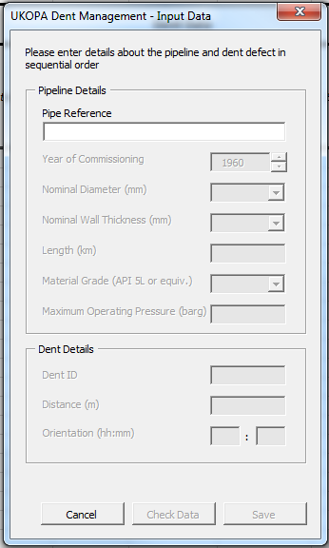
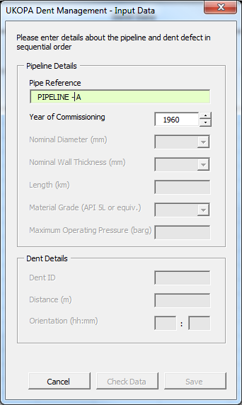
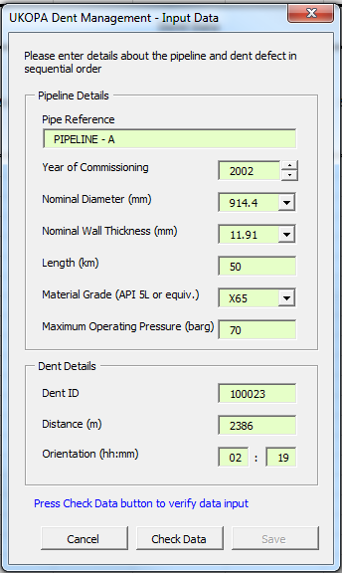
Data Input
Data entered in sequential order
Check data button will help avoid mistakes

Slide 5
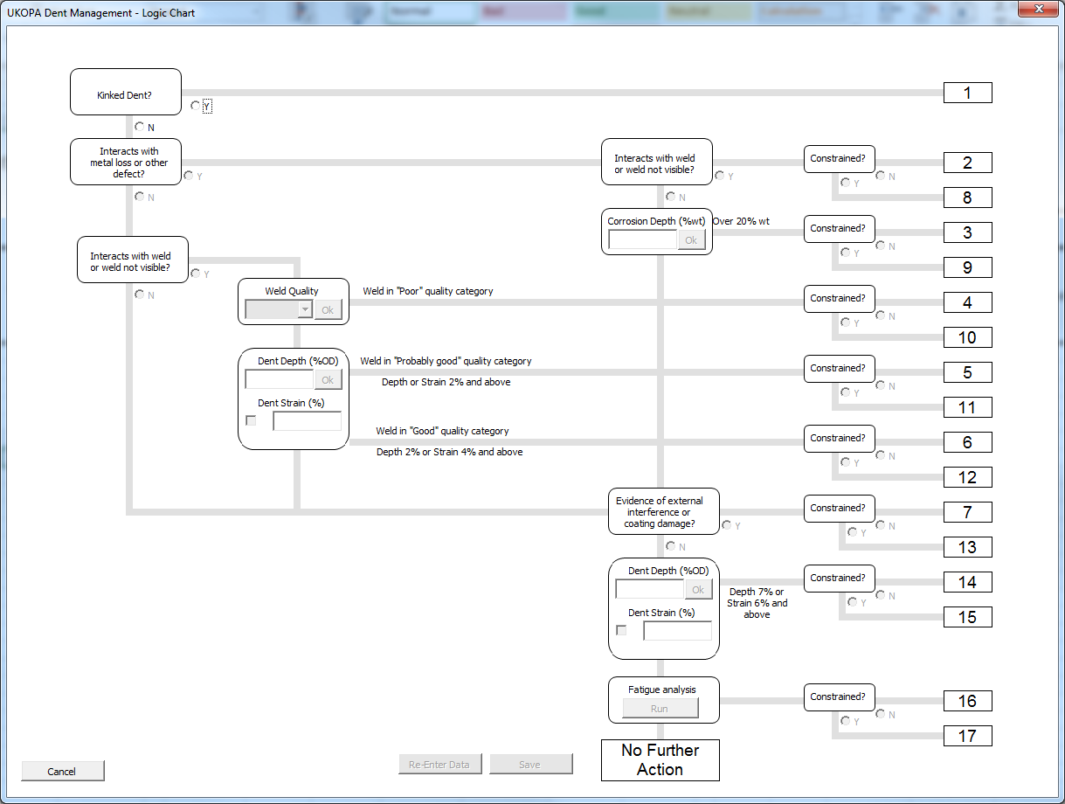
Main Program – Flow Chart Algorithm
Main part of program
Based on flow chart
from document
Questions relating to assessment
Repair/Investigation
Priority is set

Slide 6
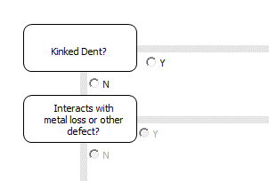
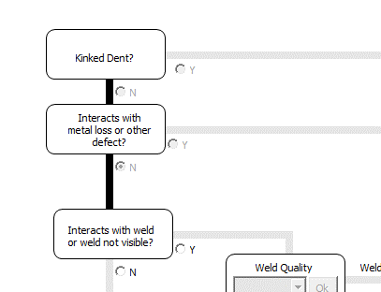
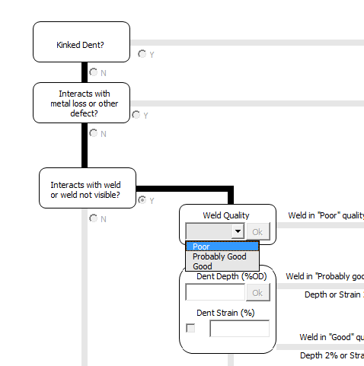
Flow Chart Selections
Certain questions require
More than Y/N answer
e.g. weld type
Use Y/N controls to
Select correct data
Follow chart through
Lines will shade progress
Press re-enter data button
to correct mistakes

Slide 7
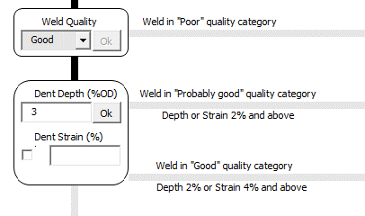
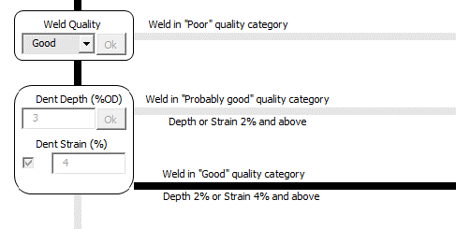
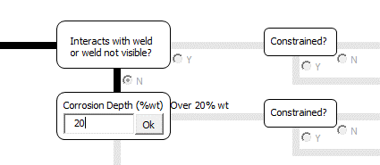
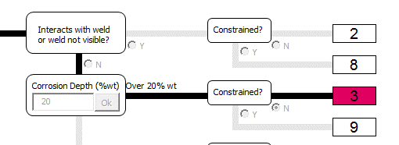

Flow Chart Selections
Dent depth and strain
Once questions complete, priority is indicated in red
Associated Corrosion Depth
Save Data to
Spreadsheet

Slide 8
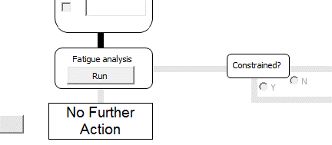
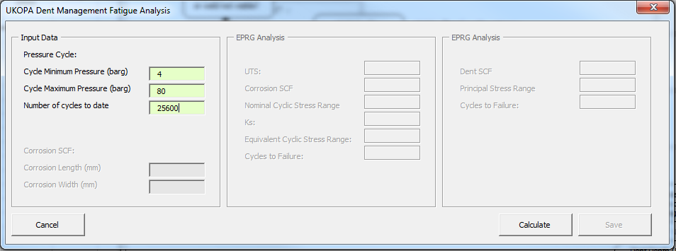
FATIGUE ANALYSIS
Certain set of choices end in the requirement of a
Dent fatigue analysis
Run by clicking control button
Enter cycle data
In sequential order
If dent has assoc.
Corrosion then a
Corrosion length +
Width will be
requested

Slide 9
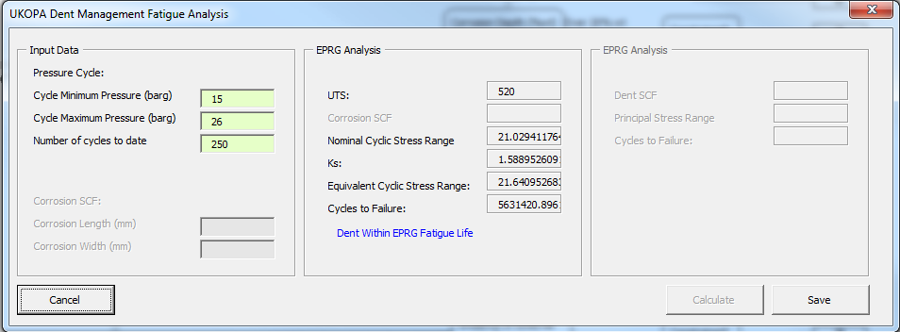
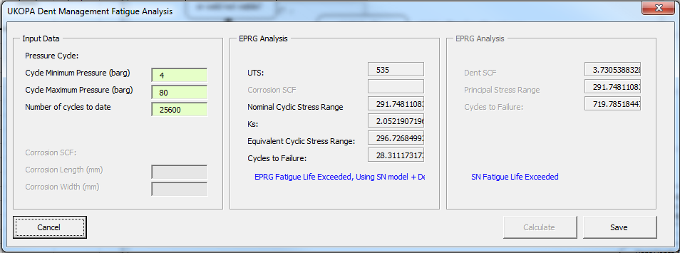
FATIGUE ANALYSIS
Fatigue Life screened
Against EPRG Fatigue model
Conservative fatigue life
If fatigue life exceeded
A dent SCF is calculated and
Class B S-N curve from BS 7608
Used for more realistic fatigue life

Slide 10
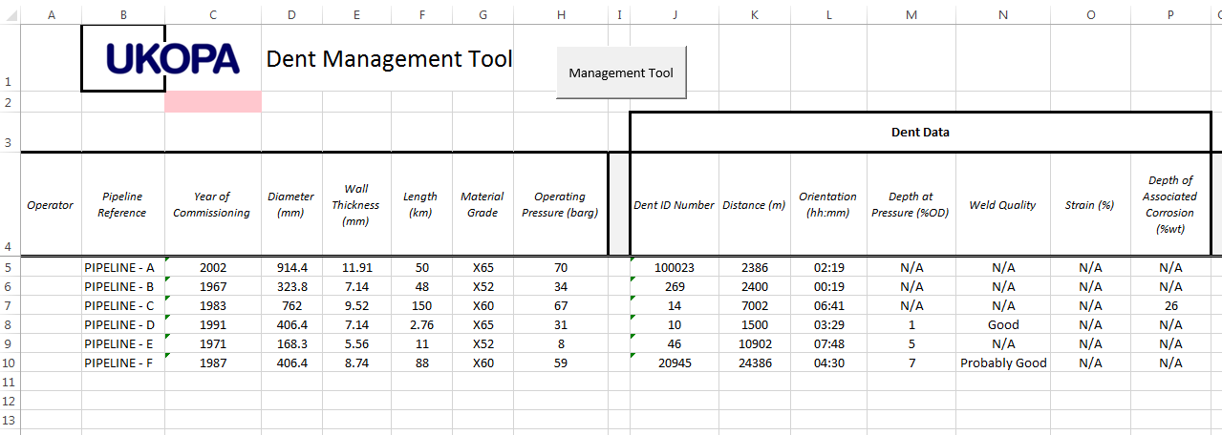
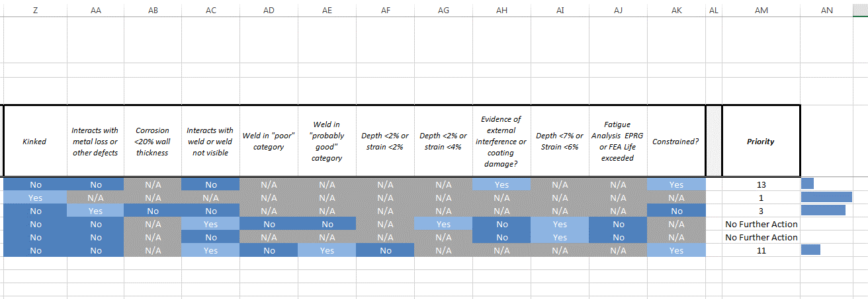
DATA OUTPUT
Pipeline data and dent data
Columns filled based on input
Questions from flow chart
Shown as shaded Y/N or N/A
If answer not required
Last 2 columns give priority
Rating. A number is given and
A data bar showing a
Visual representation

