Slide 1
ILI Research (Sleeves) Phase 1A2
19th November 2015

Slide 2
SCOPE of work
Task 1
Investigate and compare the depth distribution of corrosion features that are directly under sleeves, with those in close proximity to sleeve (upstream/downstream) and in general along the pipeline. Use this information to determine whether corrosion is different under the sleeves.
Investigate changes in the depth distribution that may occur as distance to the nearest sleeve changes. Initially this will look at 12 m increments (steps), the step size may however be altered (reduced or increased) depending on findings of the investigation.
Task 2
Obtain sleeve data for the same five (5) pipelines for which MACAW has ILI data. The source of this may be the Sleeve Risk Ranking Model, company GIS systems, or other asset data management sources.
Investigate the best approach for ‘aligning’ sleeve data with pipeline route information from GIS and the ILI data used in Task 1 and Task 2 of this extended feasibility study. This Task will report on the feasibility of applying the ‘alignment’ approach to a much larger population of sleeves/pipelines in a later Phase of work.

Slide 3
Data Summary
Operator | NGGD | NGN | SGN | WWU | Valero
Name | Kynnersley to Swindon Junction | East Bierley to Pannal | Uddingston to Wishaw | Filton to Rolls Royce | Seisdon to Manchester
Launch | Kynnersley | Pannal | Uddingston | Rolls Royce | Seisdon
Receive | Swindon Junction | East Bierley | Wishaw | Filton | Manchester
Product | Natural Gas | Natural Gas | Natural Gas | Natural Gas | Oil
ILI Vendor | ROSEN | PII | PII | ROSEN | TD Williamson
Length (km) | 36.1 | 24.4 | 15.5 | 7.9 | 113.2
Number of sleeves | 36 | 40 | 15 | 11 | 14
Number of External Corrosion | 544 | 1063 | 302 | 40 | 2962
Number of Internal Corrosion | 7 | 0 | 0 | 0 | 148769

Slide 4
Task 1 Results
Pipeline Operator | Number of Sleeves | External Corrosion Within Sleeves | External Corrosion Within 12 m of Sleeves | Total Number of External Corrosion Features
NGGD | 36 | 20 | 3 | 23
NGN | 40 | 24 | 58 | 82
SGN | 15 | 12 | 23 | 35
WWU | 11 | 18 | 9 | 27
Valero | 14 | 14 | 3 | 17
TOTAL | 116 | 88 | 96 | 184
Summary of reported external corrosion features
Operator | Average Feature Depth within Sleeve (%) | Average Feature Depth Remainder of the Pipeline (%)
NGGD | 10.95 | 9.46
NGN | 11.63 | 9.92
SGN | 25.25 | 18.91
WWU | 8.28 | 7.14
Valero | 10.21 | 7.14
Summary of feature depths within sleeves and outside of sleeves

Slide 5
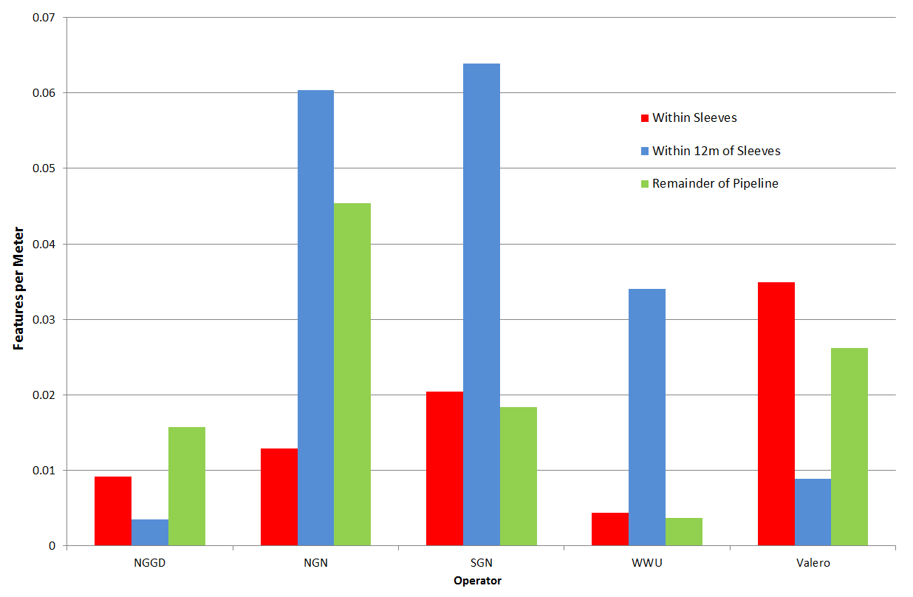
Task 1 Feature Count
Figure below shows the count of external corrosion features per meter within sleeves, 12 m either side of a sleeve and for the remainder of the pipeline, for each pipeline operator.
Three of the pipelines, NGN, SGN and WWU, show a significant increase in the number of features reported within 12m of sleeves.

Slide 6
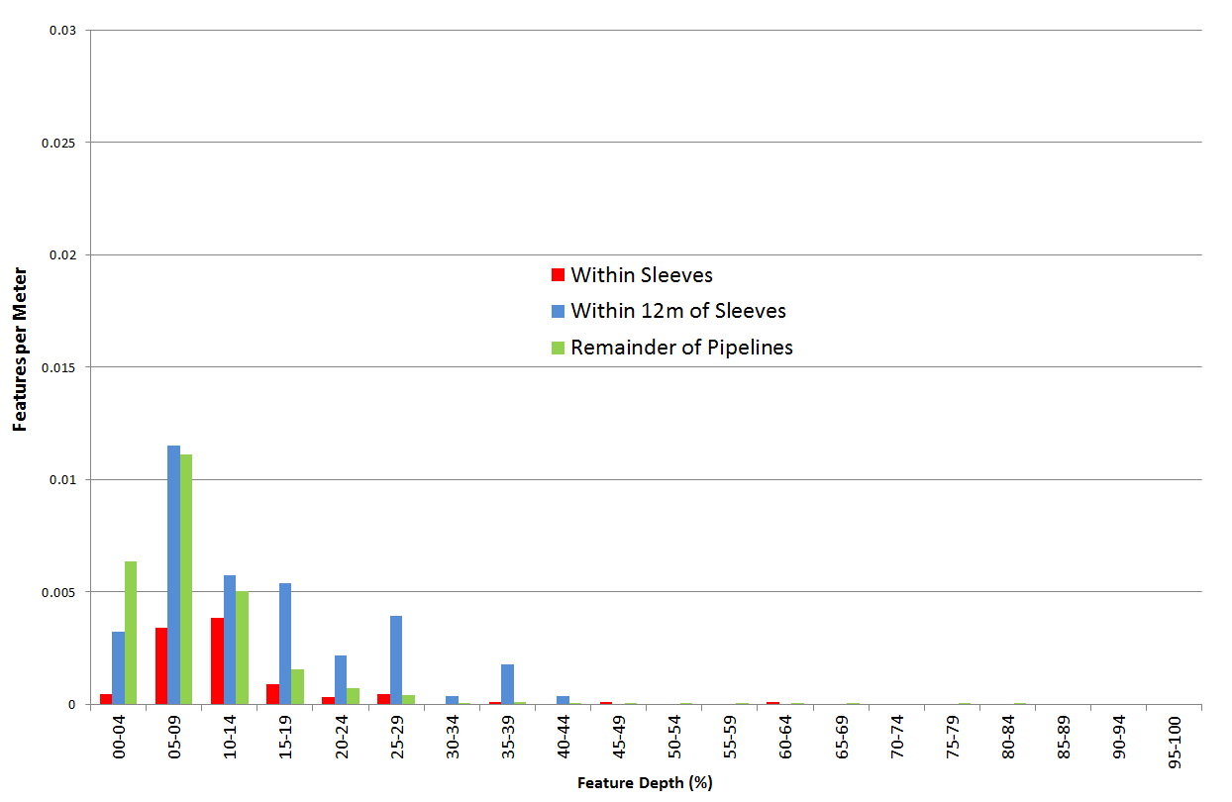
Task 1 Feature Depth Distribution
Figure shows a feature depth distribution of external corrosion for all pipelines.
This is broken down to features within sleeves, 12 m either side of a sleeve and for the remainder of the pipeline

Slide 7
Task 2 results
To support the study, sleeve location and attribute data was requested from each of the participating UKOPA members
Table below shows that sleeve data was supplied for all pipelines, with the exception of that operated by WWU
NGGD data was found to be missing sleeve location information
Information | NGGD | NGN | SGN | WWU | Valero
ILI Pipe Tally | ✓ | ✓ | ✓ | ✓ | ✓
Sleeve Location | ✗ | ✓ | ✗ | ✗ | ✓
Sleeve Attributes | ✓ | ✓ | ✗ | ✗ | ✓
Pipeline Route Data | ✓ | ✓ | ✗ | ✗ | ✗

Slide 8
TASK 2 Results
In order for alignment and subsequent analysis to be successful the pipeline operator needs to maintain a sleeve data source with both location and detailed attribute information.
This allows sleeves in the ILI data to be matched to the correct asset information and thus determine which features are beneath which sleeves and of what type.
Examples of data types required for sleeves are shown in the table below

Slide 9
Data Alignment Analysis
NGN, SGN and Valero supplied location data for their sleeves.
NGN and SGN use Ordnance Survey (OS) coordinates and Valero provided girth weld numbers.
This exercise has shown that the alignment of the features to sleeves is feasible with both types of location data. An extract of aligned data is below.
Girth Weld Number | Absolute Distance (m) | Defect Depth (%) | Feature | Sleeve length (m) | Sleeve diameter (mm) | Sleeve Class | Sleeve end-seal | Annular fill material
12950 | 14,148.68 | 9 | EXT ML | 76.2 | 1000 | 1 | Other | Unknown
12950 | 14,149.15 | 13 | EXT ML | 76.2 | 1000 | 1 | Other | Unknown
12950 | 14,149.28 | 10 | EXT ML | 76.2 | 1000 | 1 | Other | Unknown
12950 | 14,149.29 | 9 | EXT ML | 76.2 | 1000 | 1 | Other | Unknown
12950 | 14,149.29 | 12 | EXT ML | 76.2 | 1000 | 1 | Other | Unknown
12950 | 14,149.40 | 11 | EXT ML | 76.2 | 1000 | 1 | Other | Unknown
12950 | 14,149.42 | 7 | EXT ML | 76.2 | 1000 | 1 | Other | Unknown
12960 | 14,155.21 | 10 | EXT ML | 76.2 | 1000 | 1 | Other | Unknown
…

Slide 10
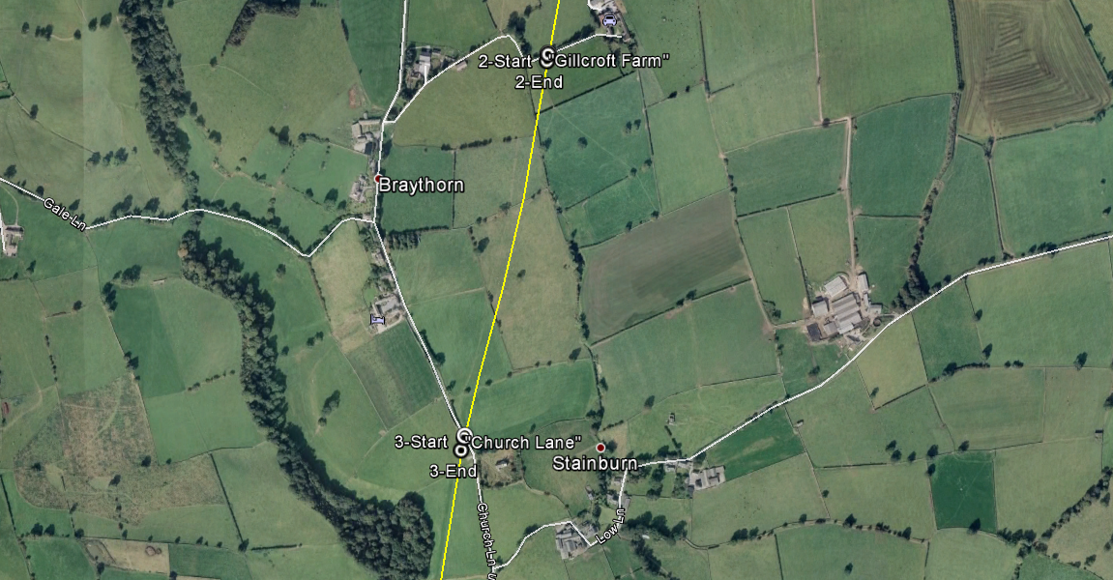
GIS Data Alignment
It has also been demonstrated that where GIS pipeline route information and sleeve location data is available, this can be used to align the pipeline and the ILI features geographically.
Figure below shows a comparison of the location information from the NGN sleeve data (white circles) and sleeves reported by the ILI (black circles with dots), based on the absolute distance reported by the ILI.

Slide 11
Conclusions
This work and the work in Phase 1A1 shows that it is feasible to evaluate external corrosion reported from ILI in an effective manner and identify those features related to sleeves.
This phase of work has shown that the number and depth of features within 12 m of a sleeve is higher than for the remainder of the pipeline for three of the five pipelines considered.
Corrosion features and sleeve assets that occur along the pipeline can be referenced at a certain distance or coordinate location. Using this information it has been demonstrated that an individual corrosion feature can be linked to a sleeve. This has been successfully demonstrated for three of the operators’ data.
Where sleeve information is not currently available or attributes are missing, operators should undertake the collection of missing data.
Following a data collection exercise, or with data from a limited number of operators, the research work can continue into Phase 1B to evaluate a large population of sleeve and pipeline data.

