Slide 1
TSEP AC Interference

Slide 2
Introduction
The TSEP pipeline has a known AC interference risk and has a monitoring and mitigation system in place. An integrity review was carried out in 2019 and a number of coating defects were inspected where no evidence of AC corrosion was found to be present. This Presentation relates to actions taken following a sudden increase in the levels of AC interference that were observed in September 20 and April 21.
The AC interference mitigation system consists of a number of zinc ribbon earths connected directly to the pipeline system. The zinc ribbon earths are installed at certain high AC interference risk locations along the pipeline route.
The AC interference monitoring system includes AC coupons installed at all CP test facilities along the pipeline route to carry out periodic monitoring of the AC current density. As a supplement to the monitoring system in September 2020 six remote access Electrical Resistance (ER) probes were installed to monitor the levels of AC interference on the pipeline system, confirm the CP status and determine the corrosion rate on the pipeline at the probe location.
The ER probes provide information of the probe CP ON and OFF DC pipe to soil potential, the AC pipe to soil potential, DC and AC current densities, the probe resistance to remote earth and corrosion rate in microns per year. The probe simulates a significant coating defect, however ongoing coating surveys are carried out to identify true defects.

Slide 3
Overhead Powerline Maintenance
In October 2020 and again in April 2021 Pipeline team noticed that there was a sudden increase in the AC voltage and current density at two ER probe locations on the pipeline system. This would not have been detected on routine 6 monthly CP routines that are carried out in March and September.
The typical AC voltage on the pipeline at the probe location, which is approximately 500m from overhead 400 kV power lines is 2.0V and the AC current density varies during normal operation between 10 to 20 Am⁻². However, on both occasions the AC voltage suddenly increased significantly to around 10 to 20V range, whilst the AC current density increased to between 280 to 550 Am⁻². The corrosion growth rate also significantly increased at location where no zinc mitigation was in place.
Pipeline Team contacted National Grid Electricity Transmission (NGET) to ascertain what activities they are undertaking on their overhead power lines, to determine the reasons for the high AC voltages INEOS were experiencing.
National Grid (NG) confirmed on both occasions, that pylon maintenance operations were taking place in the area. As a result, one circuit of the two-circuit overhead power line system had been taken out of service. This would have resulted in a higher electromagnetic field strength than that when the power line had two balanced circuits in operation.
National Grid has agreed to notify INEOS in future when outages are scheduled.

Slide 4
Actions Taken
When the high AC levels were first observed we immediately switched off the CP system on the pipeline local to the probe locations. Switching off the CP system decreases the DC current density being applied to the probe that results in a gradual increase in the probe spread resistance. The increase in the probe resistance to remote earth would mean that the AC discharge current density would gradually decrease.
Adjustment of the pipeline ON potential reduced the threat to the pipeline integrity. The AC corrosion risk has been controlled and the AC corrosion rate was reduced by using the pipeline CP system to control the AC corrosion rate. Switching off the CP system locally also reduced the DC potential and thus the DC potential on which any AC voltage has been super imposed would have been reduced.
The ER probe location that had zinc earthing installed also had high levels of AC did not show a significant increase on corrosion growth rate on the probe.
Alarm settings were added to remote monitoring system to provide immediate warning of high risk AC interference levels or alarm situations. The AC voltage excursions were only initially observed due to periodic inspection of the data base. In future an email will be sent to personnel responsible for monitoring the pipeline immediately the AC voltages and AC current densities exceed set limits.
Following on from 2020 Annual integrity review a further six ER Probes have been installed in 2021 along will zinc ribbon where High AC levels detected. Ongoing reviews will determine any further enhancements and will increase the number of zinc earths installed on the pipeline that area combat the enhanced AC corrosion risk.
In future should the AC interference levels exceed the criteria specified in BS EN ISO 18086, INEOS will reduce the pipeline CP ON potential in the short term to control the AC corrosion risk.

Slide 5
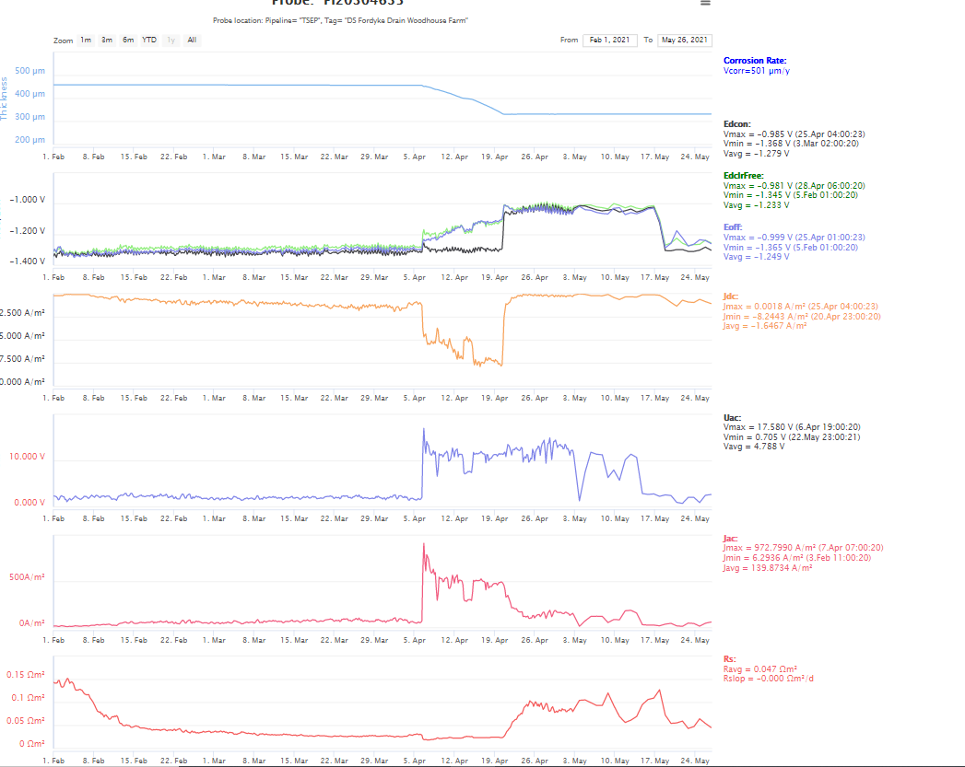
ER Probe km 141.44 – No Zinc

Slide 6
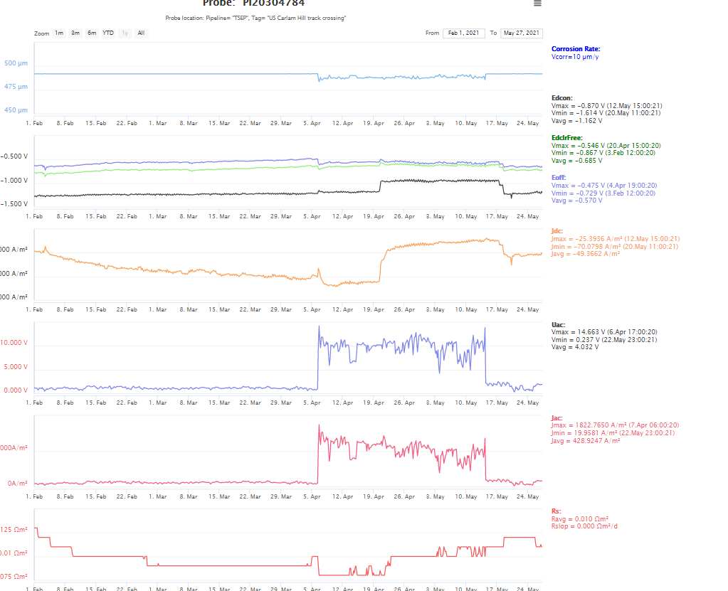
ER Probe km 140.45 – Zinc ribbon installed

