Slide 1
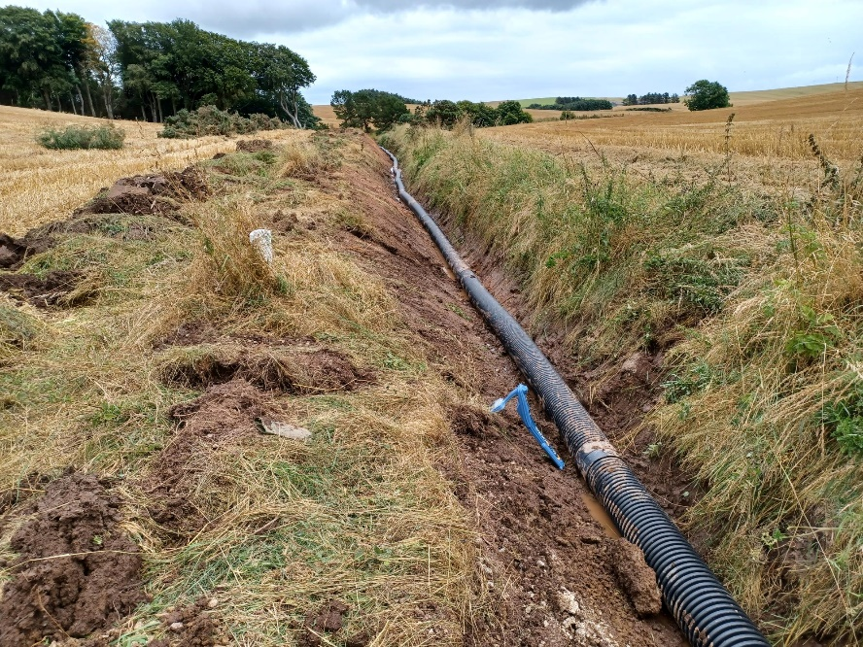
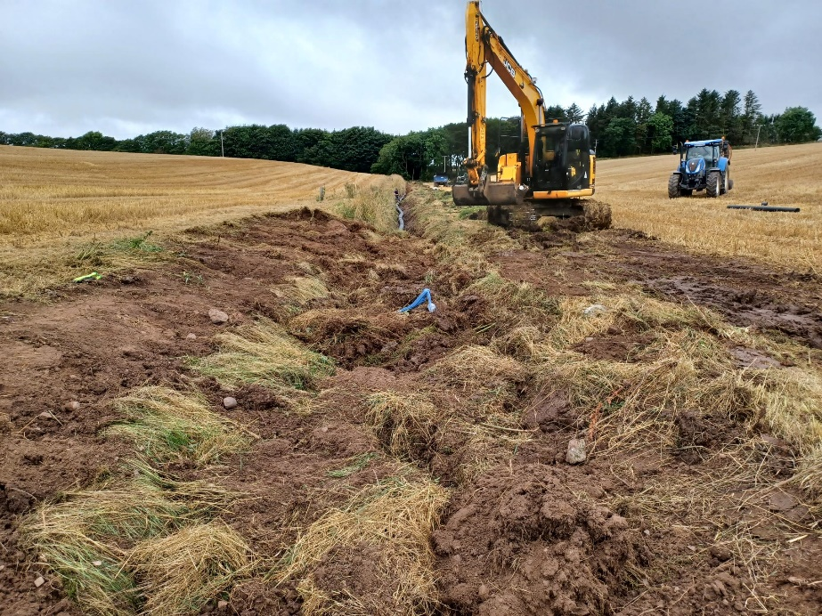
Unauthorised Drainage Works over High-Pressure Pipeline
  What happened?
  A landowner instructed their employees to clear a ditch to allow installation of a new drain
  Excavation was carried out by mechanical excavator and crossed a high-pressure pipeline
  The pipeline was not damaged
  Findings and key learning points
  A landowner instructed their employees to carry out excavation works but did not advise them of the presence of the pipeline.
  The operatives noted the pipeline marker posts but did not consider the work to be significant enough to warrant contacting the pipeline operator
  The pipeline was not damaged as the excavated ditch was shallower than the pipeline depth of cover (1 m)
  The operator held discussions with the landowner, highlighting the safety consequences of pipeline damage/release of content. The operator also went through the required procedures for works within 50m of their pipeline
  A formal letter was issued to the landowner recording the event and highlighting the relevant responsibilities under PSR (Pipeline Safety Regulations)
  Recommendation
  Operators should be aware that infringements can occur from 3rd parties who have ignored pipeline markers
  Operators should consider whether their marker posts are likely to convey the required message regarding excavation
Box 2
Box 1
Issue Date: 18/04/24, Reference: UKOPA-LB-24-07-1

