Slide 1
UKOPA – The Way Forward Chairman’s Introduction

Slide 2
Background
UKOPA formed in 1997
The driver were changes in UK legislative framework (PSR 1996) and to drive a consistent response to the HSE’s LUP requirements for pipelines
UKOPA’s obtained success in representing pipeline operator views resulted in its recognition as a forum representing the views and interests of UK pipeline operators
It became established as a organization funded by membership fees.

Slide 3
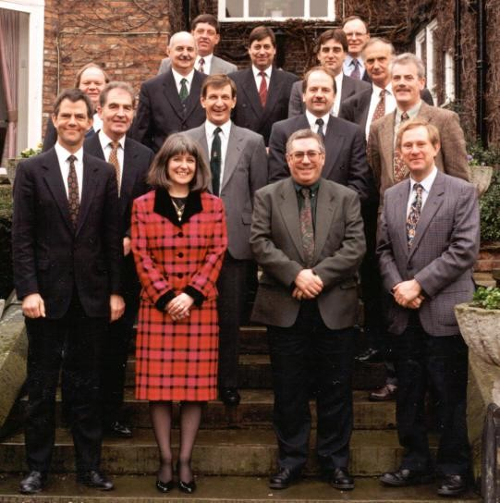
First Formal Meeting!

Slide 4
UKOPA Strategy
UKOPA exists to provide the recognised and authoritative view of UK pipeline operators on strategic issues relating to safety management, operations and integrity management of onshore hydrocarbon pipelines. The United Kingdom Onshore Pipeline Operators Association, an authoritative voice for UK pipeline operators. It seeks to effectively influence the development and implementation of pipeline-related legislation and standards for the mutual benefit of all stakeholders and promote safety and best practice in the pipeline industry.

Slide 5
Current Organisation
Board of Directors
Secretariat
Membership
Working Groups
Shares information through:
Two Members’ meetings per year
Technical seminar
Annual Publication
Website: www.ukopa.co.uk

Slide 6























United Kingdom Onshore Pipeline Operators’ Association
Chairman
Secretariat
Board of Directors
Members
International Associate
-
Technical Consultants

Slide 7
Aims
Forum for discussion, knowledge, sharing and promotion of best practice.
Influencing legislation development and modification
Co-ordinating consistent views on strategic issues

Slide 8
Objectives - What
External Communication
Liaison with HSE
Joint industry initiatives
Implementation of new technology

Slide 9
Objectives - How
Formal working Groups
Agreed ToR and organisation, work programmes and deliverables, appropriate funding
Informal Working Groups
Agreed remit, actions and reviews
Initial Studies
Limited scope, review and feedback
External interfaces
Formal involvement and representation

Slide 10
Formal Working Groups
Pipeline Integrity Working Group
Fault and Risk Assessment Working Group
Emergency Planning Working Group
Infringement Working Group
Process Safety Working Group
Informal working groups are established as required to support and contribute to the work programmes of the formal working groups (eg dent WG, Sleeve WG)
Initial studies are undertaken and external interfaces are established as required

Slide 11
Summary of “some” Achievements
Website for external information and member knowledge sharing
2 Full members meeting each year to share knowledge at track progress
Annual Technical seminar for staff training and sharing
Safety Alerts (~30 per annum)
Annual 3rd Party infringement and Process safety Reports
Biannual Fault and defect analysis report
Annual HSE liaison and strategy meeting
Biannual Process Safety benchmarking questionnaire
Pipeline Emergency Responder Officer training (additional cost per course)
Guidance documents and good practice guides.

Slide 12
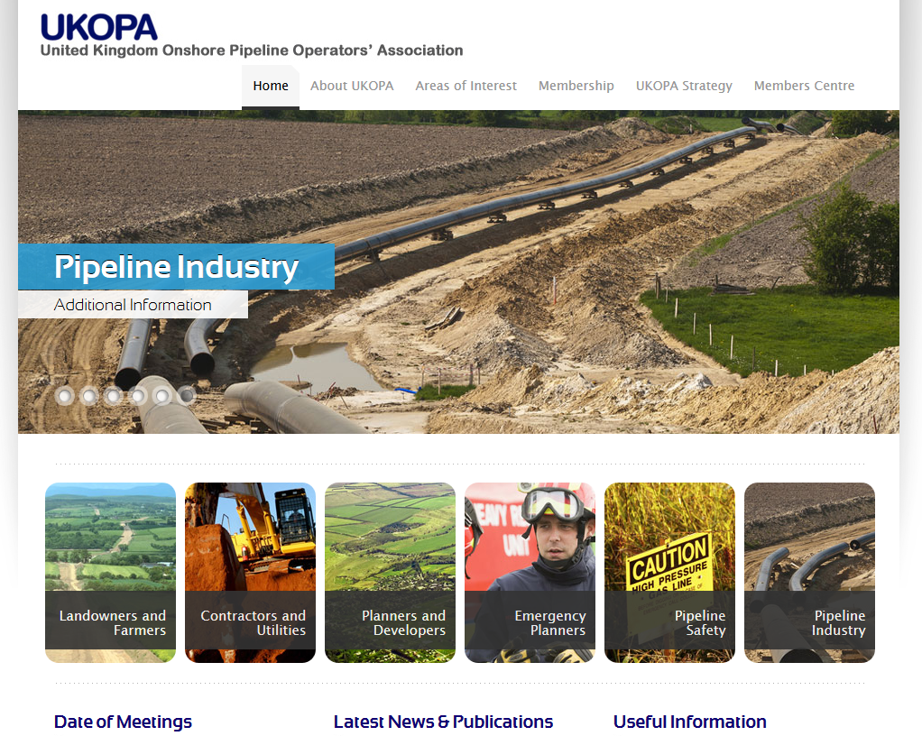
UKOPA Website

Slide 13
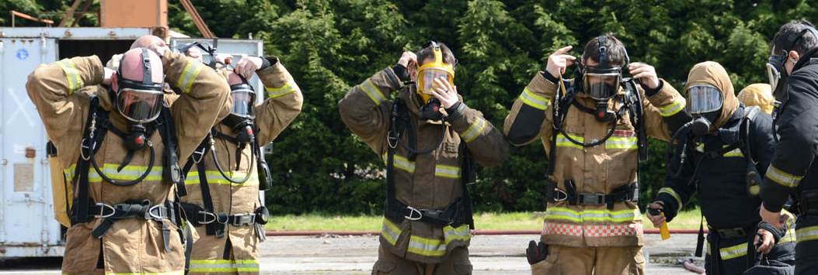
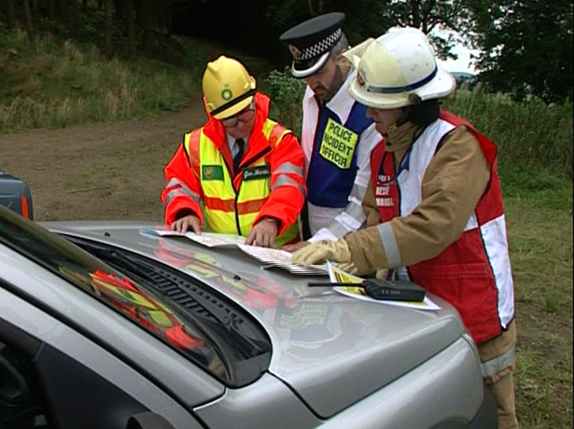
PERO Course
Could include some statistics – number of courses, number of attendees?

Slide 14
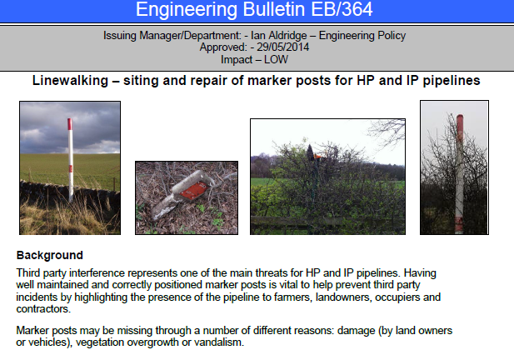
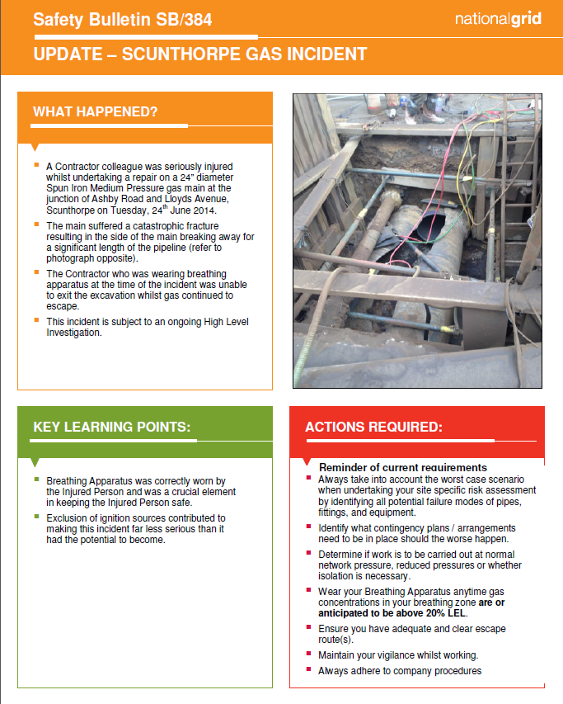
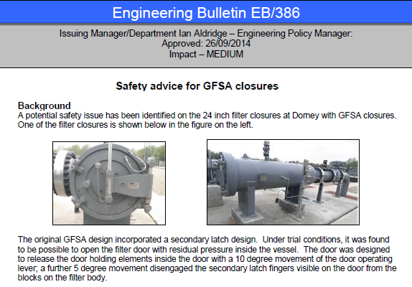
Safety Alerts

Slide 15
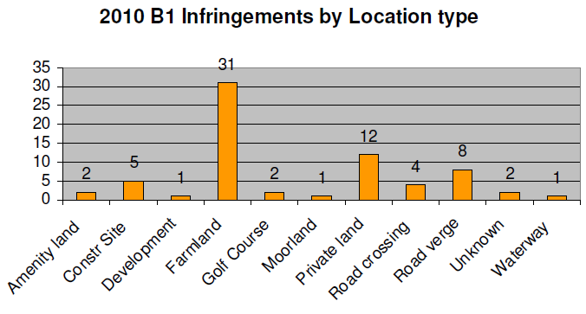
Pipeline Fault and Infringement Databases

Slide 16
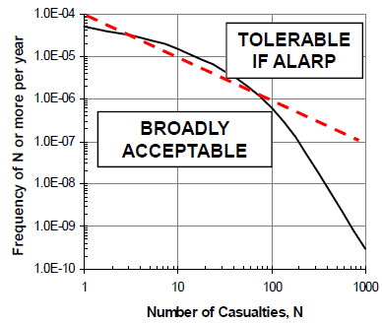
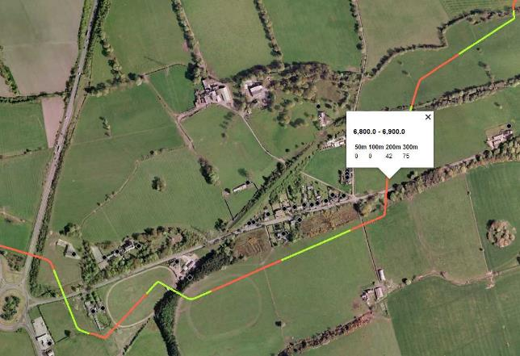
Development of BSI and IGEM Risk Assessment Standards
Societal risk studies
Risk assessment of
gasoline pipelines
Societal risk criteria

Slide 17
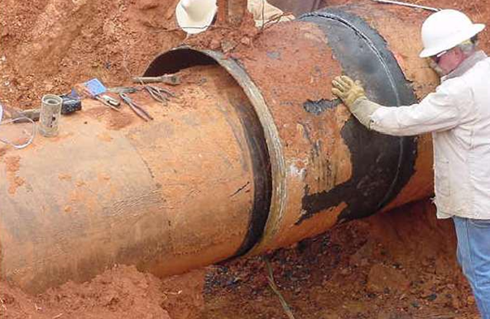
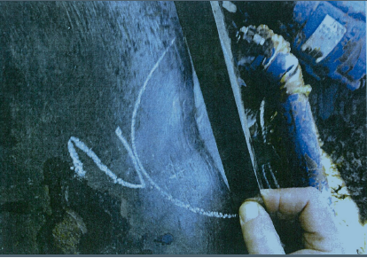
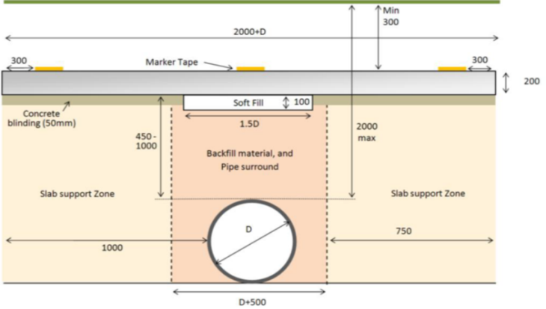
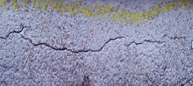

Studies Actioned by Members
Pipeline Dents
Pipeline Sleeves
SCC
Slabbing Specification

Slide 18
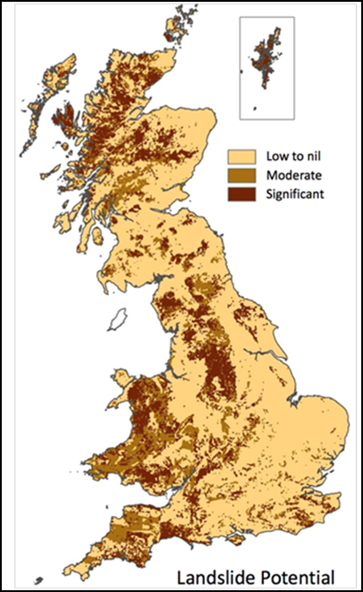
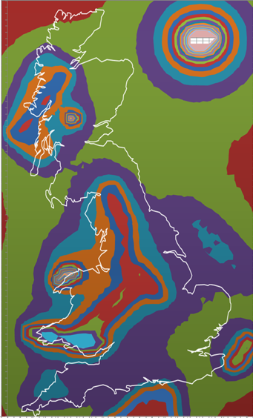
Studies actioned by Members
Landsliding
Seismic assessment

Slide 19
This Meeting
What does the membership want?
Please engage and give your views
Contribute to discussions and challenge positions
Think how UKOPA can deliver?
Think how you can help deliver?
Provide input to the decision process

Slide 20

UKOPA in 2020/25?
Notes:
Just before midday on Thursday 23 October 2014 there was a gas explosion and fire at a small german city called Ludwigshafen. It is an industrial city but as can be seen from the photos this event took place in a domestic setting.
40 cm (16”) diameter transmission pipeline (not sure what pressure yet)
57km (35 mile) section of pipeline
1 construction worker died and 3 of his colleagues were being treated for severe injuries. Additionally there were a further 7 people being treated in hospital as a result.
Over 1000 claimants have come forward for property damage and car damage

Slide 21
Workshop Agenda
Workshop session to review UKOPA in 2020/25?
Review of output from Workshop against existing Working Group Plans
Feedback from Questionnaire
Way Ahead / Next Steps

Slide 22
UKOPA in 2020
What will life be like 5 years from now?
Some challenges will be the same ?
3rd party protection
Pipeline inspection
Some things may be different?
New technology
Increased HSE scrutiny
Ageing pipelines
Change in personnel
What will the members want from UKOPA in 2020/25?

Slide 23
How it will work ?
Everyone will have opportunity to input into 5 discuss areas
What challenges will your company face in the next 5 to 10 years ?
Could UKOPA assist in meeting these challenges ?
What will UKOPA need to do to help ?
Ageing Pipelines inspection issues & techniques
Changes to pipeline operations and maintenance
UKOPA’s position and role in the wider industry Context
Succession Planning & Competency
3rd party Protection / right of way management

Slide 24
Ageing Pipelines inspection issues & techniques
Classification of pipeline damage
New threats / failure modes ?
New inspection tools / techniques?
Pipeline revalidation ?
New repair methods ?
Going beyond original asset life?
Decision support tools ?
Management of change modifications / repairs ?

Slide 25
Changes to pipeline operations & maintenance
New control systems, remote control devices ?
Theft of product / identify leaks?
Change in product being transported
Drive for more efficient maintenance
New emergency arrangements / Plans
Human Factors /
improved Procedures / DVD “youtube” how to films?
Improved setting to work processes
Reduce number of control staff

Slide 26
3rd party Protection / right of way management
New different landowners not aware of pipeline
Larger machines automated farm machinery
Increase in house building
Drive for more efficient right of way protection
Human Factors /
Improved work excavation monitoring
Greater use of electronic communication /
I-phone & websites
Improved surveillance systems satellite / drones
Loss of cover / pipeline markings
One call system for all pipelines

Slide 27
Succession Planning & Competency
Greater turn over of staff 50% of new employees will leave after 3 years
70% of existing Staff will leave in next 5 years
Loss of industry knowledge / experience
Continuation of PERO course more joint training CP, line walking, process safety
Young engineers work differently use of google to find answers
Greater use of electronic communication /
I-phone & websites
Lack of competent service providers
Consistent Competency standards for pipeline industry
Capability to act as informed buyer of expert services

Slide 28
UKOPA’s position and role in the wider industry context
Maintain reputation with the HSE
UKOPA input into industry standards IGEM / BS
UKOPA act as arbiter with HSE
UKOPA position alongside UKPIA ENA and others
Status and role of good practice guides
UKOPA role with Government
DEC and OFGEM
Provide technical advice and support to members
Carry out independent investigatory / audit service?
Manage research projects on behalf of members

Slide 30
Feedback from Questionnaire
knowledge share, peer expertise, information & discussion
Value for money
Work group supported by some members
Work group supported by some members
Inexpensive support compared to consultants
What more could UKOPA do ?
Provide more technical support ?
Provide more technical support ?
Collaborative research ?

Slide 31
Feedback from Questionnaire
Sustaining UKOPA
Manage deliverables as projects
Members resources increasingly stretched
Maintain access to competent resource
Increasing membership fees to manage deliverables ?
Potentially however would need to be justified

Slide 32
Feedback on current deliverables
Website – valued
Technical Seminar– value for money
Website – more access,
continued development
Members meeting – valued potential for improvement
Safety Alerts– Supported
HSE Liaison – member feedback on discussion
Inconsistent approach by members
Improved access and structure
3rd party infringement report – Supported
Annual Process Safety Report
Better sharing of incidents
Standardise data inputs
Interpretation of indicators

Slide 33
Feedback on current deliverables
Fault database report
Guidance documents
Implementation and control
Better sharing of faults and defects
PSAT Benchmarking process
PERO – Fully supported
Unsure how to use it
Member involvement
How do you maintain competence
3rd party infringement report – Supported
HSE Liaison – member feedback on discussion
Better sharing of incidents
Standardise data inputs

Slide 34
Feedback on potential other deliverables
Technical Training and Competency Programme
Joint Research Programme
Coordination of accredited training leading towards competence
Cost and control current UKOPA doesn’t support this
Technical standards
How to support influence BSi and IGEM ?
Provide support with interpretation
Promote pipeline awareness
Other bodies already do this UKOPA should focus on strategy link to linewatch
Provide Technical support
Lead / Support for HSE intervention
Mixed feedback some potential however not seen as core role
Resource / effort current structure would not support it
Government Lobbying
- UKOPA needs to increase exposure

Slide 35
Next Steps
Capture all proposals from workshop
Focus on high priority areas identified by questionnaire
Develop short term action plan for priority items
Develop long term strategy for UKOPA – feedback in Oct

Slide 36
Next Steps – Action Plans
Website / Communications / Linkedin etc. – UKOPA New Pipeline Engineers Group
Competency Framework / standards / training support
Engineering Governance / Input into standards good practice/ R&D collaboration/ Specialist Support
Non Piggable Pipelines Inspection / Repairs / End of line assessment
Local Authority Planners proactive liaison – Defence when planning process fails

Slide 37
Action Plan
Deliverable / Action
Timescales
Member input required
External resource requirements
Risks / Issues

