Slide 1
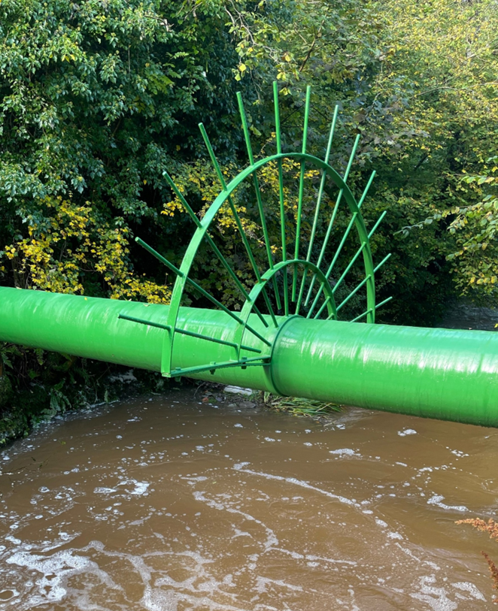
Above Ground River Crossing Pipeline Corrosion And Impact Protection
Carl Scott & Rob Balson
9th October 2025

Slide 2
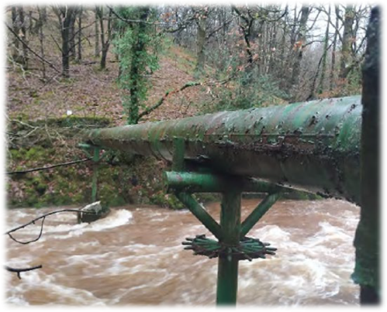
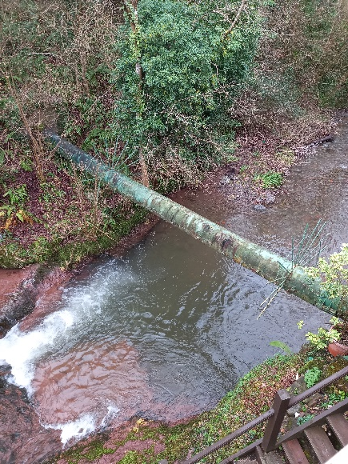
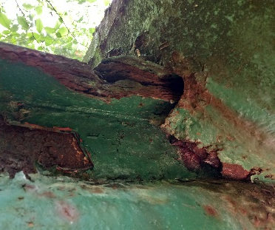
Aboveground Crossings
MLP has a number of aboveground river crossings
5 of these were areas of concern, they had external casings applied in early 1980’s
  No installation records
  No design calcs
Visual inspection in 2023 showed these to be in poor condition
Two particularly raised concerns – longer crossings, casings appeared to be sagging
One crossing has some minor external corrosion reported beneath sleeve
CEASAR analysis confirmed pipe can tolerate load of casing sleeves at current support distances
In 2024 MLP approved a work program to remove casings and replace with impact protective coating (Fibreglass)
  Lighter weight
  No potential for crevice corrosion
  No impact on ILI accuracy
  Work scope included - Full enclosure scaffold, remove original sleeve, Blast, Inspect, STOPAQ & Armourguard

Slide 3
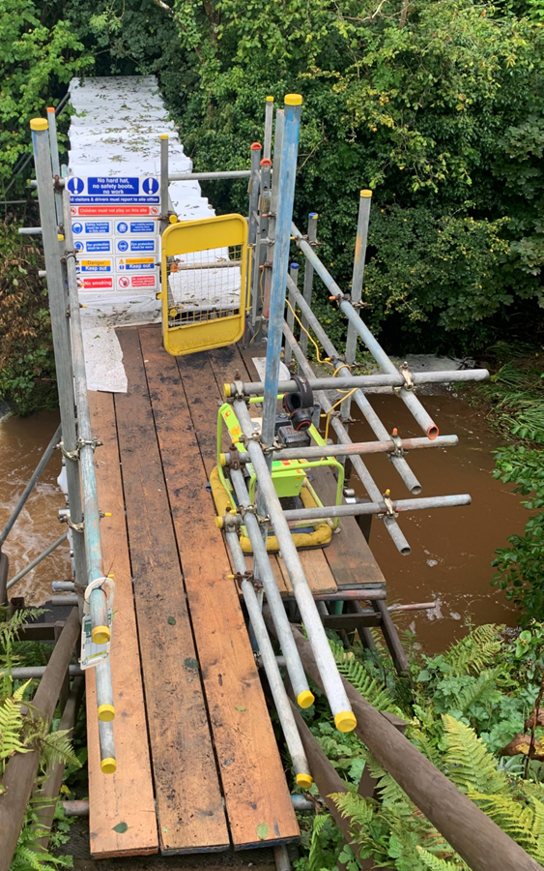
Project Overview
Challenges:
Located in a National Park and only 1 Km upstream of a Site of Special Scientific Interest (SSSI) and a Special Area of Conservation (SAC)
Pipeline positioned within waterfall splash zone, directly above river
Hydrology reports indicated that in extreme 1 in 100-year flood events the pipeline could become submerged
Limited site access, so only equipment that could be carried by hand could be used
Objective:
Provide long-term, maintenance free, corrosion protection
Provide impact resistance from debris during floods
Ensure compliance with strict environmental regulations
Hand applied system within enclosed habitat

Slide 4
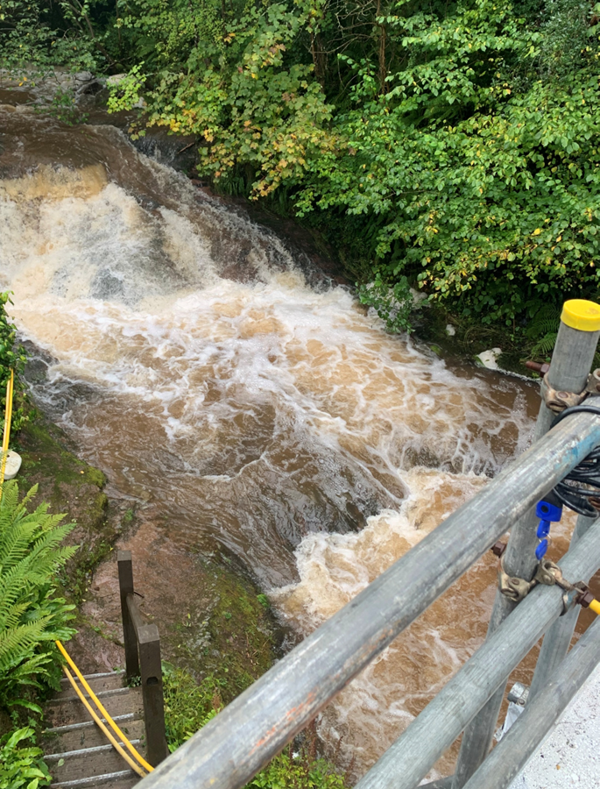
Who are Presserv?
Presserv Group specialize in providing preservation and corrosion prevention solutions. We employ over 100 people worldwide and our teams currently work from six permanent locations around the globe.
1996 – Norway
2010 – Brazil
2012 – UK
2018 – USA
2019 – Australia
2020 – Brunei
Within those territories we have various distribution rights for brands such as Cortec, Stopaq, Monti Power, Sponge Jet, Inductosense, Pipe Proteq, Precision Piping Products, Icon Protection, Trusted Global

Slide 5
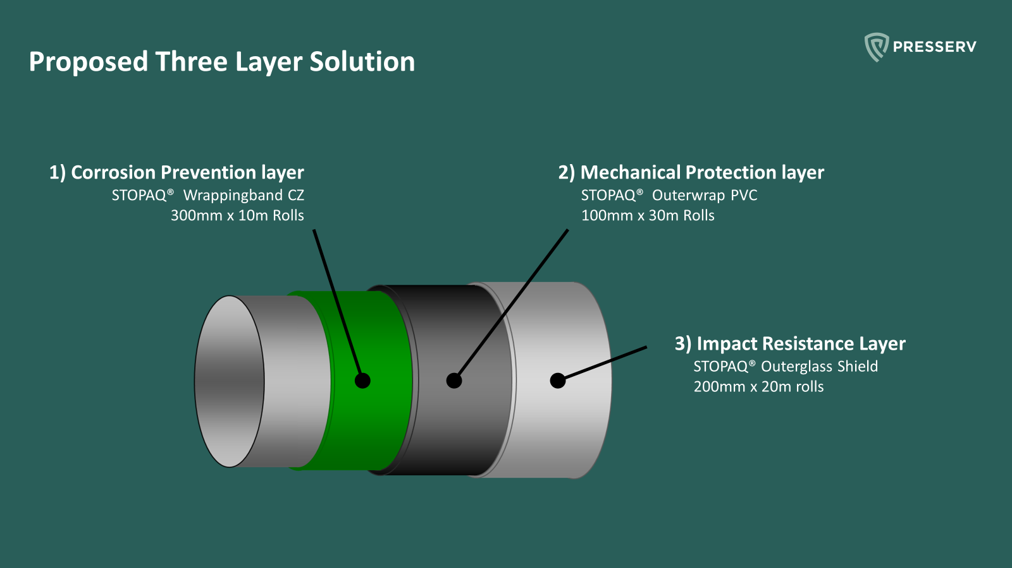
Proposed Three Layer Solution

Slide 6
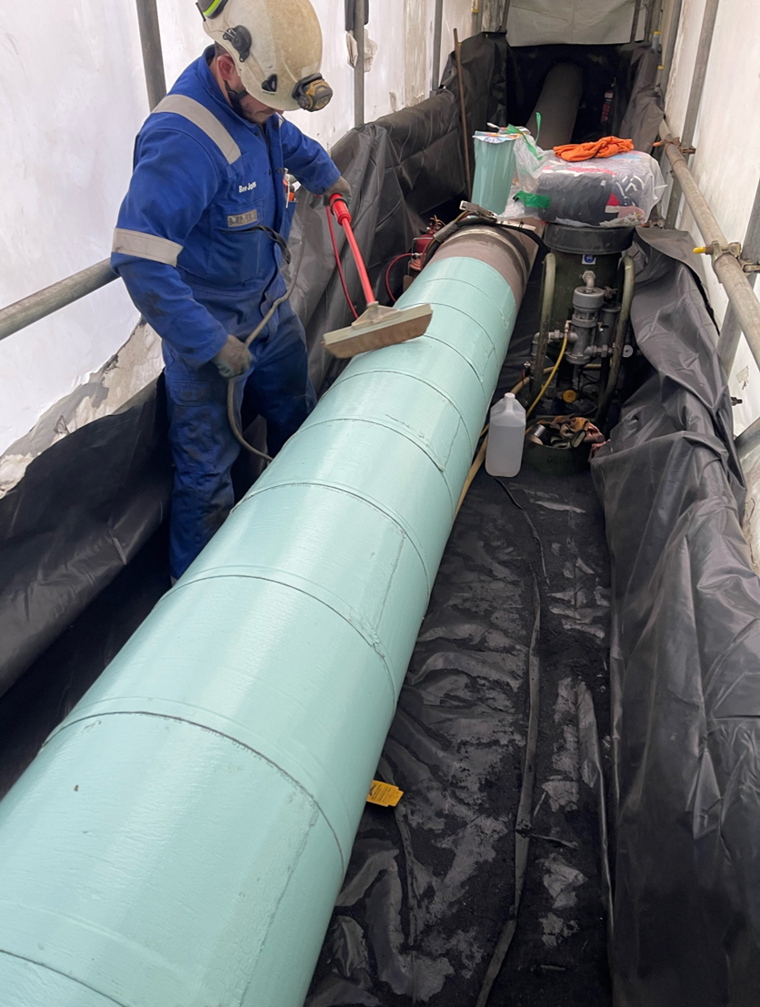
Application Of Corrosion Prevention
The pipe was prepared to meet the specification of Sa2.5 (STOPAQ requires a minimum of St2)
Surface degreased with Isopropanol wipes prior to application.
Corrosion Prevention
STOPAQ® Wrappingband CZ 300mm x 10m Rolls
Polyisobutene-based viscoelastic layer
2mm thick (2,000 microns)
Wide rolls were cut into strips equal to the pipe circumference + 50mm.
Strips were applied as circumferential wraps allowing for quick and easy application in cramped conditions.
Immediate, permanent adhesion upon application.
Permanently flexible within its continuous working temperature range of -45C to +50C (Thermal resistance +70C)

Slide 7
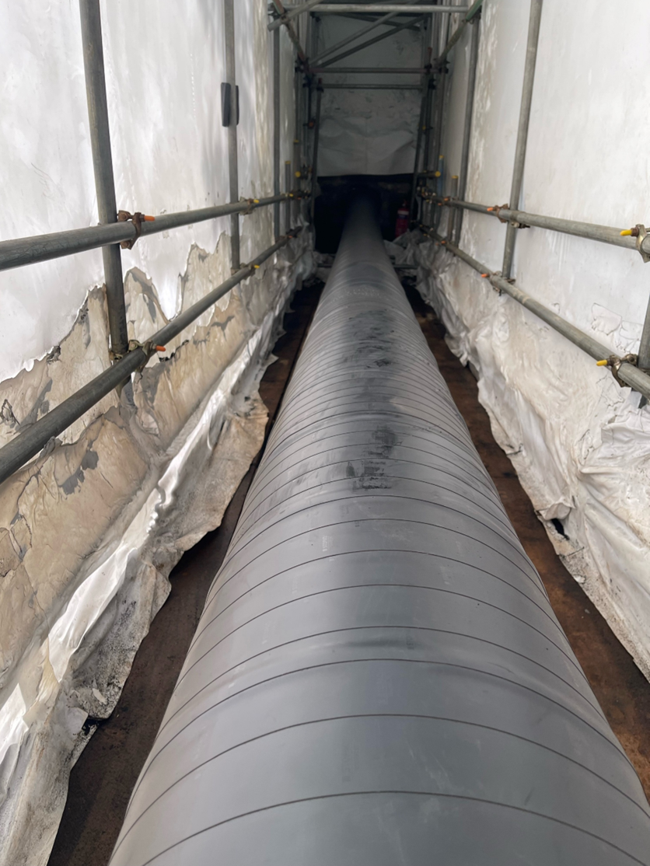
Application Of Corrosion Prevention
Mechanical Protection
STOPAQ® Outerwrap PVC 100mm x 30m Rolls
A robust, flexible tape, applied over the STOPAQ® Wrappingband CZ for mechanical protection.
Provides reinforcement and stability to the STOPAQ® Wrappingband layer.
Applied with tension to support the system’s self-healing ability
STOPAQ® Outerwrap PVC was applied in 100mm wide rolls which allowed a large volume of material to be applied quickly , whilst also being small enough to pass under the pipe during application.
STOPAQ® Outerwrap PVC has a continuous operating temperature range from -45C to +70C
Thermal resistance of +90C

Slide 8
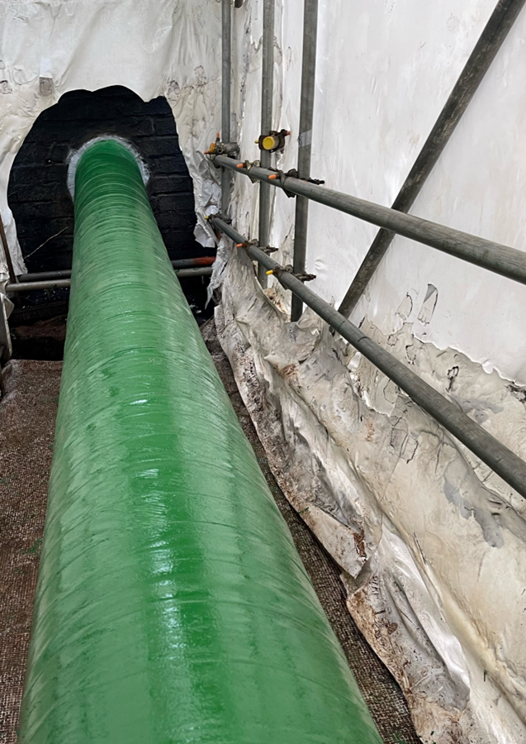
Application Of Impact Resistance
STOPAQ® Outerglass Shield
This is a composite wrap material consisting of a glass-fibre fabric, impregnated with a solvent free polyurethane resin.
After consulting with the manufacturer’s technical team, the STOPAQ® Outerglass Shield was applied six layers thick to provide significant impact and abrasion resistance.
Thickness at 6 layers = approx. 4.2mm
Impact strength of 150 kJ/m2. (ISO 180:2023)
Abrasion resistance < 0.11mm / 1000 cycles CS-17 Wheel (ASTM D4060)
Tensile Strength – 250 MPa @ 2 layers (1.4mm) (ISO 527)
For long term UV Protection and for Environmental factors the STOPAQ® Outerglass Shield was painted green using a long-life topcoat.

Slide 9
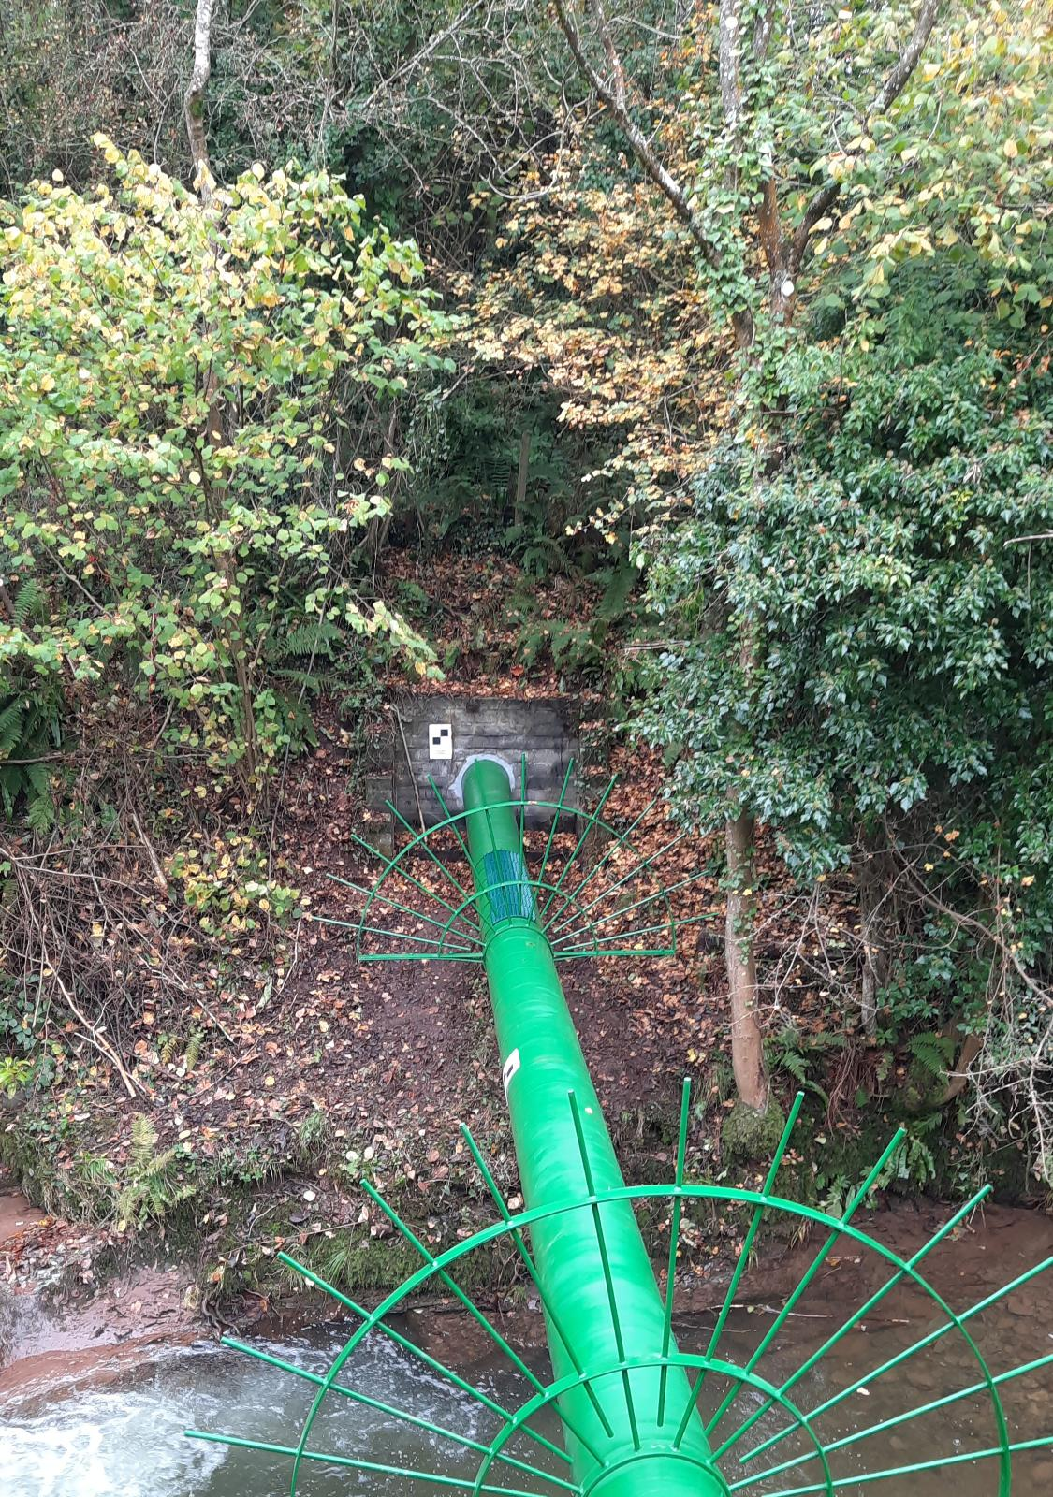
Key Project Benefits
Minimum 30-year design life
Minimal maintenance requirements
High resistance to mechanical impact & environmental stressors
Environmentally responsible application
Virtually no waste. 90% of packaging is recyclable.
Quick, safe application. (Stopaq application completed in 2 days)
Resistant to very low temperatures without getting brittle
Lessons learned – environmental permitting timescale took far longer than anticipated. Access issues to site caused delays.

