Slide 1
UKOPA Members Meeting – FARWG Update
Martin Davey, Chair FARWG
8th October 2025, Birmingham

Slide 2
FARWG Current Membership
Martin Davey SGN (Chair)
Nikki Barker PIE (Secretary)
Richard Price BPA
Roy Moobola Cadent
Richard Vickrage Cadent
Stephen Humphrey Exolum
Lar English Gas Networks Ireland
Jody Harrison National Gas Transmission
Kristina Wood Northern Gas Networks
Neil Morgan SGN
Marcel Swissgas
Daniel Milne Valero
Darren Cushen Wales & West Utilities
Greg Thompson Wood Group
Michael Acton DNV
Karen Warhurst DNV
Graham Goodfellow PIE
Members’ Meeting October 2025

Slide 3
FARWG Meetings
2025
  14th January – BPA – Kingsbury
  29th April – Warwick
  9th September – Meetpoint Midlands
Members Meeting October 2025

Slide 4
2025 Work Programme
Flooding / Erosion Risk Matrix / Screening Tool
  Develop scope of work and identify competent external organisations, ERM appointed to produce the screening tool
H₂/CO₂ Projects
  Produce signposting document – what was covered, key findings etc – started production of spreadsheet that is currently being added to
IGEM/TD/2 Edition 3 Support
  Complete reports of predictive and historic analysis undertaken for Edition 3 – these are to be transposed into reports for the UKOPA archive.
H/T Area Interpretation
  Guide for members – how to identify H and T areas, what to do once identified etc. DNV engaged to produce should be completed by mid 2026 – query on Ed6 TD1 to be sent to IGEM for clarification
GPG/TBN Review
  2024 docs for review (GPG025, TBN 02/03/06/07) required minor edits and will be reissue by end of year
  TBN09 requires updating following further published paper at HAZARDS 2024 and will be completed by mid 2026
2023 / 24 Fault Data Collection & Product Loss Report
  Attempt to improve speed of data supply by members
  ‘Database’ improvements
Shallow depth of cover
  Documents provided by National Gas and BPA will be used as the basis for producing a UKOPA version of the tool and a workshop will be held in the April 2026 to identify areas to be included
Members Meeting October 2025

Slide 5
Flooding risk matrix and priotisation tool
ERM engaged to carry out the work
Scope covers pipelines and the impact
  Rivers
  Water Course
  Surface water (pluvial and heavy water run offs
  Sea water
Will consider
  Operational Impact *
  Supply / Business Continuity *
  Asset Integrity
  Societal Impact *
Priotisation of Sites
* Support from members will required for the consequences
Members meeting October 2025

Slide 6
2023-24 Product Loss Report
Graham to add
Members’ Meeting February 2025

Slide 7
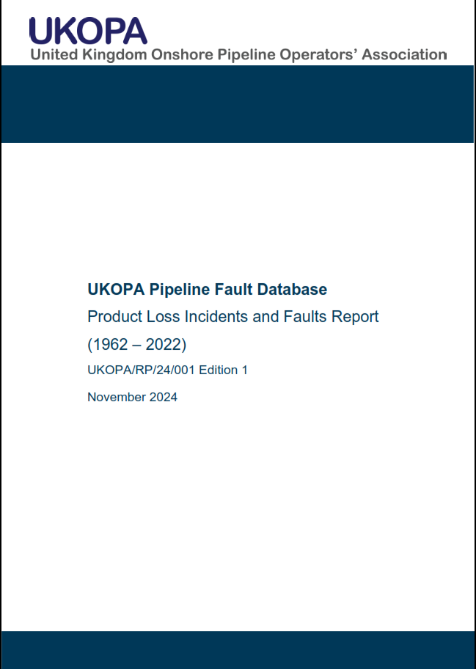
2022 Product Loss Report
Timetable for Issue
Draft circulated to FARWG on 23/09/2024
  Comments received from
    Fridolin Jenny (Swissgas)
    Mike Acton (DNV)
    Chris Lyons (PIE)
  Calculations QA’d by Chris Lyons
Calculations updated & final report issued to UKOPA
on 25/11/2024
Available on UKOPA website from December 2024
  Published Documents / UKOPA Reports
    https://www.ukopa.co.uk/wp-content/uploads/2024/12/UKOPA-RP-24-01-Product-Loss-Report-1962-2022-Ed1.pdf

Slide 8
2022 Summary
Contributions from Members
9 members have provided fault data
  Cadent, GNI, INEOS, NGN, NGT, Sabic, SGN Scot & SGN South, Shell (part), WWU
2 members confirmed they have no data for 2022
  E.On, Essar
3½ companies who have provided data in past have not responded
  INEOS FPS, Shell (part), Uniper, Wood
3 members who operate MAHPs currently not contributing
  Drax, ENI, Mutual Energy
Amount of data appears to be reducing and pipeline data not being updated regularly…
  Change in staff / workload issues?
  Less digs / not every dig reported to UKOPA?
  FR/1 / P11 policies not being followed?
  All of the above?

Slide 9
2022 Summary
Data Collection Issues
Late provision of data
  Especially pipeline data
Not all defects (or any) reported on defect sheet
‘New’ dent/gouge classification not being followed
Not many faults reported
  One operator said that are doing 50-60 digs per year
    But only 2 faults reported for 2022!
  Report length of pipeline ILI’d and/or CIPS/DCVG each year?
    Way to cross-check number of faults
Lots of faults reported in 2022 were discovered in earlier years
  Discovery is ILI date
    Long delay to excavation?
    Takes this long for data to work through company?

Slide 10
2022 Fault & Product Loss Data
Cause | Faults | Product Loss
External Corrosion | 2
Internal Corrosion | 0
External Interference | 3
Original Construction Damage | 2
Material defect (pipe, mill damage, seam weld) | 0
Girth weld defect | 2 | 1
Ground movement | 0
TOTAL | 9 | 1
Leaking Girth Weld
  Rebuild at valve pit
  Pinhole leak at weld wrap at tee
    Repaired by encapsulation

Slide 11
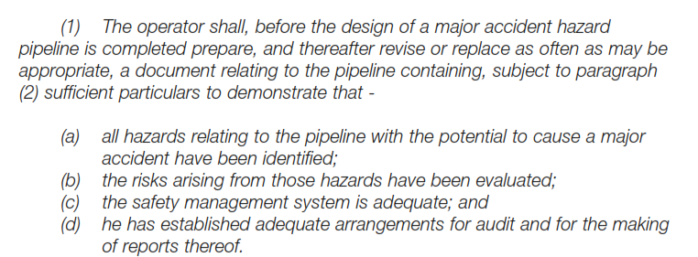
Record Keeping – Regulatory Warning
PSR96 – Regulation 23 - MAPD
Guidance Document Paragraph 118
  “It will be necessary that suitable and sufficient records of a pipeline are kept, including the design, construction, operation, and maintenance, so as to be able to demonstrate that the pipeline is safe.”
If you think your company’s records are up to scratch, you may want to talk to any members who have had a recent HSE investigation…

Slide 12
Product Loss Incident Data
207 Incidents (1962 – 2022)

Slide 13
Product Loss Incident Data
Overall Product Loss Incident Frequency

Slide 14
Product Loss Incident Data
By Cause – since 1962

Slide 15
Product Loss Incident Data
By Cause – since 2005

Slide 16
2024 Fault Data Collection
Need to add the process as the first slide – from Jan 2025 meeting
Members’ Meeting February 2025

Slide 17
2023 Data Collection
So far…
Company | Contact (?) | Data
 |  | Pipeline | Product Loss | Fault
Cadent | Karen Green | ✓ | 0 | 26
EOn | Neil Price | ✗ | 0 | 0
Essar | Paul Potts | ✗ | ✗ | ✗
GNI | Brian Leahy / Lar English | ✓ | 0 | 4
INEOS | Jim Jarvie / Pauline Scott | ✓ | 0 | 2
Ineos FPS | Akin Oshinowo | ✓ | 0 | 0
National Gas | Ikenna Asogwa | ✗ | 2 | 35
NGN | Iain Welldon | ✓ | 1 | ✗
Sabic | Geoff Glover | ✗ | ✗ | ✗
SGN Scot | Mark Fisher | ✓ | 0 | 5
SGN South | Zakir Ali | ✗ | 0 | ✗
Shell | Forbes Masterton / Dave Brown / Andy Mottram | ✗ | 0 | 0
Uniper | Dan Davies | ✗ | ✗ | ✗
Wood | Greg Thompson | ✗ | 0 | 0
WWU | Matt Davies | ✓ | 2 | 21
TOTAL |  |  | 5 | 93

Slide 18
2023 Fault & Product Loss Data
Preliminary Results
Cause | Faults | Product Loss
External Corrosion | 48
Internal Corrosion | 0
External Interference | 12
SCC | 1
Original Construction Damage | 13
Material defect (pipe, mill damage, seam weld) | 0
Girth weld defect | 4
Ground movement | 0
Other/unknown | 14 | 5
TOTAL | 93 | 5

Slide 19
2023 Product Loss Incidents
Leaking Valve
  Sealant line connection on 6” valve
    Spring loaded non return / check valve
    Used flowstop to repair
Leak from Buried Stopple Tee
  Stopple flange leaking
    Repaired by replacing O-ring, studs and nuts
Loose bolts on flange
  Public reported smell of gas
  Gas readings in bar holes revealed location
Leaking stem on valve
  Valve cleaned, greased and reset
Plus one unknown (at present!)

Slide 20
2023 Data Collection Issues
Main issues this year
Late provision of data
  5 members who normally contribute (eventually) haven’t provided data
    Essar, NGN, Sabic, SGN South and Uniper are on the naughty step
Not all defects reported on defect sheet
  Fault record says fault is associated with x defects
  Defect sheet has details for less than x
Not using fault categories correctly
  If not one of standard categories, select other and add details in fault comments free text field
  DO NOT OVERWRITE WITH YOUR OWN LABEL!!
Use of multiple fault categories
  If more than one cause – e.g. external corrosion at location of coating damage from construction
    Choose most important one and add comments in free text field to explain other causes
    In this case, I’d probably pick external corrosion as that is what caused the product loss even though it occurred after the construction damage…

Slide 21

Any Questions?

