Slide 1
Governance Group Update
Barry Dalus
Chair
October 2025

Slide 2

UKOPA Governance Group - Aim
Providing a consistent approach across UKOPA’s Good Practice Guides (GPG) & Technical Briefing Notes (TBN)
To provide Governance support and guidance to UKOPA Working Groups
Sharing good practice across UKOPA and its Stakeholders
Support UKOPA Board with publications of GPG & TBN
Represent UKOPA on external forums
UKOPA

Slide 3
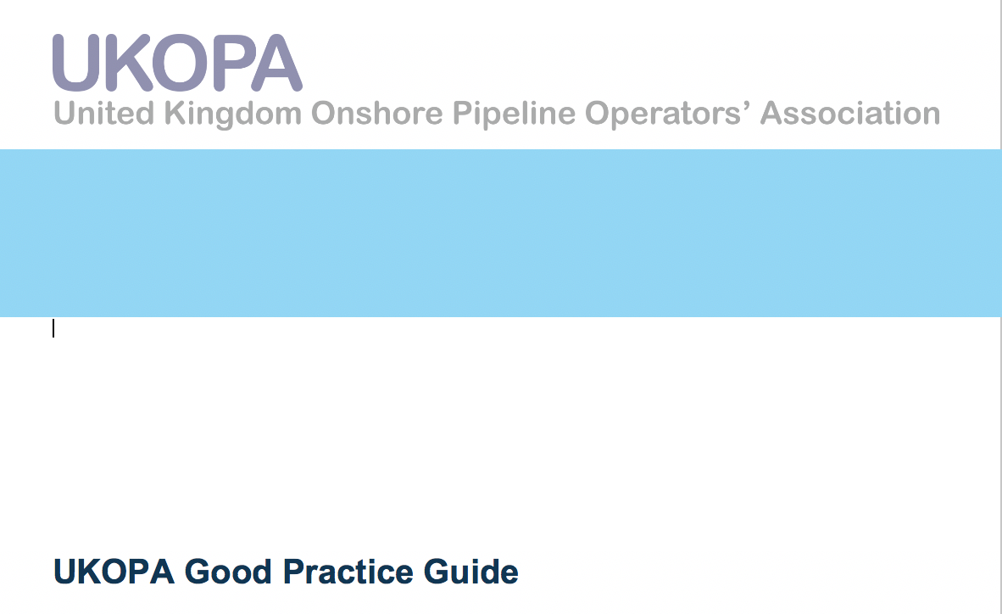
GPG & TBN Sent for Board Approved Since Feb 2025 meeting
GPG 040 Ed1 - Hydrotechnical hazard integrity management
Aims to provide an overview on the principles involved in developing a hydrotechnical hazard integrity management system.
Applicable to UK onshore pipelines at risk from hydrotechnical hazards at watercourse crossings or in close proximity to watercourses.

Slide 4
GPG Review Required / Ongoing - (18)
Number | Title | WG
UKOPA/GPG/003 | Pipeline Process Safety Performance Monitoring. (Review or Not?) | PSWG
UKOPA/GPG/013 | Requirements for the Siting and Installation of Wind Turbine Installation in the Vicinity of Buried Pipelines | PIWG
UKOPA/GPG/015 | Managing pipeline Infringements | IWG
UKOPA/GPG/018 | Pipeline Remaining Life Assessment | IWG
UKOPA/GPG/019 | Seismic screening assessment of UK onshore pipelines and associated installations | PIWG
UKOPA/GPG/020 | Managing pipelines subject to ground movement (Edition 1.1) | PIWG
UKOPA/GPG/021 | In Line Inspections | PIWG
UKOPA/GPG/025 | Cost Benefit Analysis to Demonstrate ALARP | FARWG
UKOPA/GPG/026 | Verification of Features Identified by ILI | PIWG
UKOPA/GPG/027 | AC Corrosion Guidelines. Expected 2026 due 2025 | CPWG

Slide 5
GPG Review Required / Ongoing - (18)
Number | Title | WG
UKOPA/GPG/029 | Local Authority Planners Information Regarding On Shore Pipelines & Installations | IWG
UKOPA/GPG/030 | Managing Pipeline Vibrations | PIWG
UKOPA/GPG/031 | DC Interference Guidelines | PIWG
UKOPA/GPG/032 | Seismic assessments of UK onshore pipelines and associated installations | PIWG
UKOPA/GPG/035 | Pipeline process safety studies and methodologies | PSWG
UKOPA/GPG/039 | Use of Drones. (No Activity) | FARWG
UKOPA/GPG/044 | Contractor’s Guide to Working Safely Near High Pressure Pipelines (Leaflet) | FARWG
UKOPA/GPG/045 | Working Safely Near High Pressure Pipelines (Leaflet) | IWG

Slide 6
New GPG in development – (5)
Number | Title | WG
UKOPA/GPG/033 | Epoxy shell repair Ongoing with Rosen & PMC | PIWG
UKOPA/GPG/047 | Requirements for the Siting and Installation of battery storage facilities in the Vicinity of Buried Pipelines | CPWG
UKOPA/GPG/048 | Guidance on pilling and ground vibration | PIWG
UKOPA/GPG/049 | Process Safety Culture | PIWG
UKOPA/GPG/50 | Flooding risk management | FARWG

Slide 7
TBN Review Required / Ongoing - (8)
Number | Title | WG
UKOPA/TBN/001 | The Risk of Ethylene Decomposition on Cross Country Pipelines | FARWG
UKOPA/TBN/002 | Managing Societal Risk in the Vicinity of HP Natural Gas Pipelines | FARWG
UKOPA/TBN/003 | Managing Encroaching Development and Societal Risk Around Ethylene Pipelines | FARWG
UKOPA/TBN/005 | Electrical Hazards on Pipelines | CPWG
UKOPA/TBN/006 | Hazardous Pipelines - a Risk Based Methodology for Calculating Land Use Planning Zones | FARWG
UKOPA/TBN/009 | Effect of Pipeline Surveillance on Risk of 3rd Party Interference | FARWG
UKOPA/TBN/010 | Lower bound for required fatigue assessment of pipeline dents | PIWG
UKOPA/TBN/014 | Application of SN Curves to Fatigue Assessment of Pipeline Dents | PIWG

Slide 8
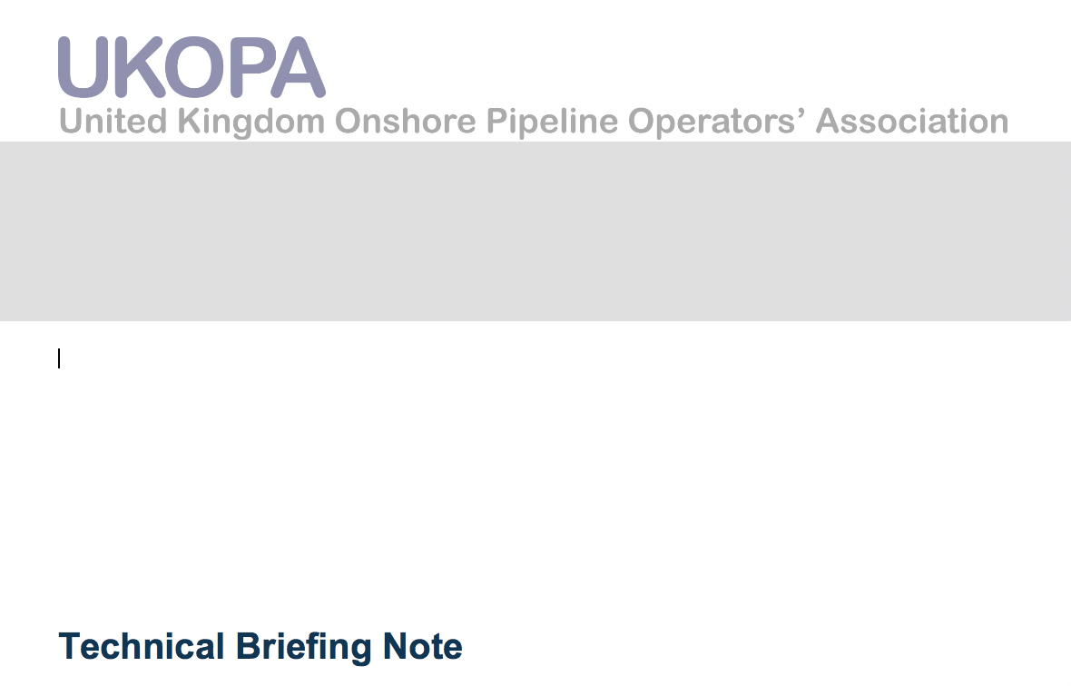
New TBN in development - (4)
Number | Title | WG
UKOPA/TBN/021 | Recommendations for the management of unsurveyable sections of buried pipelines | CPWG
UKOPA/TBN/023 | Evaluating route cause of pipeline features | CPWG
UKOPA/TBN/24 | Guide for IGEM/TD/1 H area QRA | FARWG
UKOPA/TBN/025 | Reporting and analysis of features | CPWG

Slide 9
UKOPA Reports – (10) Members Centre
Number |  |  |  | Title | WG
UKOPA | RPT | 22 | 1 | UKOPA pipeline product loss report 1962-2020 | FARWG
UKOPA | RPT | 22 | 2 | 2021 Infringement database report | IWG
UKOPA | RPT | 22 | 3 | Weld Quality Project Discussion of Findings & Recommendations Issue 2 | PIWG
UKOPA | RPT | 22 | 4 | Weld Quality Investigation of Pre 1972 Girth Welds Carried Out by ATCO | PIWG
UKOPA | RPT | 22 | 5 | Swansea University Fatigue Study for the UKOPA Weld Quality Project | PIWG
UKOPA | RPT | 22 | 6 | University of Strathclyde Fatigue Study for the UKOPA Weld Quality Project | PIWG
UKOPA | RPT | 23 | 1 | Product Loss Incidents and Faults Report (1962 – 2021) | FARWG
UKOPA | RPT | 24 | 2 | Observations from PERO course, Fire Service College 2024 | EPRWG
UKOPA | RPT | 23 | 2 | 2022 Infringement database report | PIWG
UKOPA | RPT | 24 | 1 | Product Loss Incidents and Faults Report (1962 – 2022) | FARWG

Slide 10


UKOPA Governance Representation
Represent UKOPA on external forums:-
Support BSI - PD-8010 (PSE17/2) Transmission Pipeline group
Ensuring the use of GPG meet UKOPA’s requirements
Update Igem GTDC on key UKOPA deliverables

Slide 11
Summary
GPG Completed to Date = 38
Review Ongoing / Due = 18
New GPG in development = 5
TBN Completed to Date = 18
Under Review = 8
New TBN in development = 4
Reports completed to date = 10
Going forward - add GPG & TBN updates to working group agenda
Review dates
Ask for help if needed

Slide 12
UKOPA Governance Group
Governance Questions?

