Slide 1
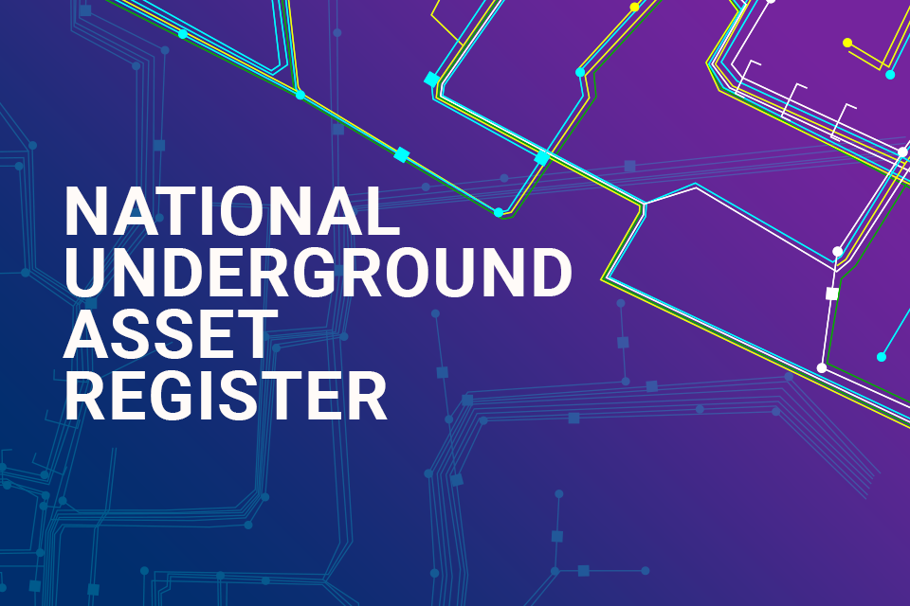

Slide 2
What is it?
NUAR (National Underground Asset Register) is currently in its minimum viable product/beta test phase. The full system is intended to go live by the end of 2025.
The asset register is currently optional, with asset owners volunteering their asset data to help develop the system and affects assets in public roads and streets as defined by the New Roads and Streetworks Act 1991.
The system is pioneering the use of the MUDDI model - Model for Underground Data Definition and Integration and is an approach to make sub-surface data Findable, Accessible, Interoperable, and Re-Usable.
NUAR is a Government lead programme, and other nations are interested in seeing how it is built, utilised and operated. Therefore, its success is critical to the government, especially in the current economic climate.
The Data Use and Access Bill has just received royal assent, and is critical to NUAR being able to mandate asset owners to share their data with NUAR. NUAR will now begin working with stakeholders to determine the content of secondary legislation that will affect how the system is managed and operated.

Slide 3
Benefits and Risks
Cadent agrees that for the system to improve safety, the applicable legislation must mandate all buried asset owners to submit their asset data to NUAR. This will provide a singular source of information for all asset owners within an area of interest, enabling users to contact each affected asset owner efficiently.
Mandating the submission of buried asset data will also improve quality, as a minimum standard would need to be in place for NUAR to accept each organisation’s data. It is likely that this will in turn lead to greater levels of standardisation.
NUAR will be chargeable to “those that benefit the most”, but at this stage, we do not know how this benefit will be determined or how cost sharing will be agreed, but operating costs (to be borne by asset owners) is expected to be between £5m and £10m per year.
NUAR will not necessarily cover buried assets in private land and may not provide the same level of functionality that LSBUD does regarding plant protection. This means Cadent, and our colleagues across the industry, are likely to have to ‘pay twice’ to effectively discharge our legislative responsibilities.

Slide 4
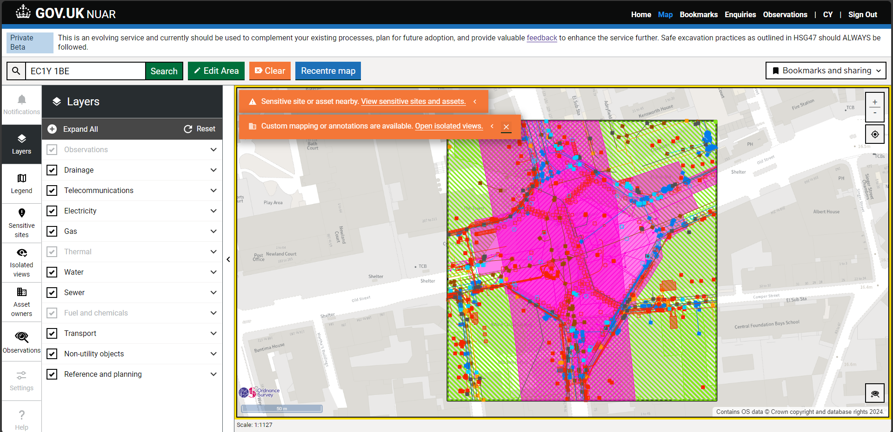

Slide 5
Observations
NUAR has an observation feature where users can identify asset errors or general observations and record these in the system. The observations are only viewable to members within the same organisation.
There is a risk that people will assume that these observations are being sent to the asset owner for action, which they are not. They may also assume that these asset errors are being addressed internally, such as through our normal DR4 process, which they are not.
NUAR have indicated that they intend to make these observations notifiable to the asset owner, but there is no indication of how this process is going to be managed.

Slide 6
What’s next?
We have been working very closely with NUAR since its inception and have been key stakeholders in shaping the system. We continue to engage with the Ordnance Survey, Atkins and the Department for Science, Innovation and Technology to ensure the system can achieve its aims while improving safety.
We will now work on the secondary legislation with NUAR to ensure Cadent’s assets and business are protected.
NUAR User Group - we will work with Ordnance Survey to ensure the system is fit for purpose.
We will await further responses and consultation following our submission of evidence towards NUAR and the Data, Use and Access Bill.
We are preparing our response to the NUAR consultation prior to the full system release at the end of the year.

