Slide 1
COMMUNICATIONS UPDATE

Slide 2
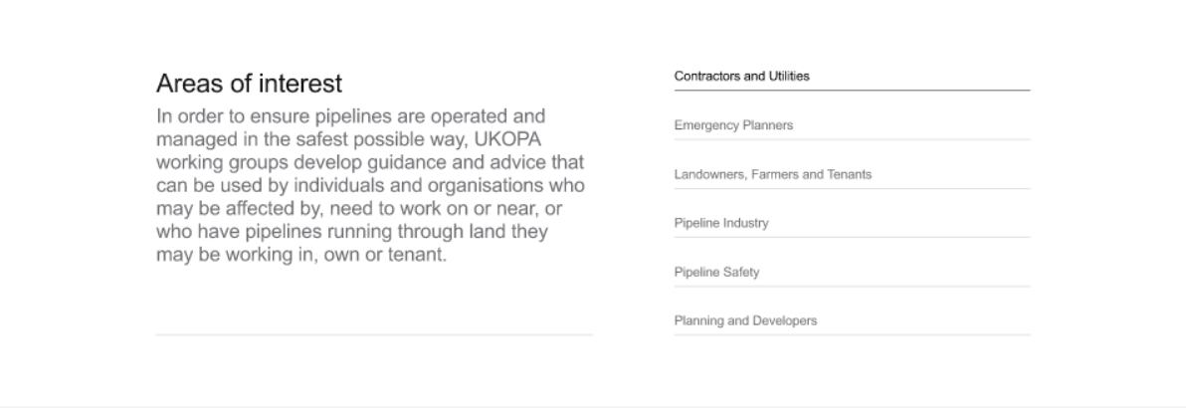
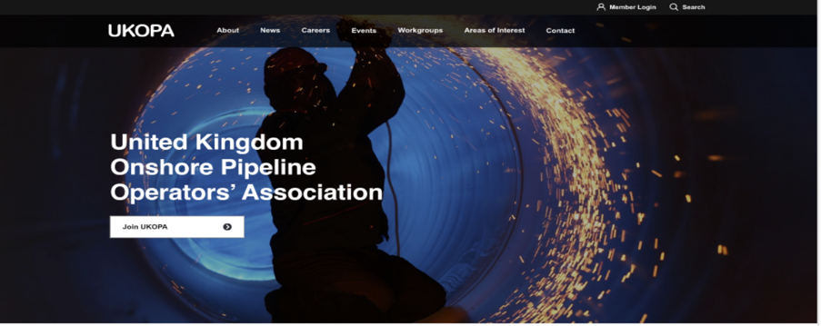
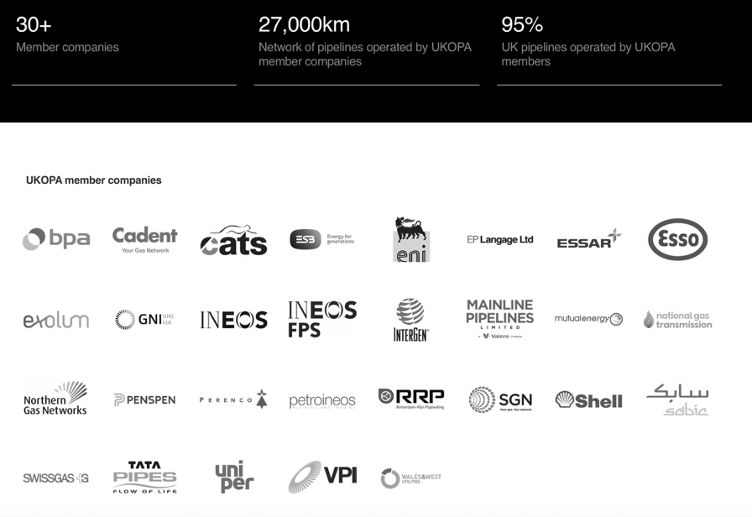
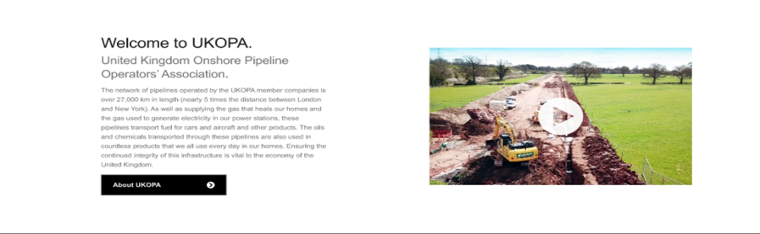
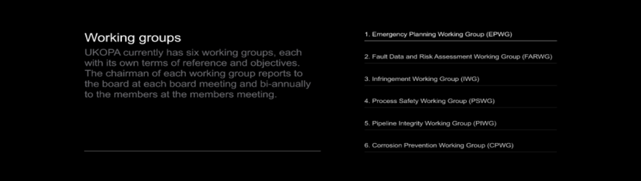
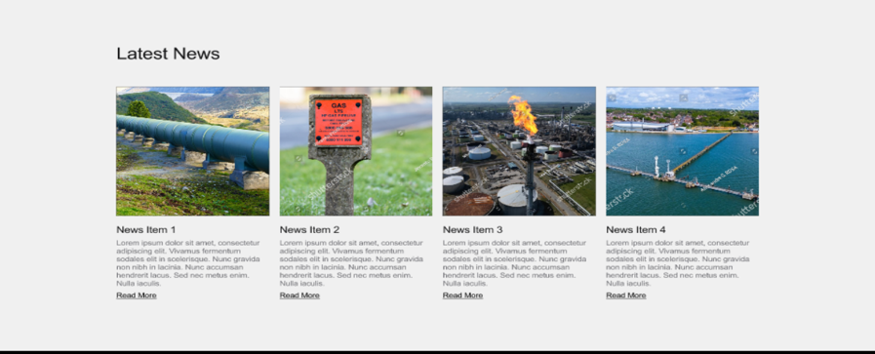
Launch of new UKOPA Website
New site offers easy access to working groups, advice, good practice guides, news and UKOPA events
Search facilities to find key documents
Access to safe working guidelines and good practice
Dedicated Members section
Some teething troubles working through 10 years of documents but hopefully there now

Slide 3
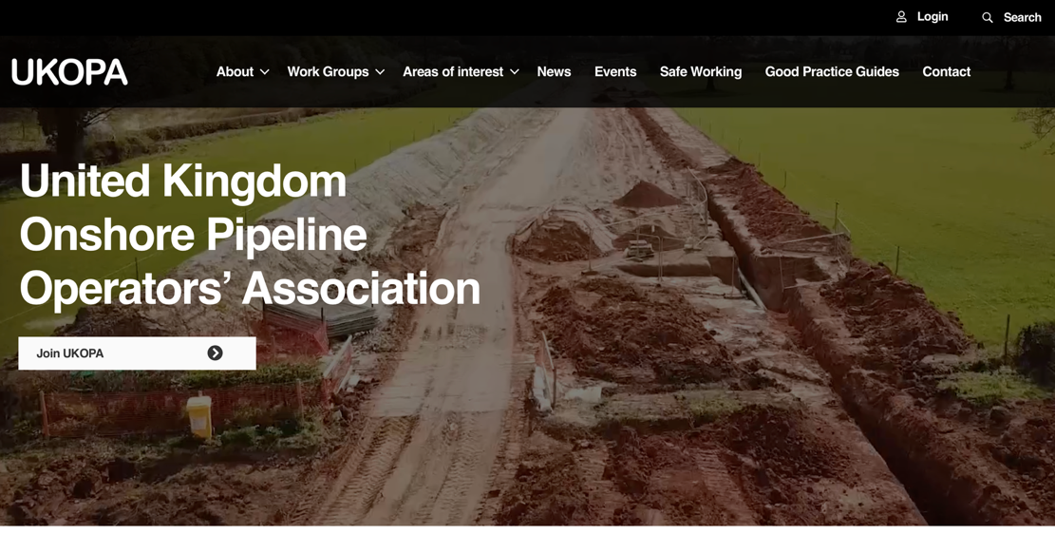

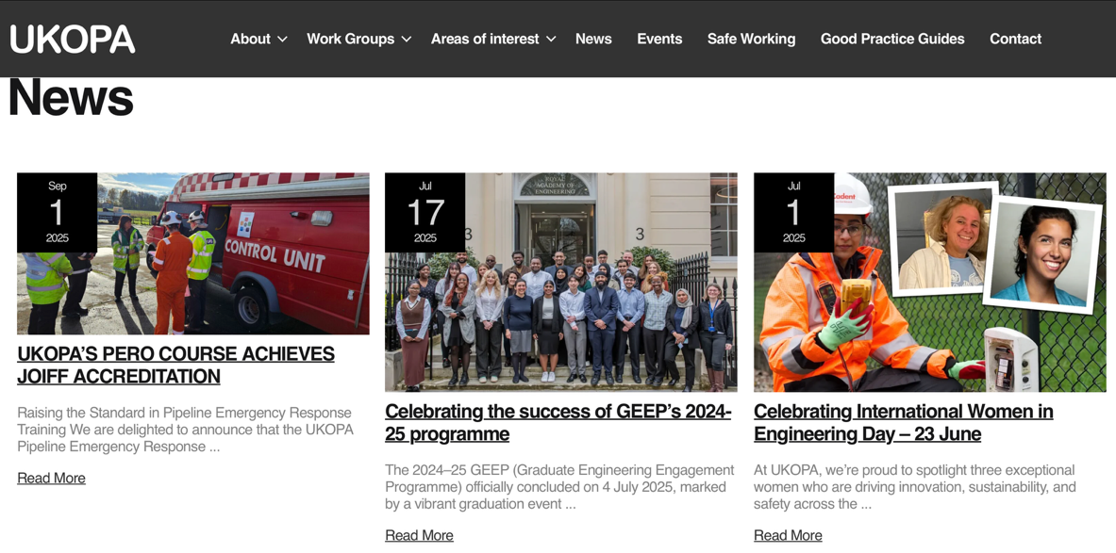
Easy to use and accessible information

Slide 4
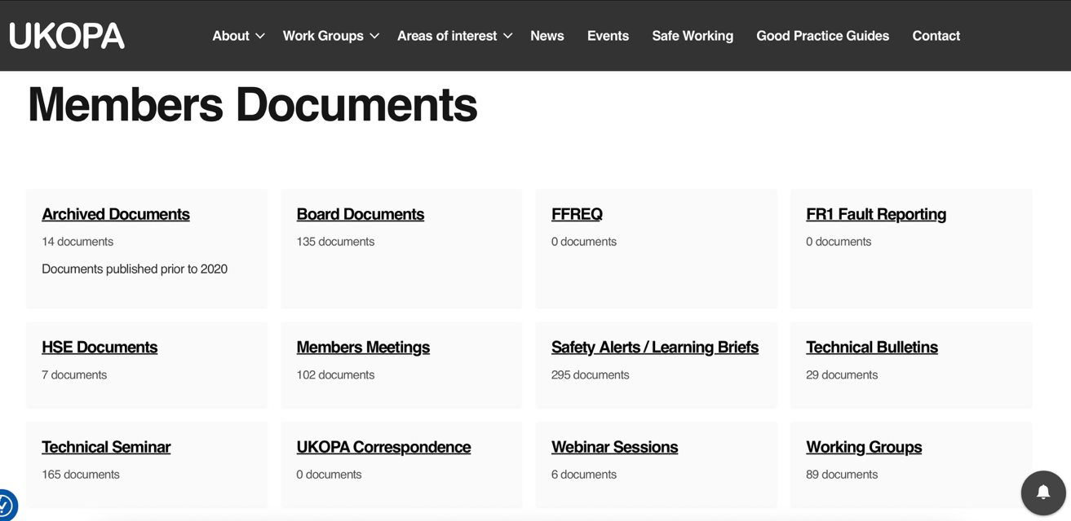
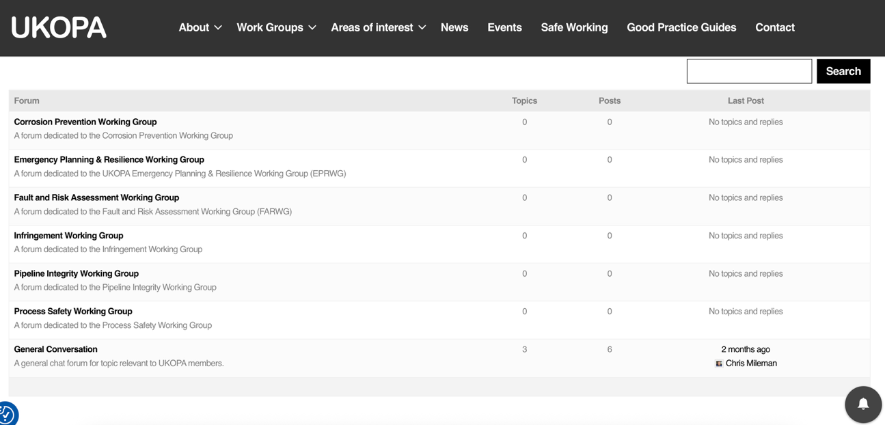
New Members Section
Improved access to Members documents
Safety alerts, learning briefs, technical briefs
Member profiles shared online and for access to expertise
New forum to raise questions and seek advice from Members, also structured by Working Groups or discussion topic
Archive of older documents

Slide 5
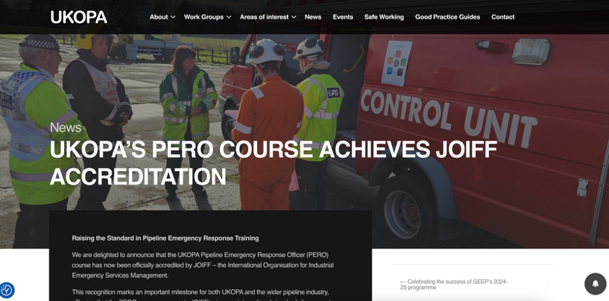

Building website content for Member advice
Continue to develop content to share digestible round ups of WG activities and Member insights
Provide easy to read articles from the GPG
Last few months topics have included:
UKOPA’s PERO course
Success of GEEP
International Women in Engineering Day
Understanding Crack Susceptibility Analysis to Ensure Pipeline Integrity
Key Findings and Next Steps from UKOPA Infringement report

Slide 6
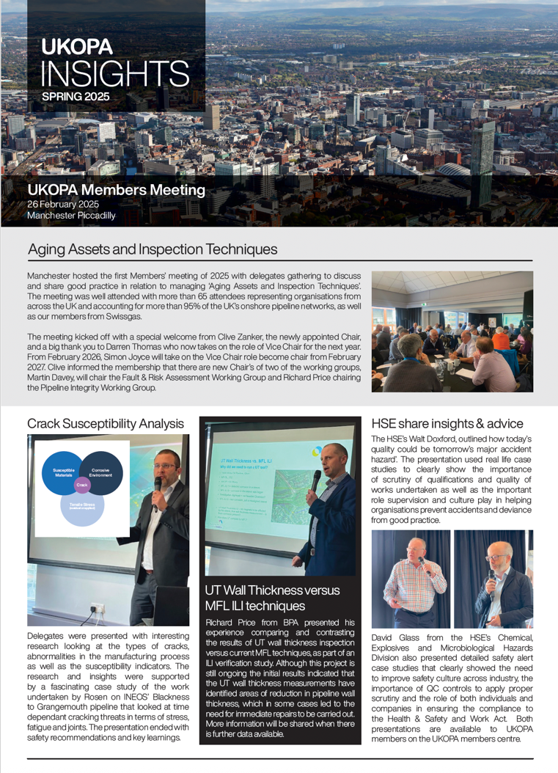
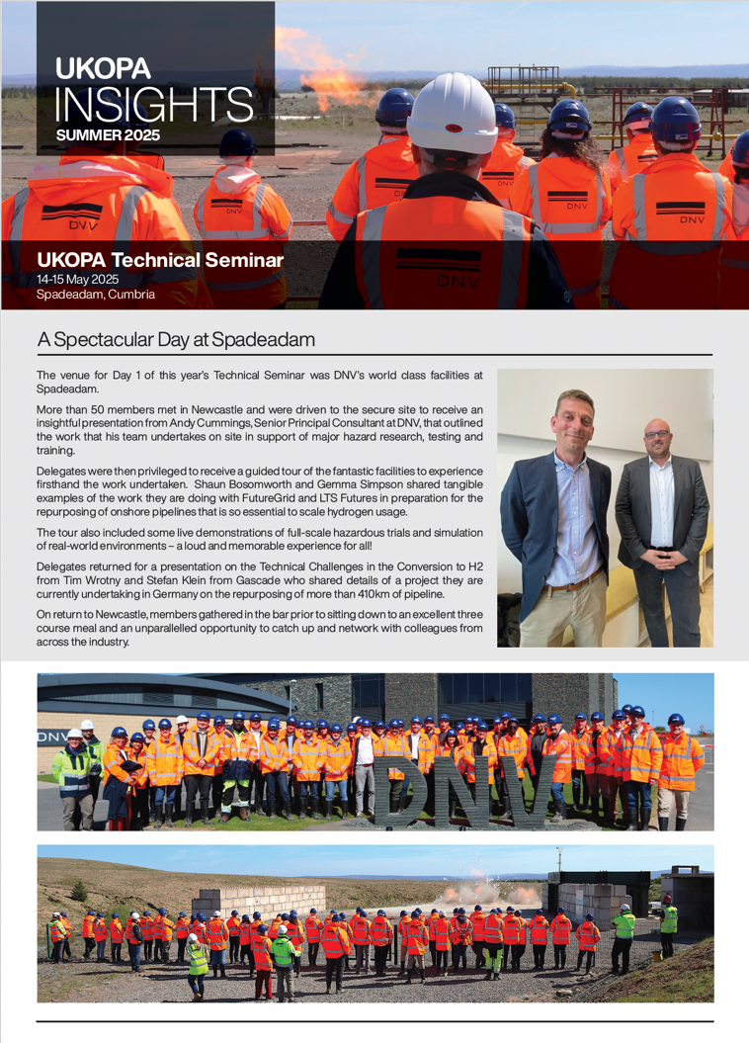
Newsletter e-shot
Produced Members newsletters, summarising events, sharing presentations and WG activities as well as future events
Created email distribution lists to save on printing
Distribution list grown by 20% with wider team members / interested parties.
Need to continue to encourage others to sign up and receive a copy
Colleagues
Comms teams
Appropriate management

Slide 7

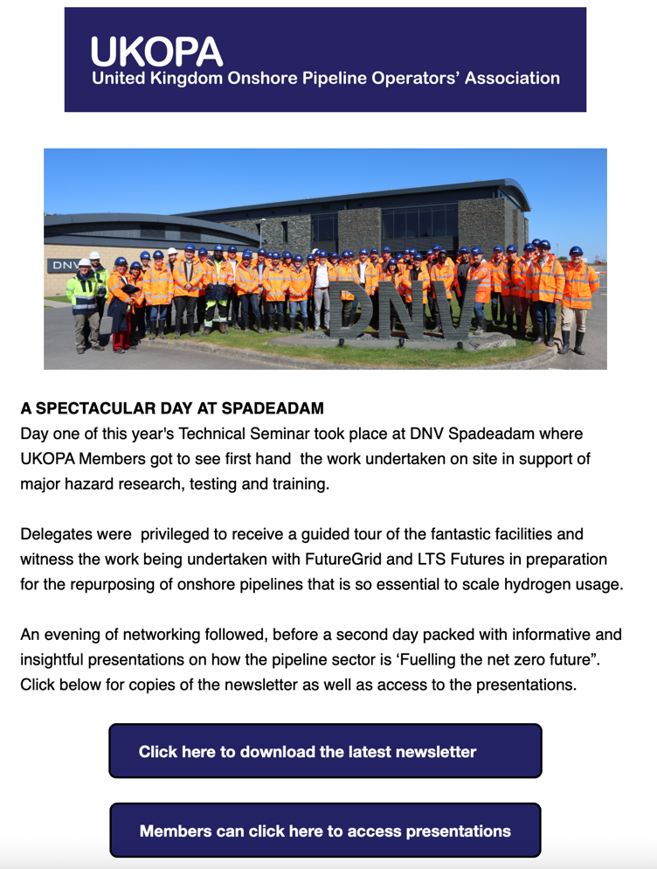
E-mail communications to Members
Drafted e-shots to support communications from the organization, focusing on Members meeting, support for GEEP and business updates
Now 118 on distribution list (increase of 25%)
Download and read response rates of 75% and 65% respectively (above industry average of 20%)
Still looking to circumnavigate some internal firewalls

Slide 8

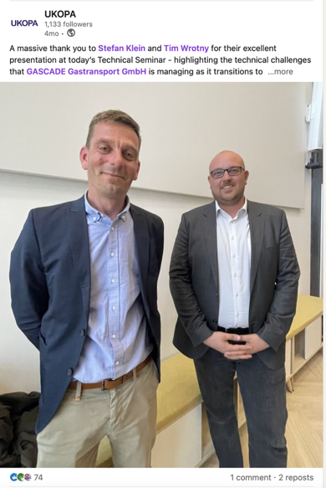
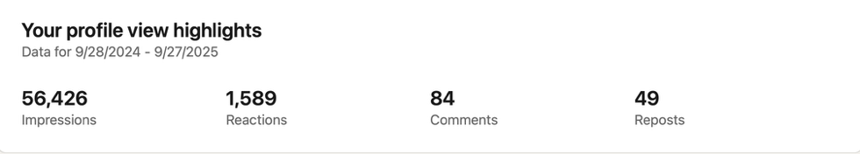
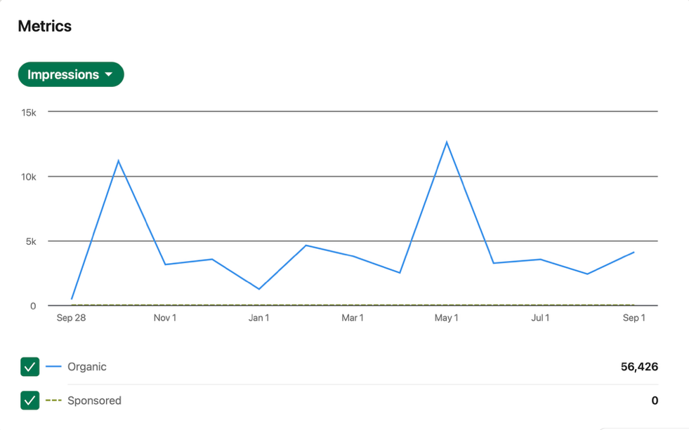
LinkedIn Update
Continue to post regular LinkedIn updates
Looked to improve design feel and content
Follower numbers continue to grow (117 since last meeting)
56,200 impressions on posts (175% increase in last year), 15% increase in comments
Looking for content to share from Working Group meetings
People stories!
Industry successes

Slide 9
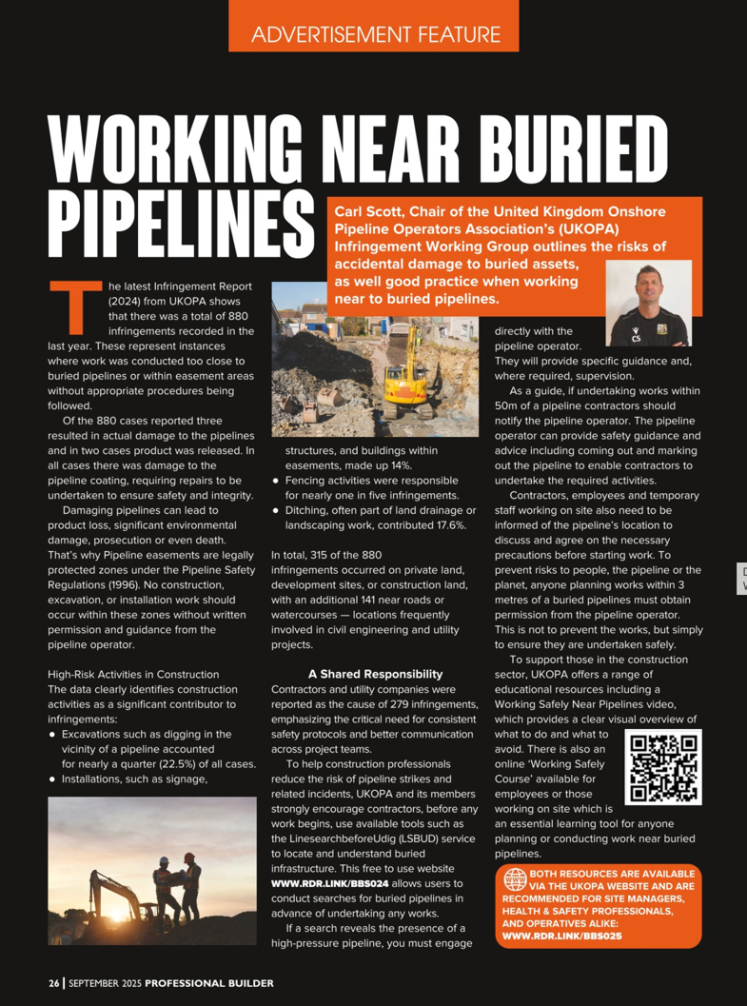

Media Update
Taking the UKOPA message and work undertaken by IWG to share with specific target groups
Last year there was a focus on farming, now working with the Construction sector – Professional Builder Magazine
Feature article with QR code to safety video / on-line course
Also reached out to the Farm Safety Foundation’s Yellow Wellies Campaign – activities targeted in July 2025
Magazine coverage
Newsletter inclusion
Social media posts

Slide 10
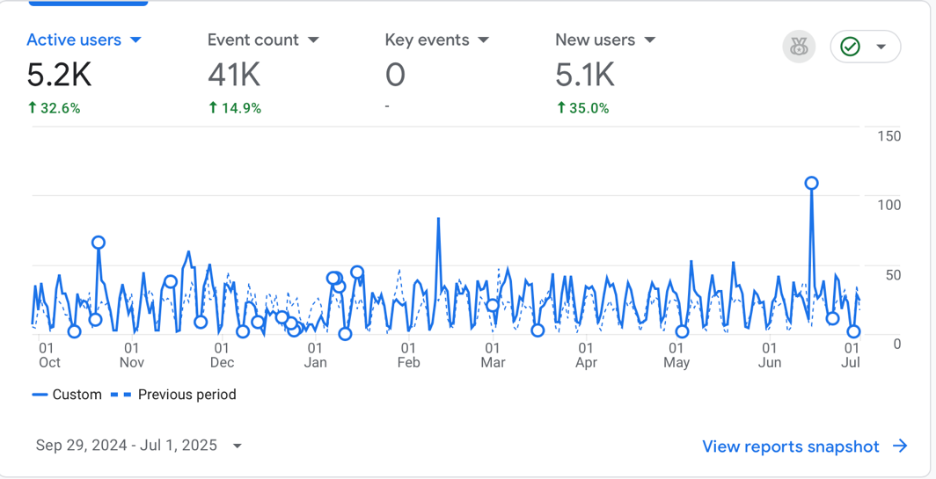
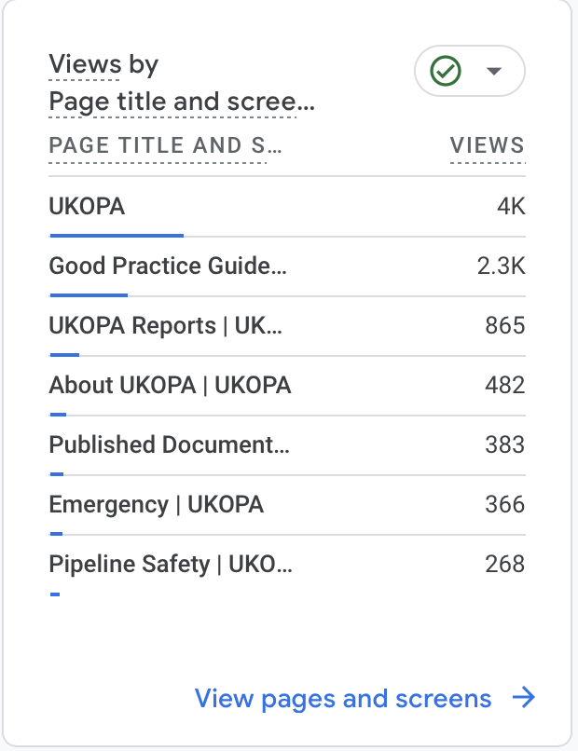
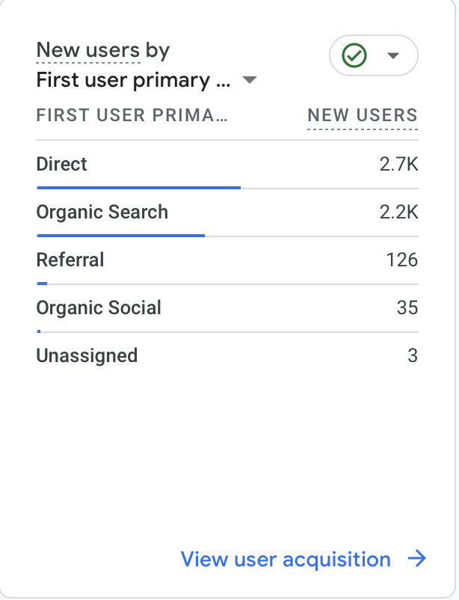
Google Analytics
Continued uplift in website traffic (+33%)
Users finding site from mixture of direct(52%) organic search (44%), and referrals (3%)
Key pages are GPGs, UKOPA Reports, About UKOPA and Published Documents
New website data being processed

Slide 11

30th Anniversary Celebrations
Planning now well underway for UKOPA’s 30th Anniversary Celebrations
Location now confirmed to be Silverstone
Currently looking to confirm 21-22 October 2026
Building on the existing Member’s meeting schedule to include:
Regular 2 Day Members Meeting
Trade show involving selected industry suppliers and partners
Black Tie Gala Dinner
Industry awards and recognition
Tickets allocated for Members, with option to buy additional seats
Fantastic networking and opportunity to engage with suppliers and wider stakeholder groups
Please let Kirsty know if you can think of organisations who would like to exbibit – industry wide event!

Slide 12
Questions?

